Slide 1

Human Body Form
What does it mean?
Frederick S. Cottle, Ph.D., Middle Tennessee State University, USA
Pamela V. Ulrich, Ph.D., Auburn University, USA
Karla P. Teel, Ph.D., Auburn University, USA

Slide 2

Constructs used to Measure the Human Body

Slide 4
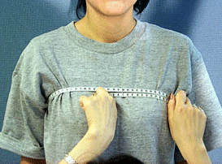
Size

Slide 6
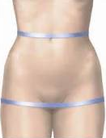
Build

Slide 8
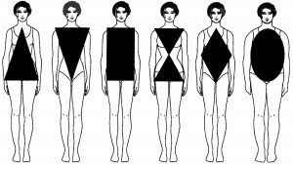
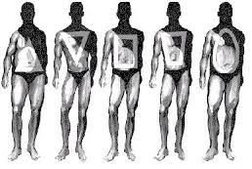
Shape

Slide 10
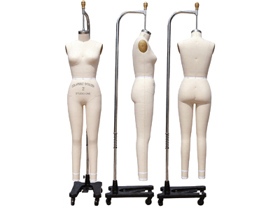
Form

Slide 12
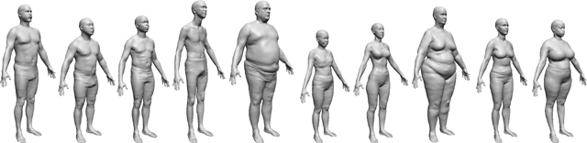
Human Body Form Continuum

Slide 14
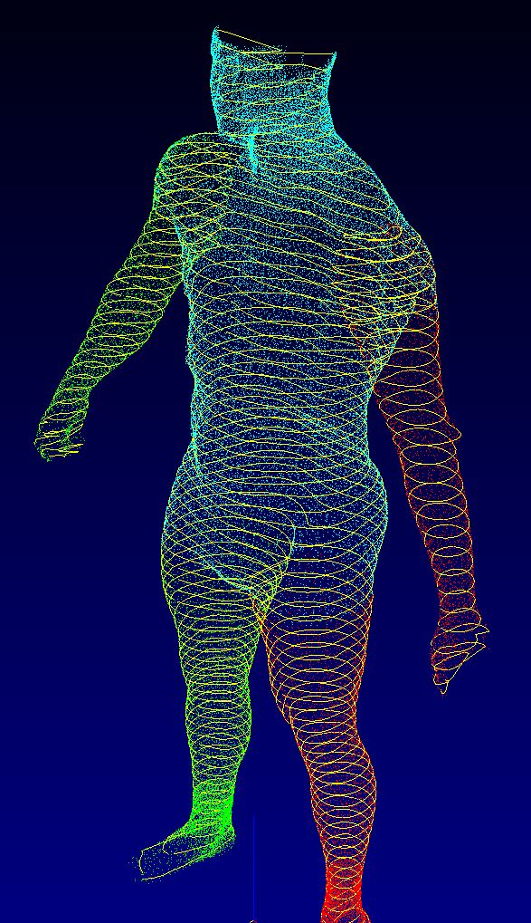

Slide 16
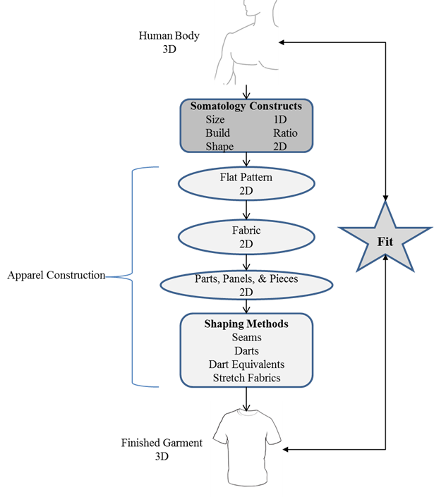

Slide 18
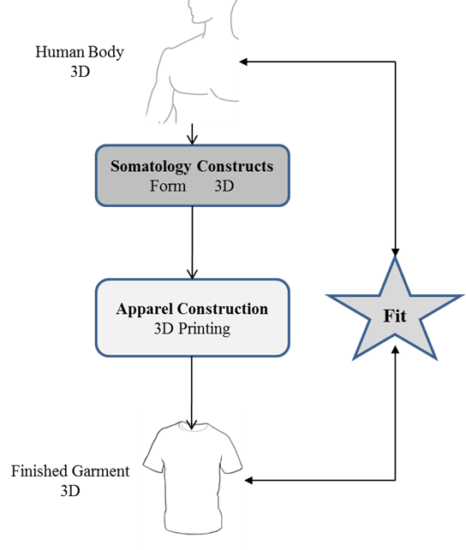

Slide 20
