Slide 1
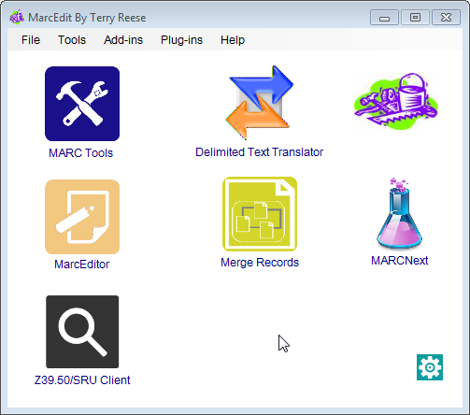
MARCEdit
TNUIG 2016

Slide 2
Topics
1. MarcEdit – What it is
2. Features
3. Editing MARC
4. RDA Helper
5. Regular Expressions (Regex)
6. Regex Examples
7. Task Manager
8. Resources and More Information

Slide 3
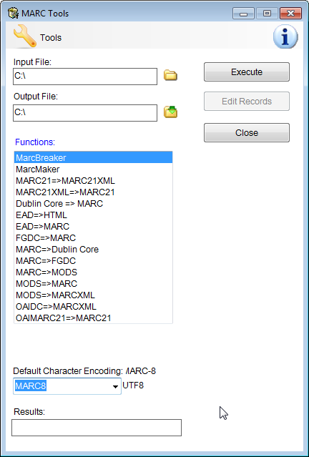
MARCEdit – What it is
Terry Reese created MarcEdit in 1999 as a simple MARC=>plain text translation utility. Today, MarcEdit contains a variety of metadata edit suites which work with much more types of data than simply MARC records.

Slide 4

Features
MARC Editing: MarcEdit includes a MARC Breaker and Maker to move MARC data into a more friendly mnemonic file format. It includes a dedicated MARC Editor, that provides a number of global editing functions, the ability to edit MODS and MARCXML data (in a mnemonic format) and integrate data from other data sources like OCLC, etc. into a batch set of MARC data.
MarcEditor: The MarcEditor is MarcEdit’s built in metadata editor. It includes a number of global editing functions, full regular expression and UTF-8 support, as well as the ability to configure the editor to utilize any characterset supported by the operating system. Included functions: Globally Add/Delete Fields, Edit Subfields, Swap Field Data, Copy Field Data, Edit Indicators, Generate Call Numbers, Validate Records, Generate Reports, Find/Replace, Direct Integration with Supported ILS systems, Macro support, Task Support, etc.
RDA Helper: The RDA Helper is both a stand alone and integrated tool that allows users to take a set of MARC data and automatically generate RDA specific data. The RDA data is derived from the source recordset using available control data, variable field data, and RDA specific assumptions.
Delimited Text Translator: The Delimited Text Translator is a tool that allows users to translate data in Excel, Access, or any delimited format into MARC.
Export as Tab Delimited: A tool that allows users to export their MARC data as delimited text.

Slide 5

Features cont.
Harvest OAI Data: MarcEdit has the ability to harvest metadata from an OAI data provider and convert the data directly to MARC. Supported formats are MARCXML, oaimarc, oai_dc, and MODS. However, the program allows the user to provide their own translation rules, so any format could be accommodated.
XML Translations: MarcEdit supports the facilitation of metadata from XML and non-XML formats into various forms, including MARC.
Characterset conversion: MarcEdit supports the ability to convert MARC records from one characterset to another. This includes the traditional charactersets like MARC-8 (ANSEL) and UTF-8. But it also includes support for any characterset currently supported by the operating system. So users with MARC data in Traditional Chinese can utilize MarcEdit to convert that data to UTF-8.
Z39.50/SRU Client: MarcEdit includes a built in Z39.50 and SRU client for interaction with other library systems.
MARC SQL Explorer: MarcEdit includes an SQL Explorer — a tool that allows users to export their data into either an SQLite or MySQL data and run SQL queries directly on the data to mine for information.
MARCValidator: MarcEdit includes a number of tools to help users validate data and identify incorrectly structured MARC record data.
Many more features: Like the ability to split, join, sort, etc. data in various formats.

Slide 6
Editing marc
MarcEditor
Supports a number of global editing functions:
Find/Replace functionality
Globally Add/Delete MARC fields
Globally Edit Subfield data
Conditionally add/remove field data
Globally Edit Indicator data
Globally Swap field data
Record Deduplication
Record Sorting
Call Number Generator
Automation

Slide 7
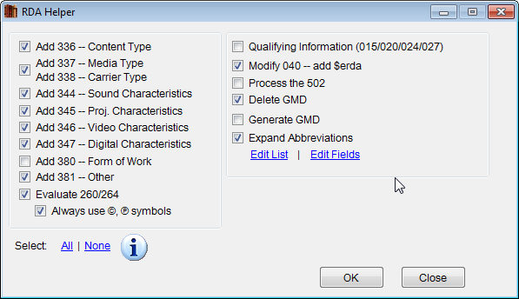
RDA helper
Purpose:
Provide automated conversion between AACR2 and RDA based on coded data in LDR/007/008
Looks specifically at:
336/337/338 field groups
344/345/346/347 field groups
380/381 field groups
Evaluating the 260/264
040 Modifications
Processing Abbreviation Expansion
And allowing for custom abbreviation expansion via regular expressions
GMD processing

Slide 8
Regular expressions (REGEX)
“A regular expression (regex or regexp for short) is a special
text string for describing a search pattern. You can think of
regular expressions as wildcards on steroids”.
\b[A-Z0-9._%+-]+@[A-Z0-9.-]+\.[A-Z]{2,4}\b
http://www.regular-expressions.info/

Slide 9
Regex examples
245 10 $aA life to remember
245 10 $aAn incredible story
245 10 $aThe magic kingdom
Find Replace with
(=245 .)0(\$aA ) ${1}2$2
(=245 .)0(\$aAn ) ${1}3$2

Slide 10
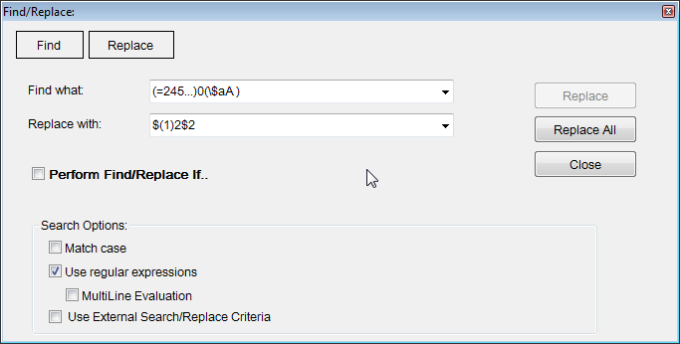
REGEX examples - find/replace

Slide 11
More regex examples
Change title to sentence case
=245 10 $aENCYCLOPEDIA OF THE HISTORY OF PSYCHOLOGICAL THEORIES
Find Replace With
(=245.{4})(\$a.)([A-Z .]*) $1$2lcase($3)
Find all subject headings with 2nd indicator other than 0 or 2
=650...[^02]
Find all subject headings with 1st indicator other than \ and 2nd indicator other than 0 or 2
=650..[$\][^02]

Slide 12
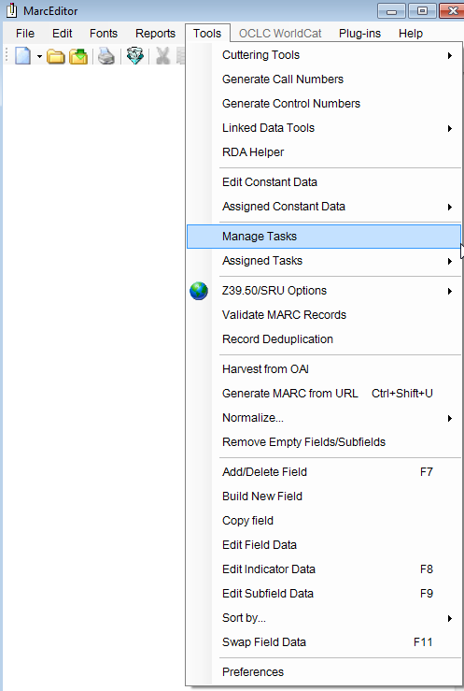
Task manager
Create defined task lists executed automatically
Anything done in the MarcEditor, you can automate as task
Chains task lists together
Performs the tasks procedurally
Located in MarcEditor > Tools > Manage Tasks

Slide 13
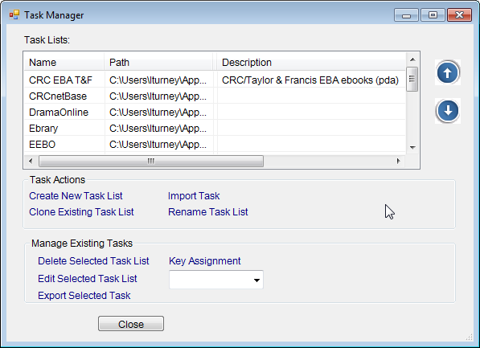
Task manager
o Create new tasks
o Clone tasks
o Rename tasks
o Delete tasks
o Edit tasks
o Key assignment
o Share tasks (import / export)

Slide 14
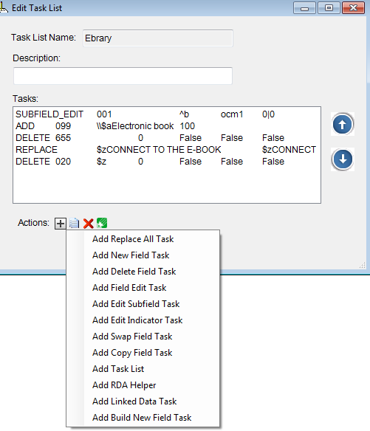
Task manager
Add a new task

Slide 15
Resources and more information
MarcEdit Website: http://marcedit.reeset.net/
MarcEdit 101 Workshop: http://marcedit.reeset.net/marcedit-101-workshop
MarcEdit Listserv: http://listserv.gmu.edu/cgi-bin/wa?A0=marcedit-l
MarcEdit Youtube Playlist: http://tinyurl.com/he2hhyn
Regular Expressions Cheatsheet http://regexlib.com/CheatSheet.aspx

Slide 16
Thank you!

