Slide 1

Create List for Beginners
Introducing New Employees & Infrequent Users to Reporting Options
Suzanne Mangrum
TNIUG 2016

Slide 2
Original Purpose
Need for a training guide to orient new employees to Create Lists in a general way
Help library liaisons to run their own reports
Introduce our data in a way that makes sense as well as how it can be manipulated in create lists

Slide 3
About me
We use Sierra
Basic Create Lists capabilities; I am not an advanced user
I am the acquisitions librarian for firm (one-time payment) materials
I work primarily with books (print and electronic), media (dvds and streaming), and Music (scores)
I assist liaisons with the approval plan for books

Slide 4
Audience & Scope
Audience
Acquisitions staff and Liaisons
Possible uses
View purchases and/or collection from a subject perspective
Keep track of purchases
Manipulate order data
Records used
Order
Bibliographic
Item

Slide 5
What is it?
Create Lists is a function in Sierra that allows the user to bring together a group of records. Records are gathered together by creating a query using Boolean searching (and, or)

Slide 6
A brief glimpse of the goal
Example: An open order report
Our orders in YBP should be cancelled after 90 days. We get cancelation notices and can run open order reports in GOBI. Are there items that YBP has canceled that are still on order in Sierra? If so, they need to be canceled in Sierra and reordered from another vendor.
.
Notes:
First I want to quickly walk everyone through a simple search. There are so so many ways to use Create Lists, but this is typical for us.
And then I will talk about how I organized my training material and why. I promise that we aren’t going through step by step training.

Slide 7
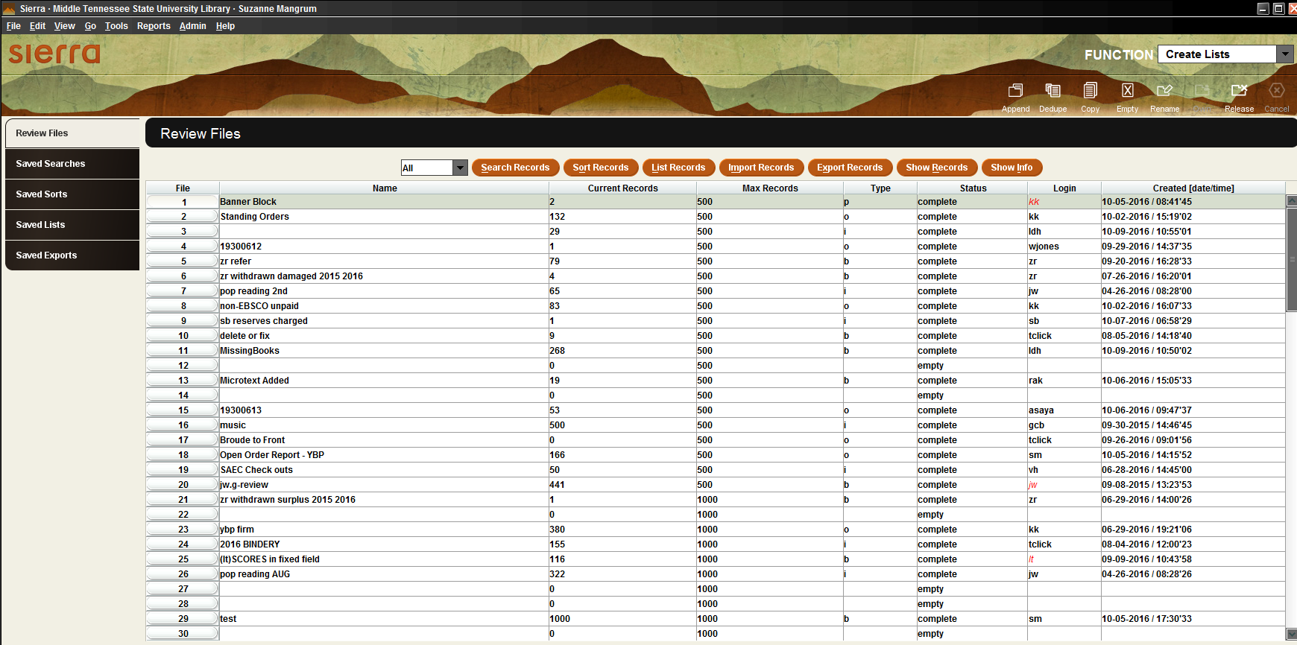
Notes:
This is create lists. I actually think this screen is a terrible place to start training someone because there’s a lot going on. It’s like being asked to parallel park your first day of driving school.

Slide 8
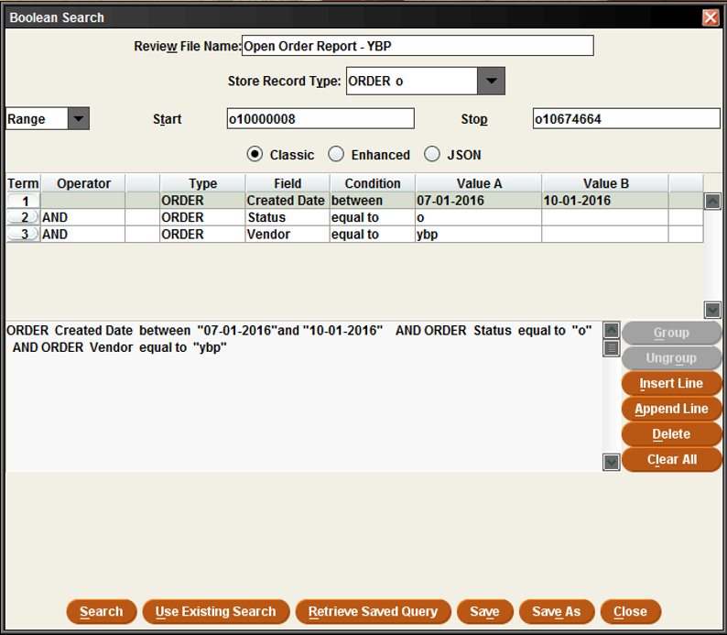
Example

Slide 9
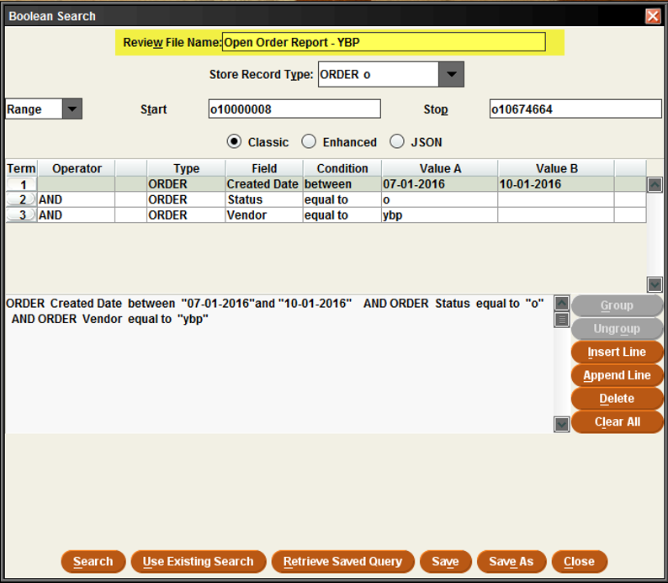
Example

Slide 10
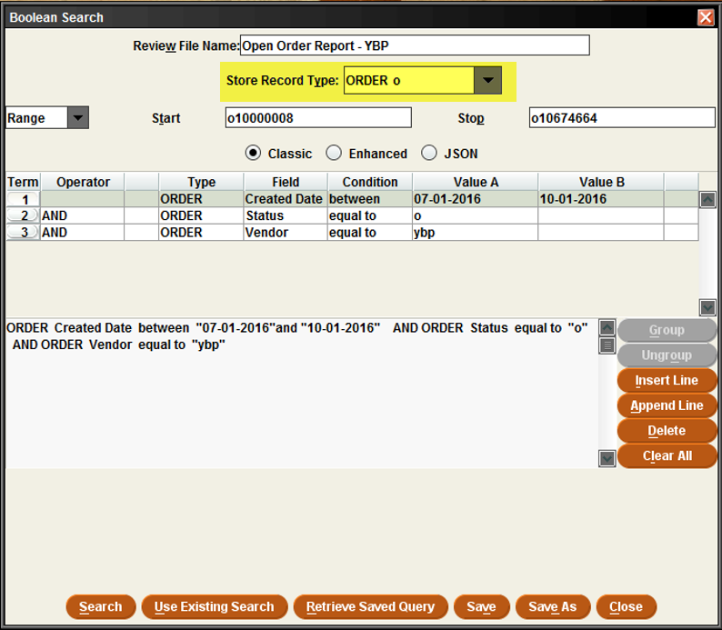
Example

Slide 11
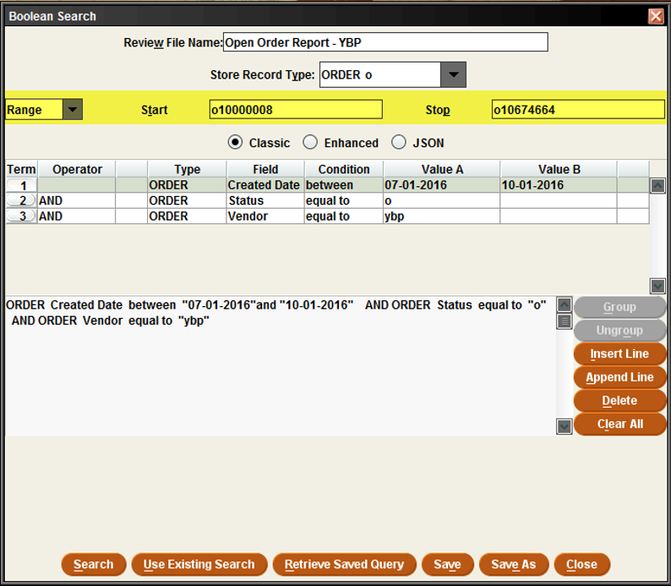
Example

Slide 12
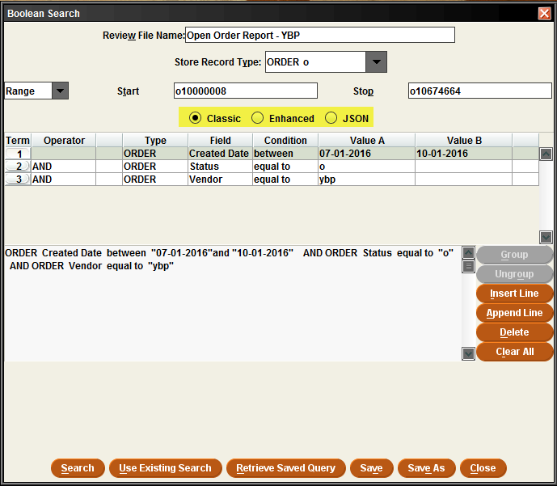

Slide 13
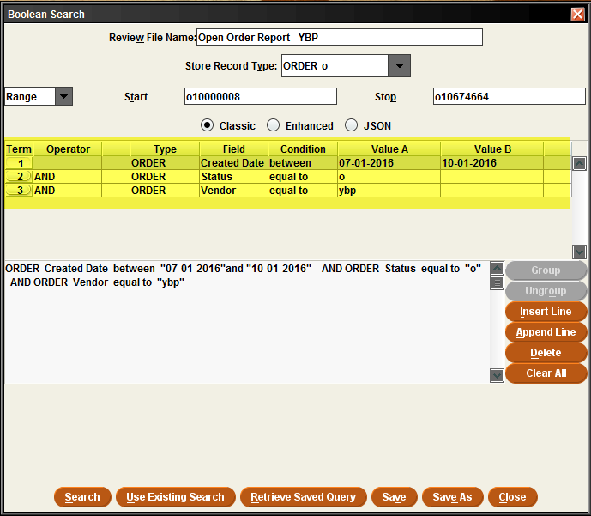

Slide 14
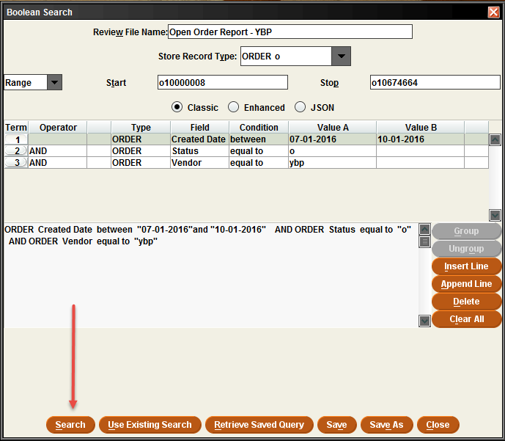

Slide 15
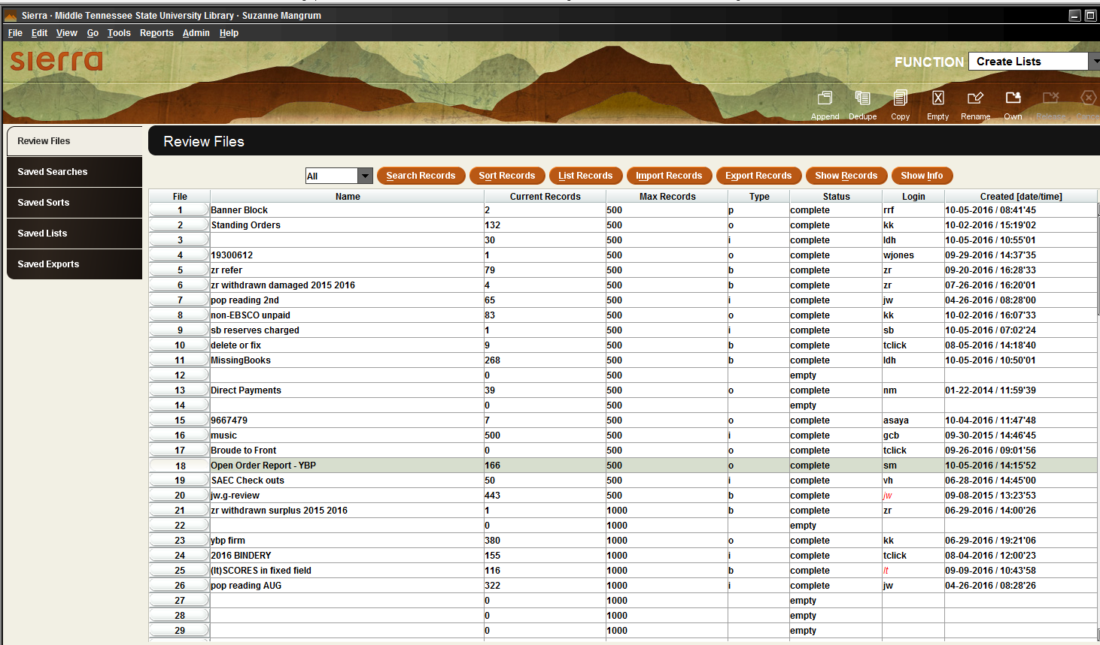

Slide 16
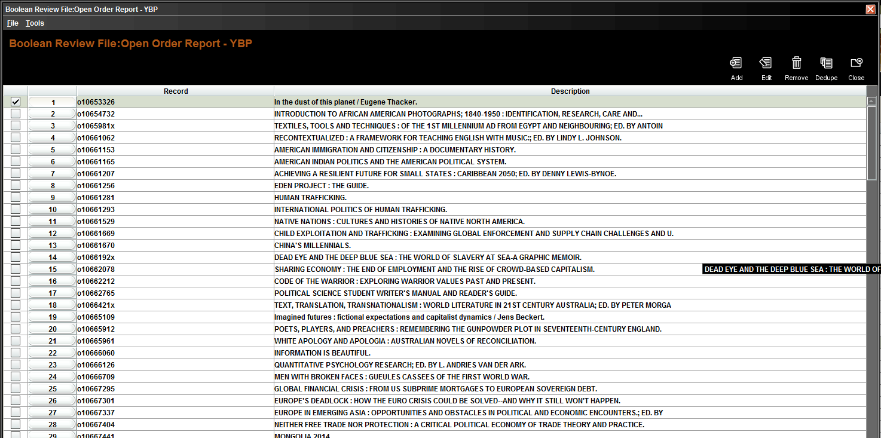

Slide 17
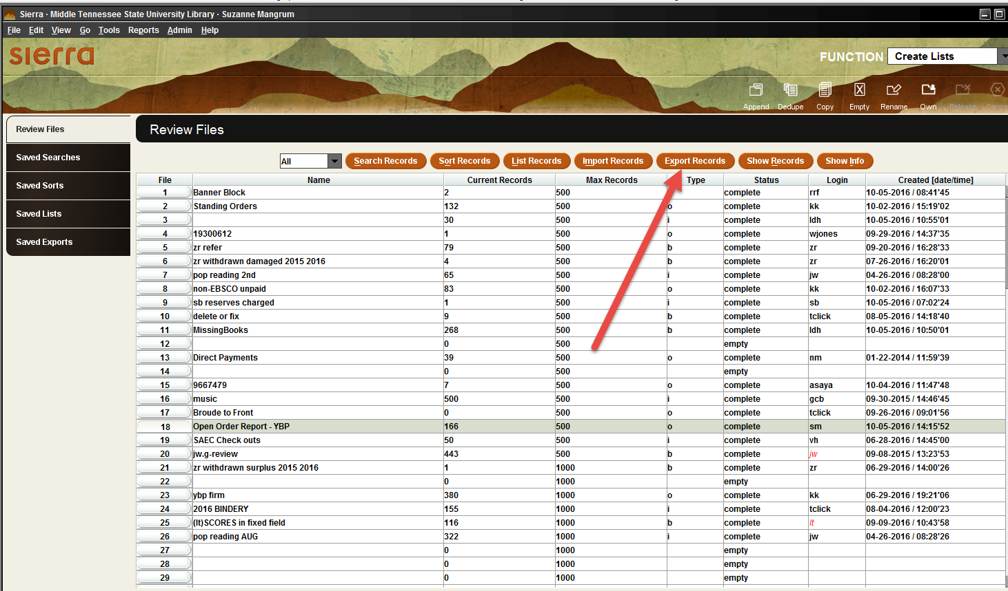

Slide 18
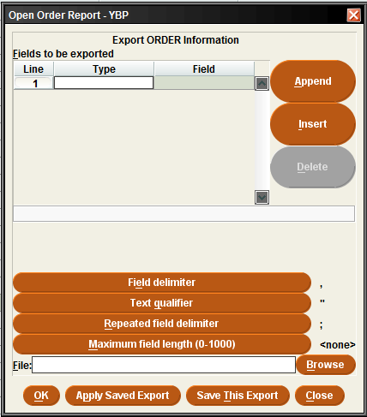
Portal to Excel

Slide 19
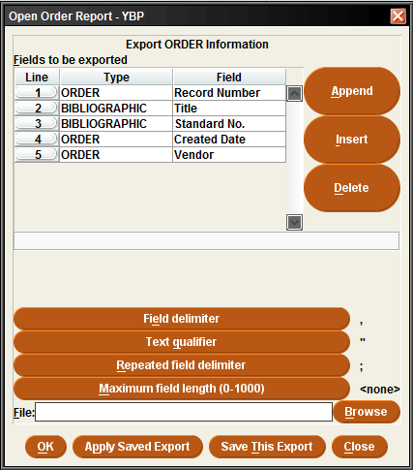

Slide 20
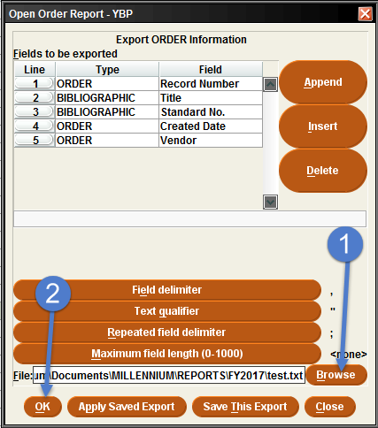

Slide 21
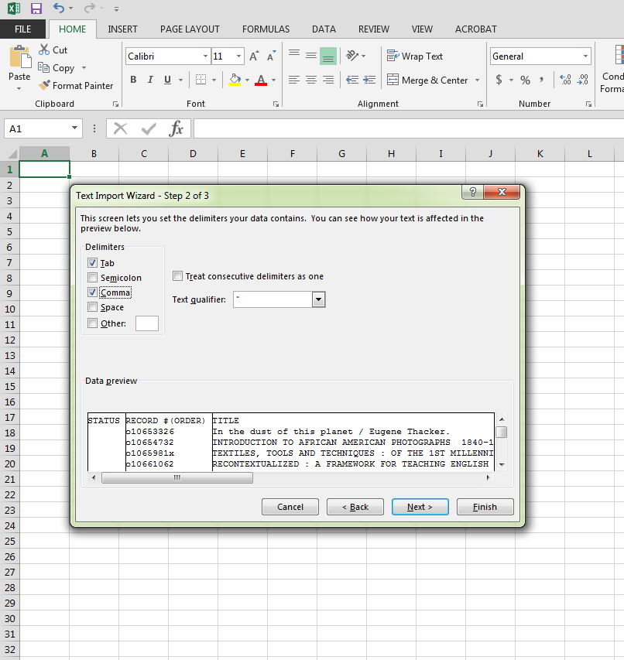

Slide 22
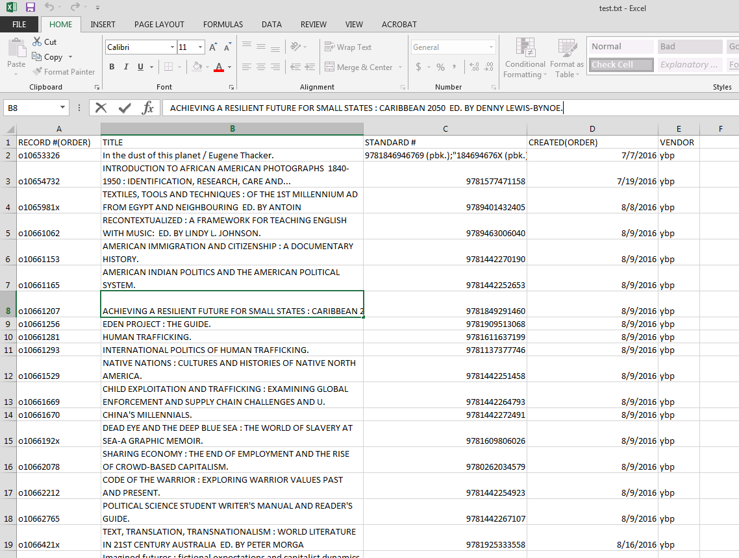

Slide 23
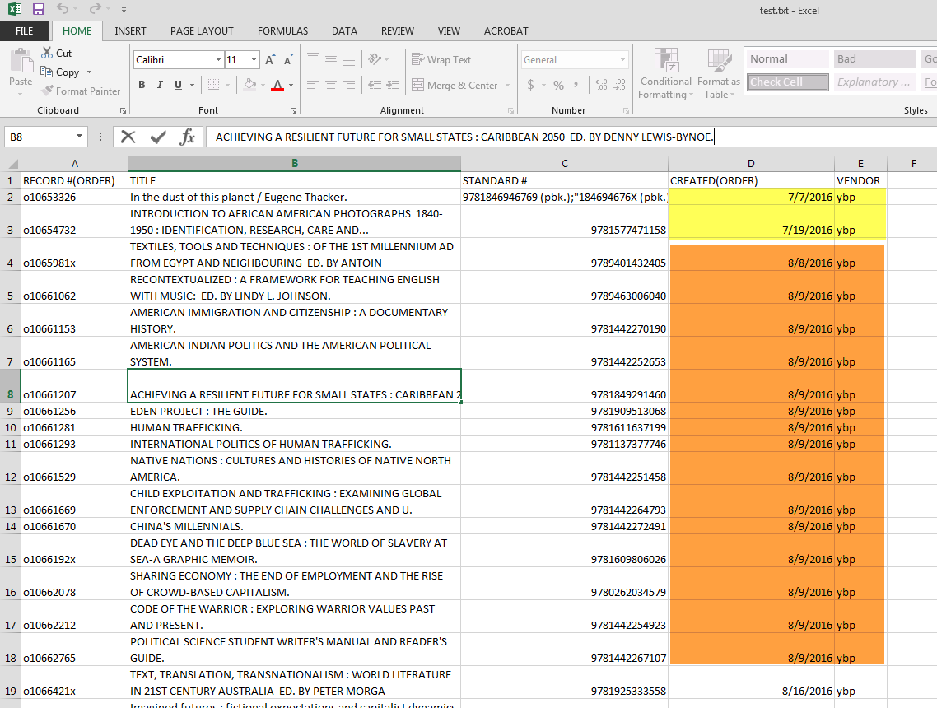

Slide 24

Let’s pause a moment
This is a basic step-by-step approach to create a specific list and does not require much specific knowledge.
Notes:
You can, with good directions and lots of pictures, get anyone through a create list report. It is the fast food approach to create lists. There’s nothing wrong with chicken finger and fries, but it’s not what we would want to make forever.

Slide 25
Question
How do we get people from working step by step to actually creating reports for themselves? To actually answering questions with data on the fly?
Notes:
Throw them in the pool? That is what happens to most people. But liaisons are already swimming in a different pool of responsibilities. And new employees, particularly classified staff, are entitled to some orientation and training if they’re going to be successful at their jobs.

Slide 26

Question
How do we get people from working step by step to actually creating reports for themselves? To actually answering questions with data on the fly?
Notes:
With the understanding that we are NOT trying to create an expert. We need experts. I am supremely thankful to the Larrys and Annes of Sierra who can help me navigate data and data relationships. But the training need I see and try to provide is not about that.

Slide 27
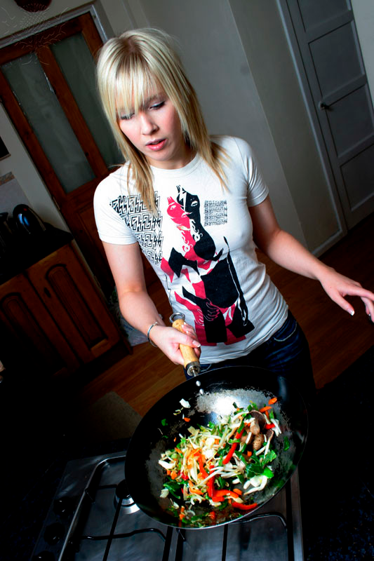
Question
How do we get people from working step by step to actually creating reports for themselves? To actually answering questions with data on the fly?
Notes:
My goal is to create competent, confident builders of basic Lists. I have tried (and I am still trying) to create training and documentation as a place for people in my organization to get started so that they can do for themselves.

Slide 28
Hypothesis
We know that before creating a report, we have to know:
What question we want to answer
What data elements need to be included in the report
Then we need to know how to put those elements together to form a query
Notes:
We can’t simply introduce Create Lists, we also have to introduce our data.

Slide 29
Time to break it down
We need to focus on data elements before we focus on building a report.
To accomplish this I focus on the following:
Our data structure
Record types
Fields stored in each record type
Notes:
Our data structure
--There are certainly particular constructs in create lists, but I think it’s important to first know the data structure of a particular workflow (in my case, acq.) It’s like having a map to plot your course.
Record types
--This includes record types and the purpose they serve, but also record views. I think it’s important to orient people that you can see the representation of an item or bib record in many ways in Sierra, but they serve a particular purpose
Fields stored in each record type
--Record fields store the golden nuggets of information that we seek. Once you start searching them and pulling them together in a list, you will have respect for their power and how they are created.

Slide 30
Our Data Structure
Bibliographic Record
Order Record(s)
Item Record(s)
Notes:
You may see this as overly simplified, but I think it’s a good way to start. From our perspective—our interaction with the system—this is our “world order”. Everything begins with a bibliographic record. We attach an order (or orders) to a bib. Our most important contribution to the system is the order records. We also usually create an item when we create an order (except in some circumstances.)
We don’t have holding records for our stuff.
We don’t use resource records. It’s mostly about these three.

Slide 31
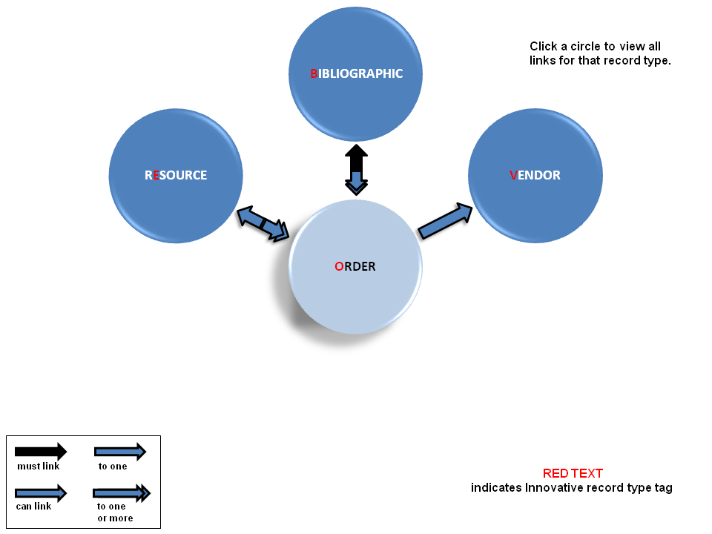
From CS Direct
Notes:
I would also like to insert here that there is good documentation from CS Direct. I use it. But I have had to work—I’m sure many of us have—on finding relevance in the documentation. You have to know where the system ends and LOCAL PRACTICES begin. That still challenges me. There are some interesting charts in the documentation that show how the records interact with each other. >>>>more on next slide

Slide 32
Record Types
Records “draw a line” around certain facts
Interact with different parts of the system
Notes:
The previous two slides illustrate my basic view on record types:
They “draw a line” around certain facts. I am going to dwell mostly on this one. We record a vast amount of data about our collection that are of interest to my people (acq. and Liaisons). A lot of reporting is about what lives where…and why.
How the records interact with the system is…advanced. It matters. But local practice matter more at the beginning. In my experience, most of building a good create list is about knowing where to go for the best source of information.
Now let’s look at the individual record types >>>>>

Slide 33
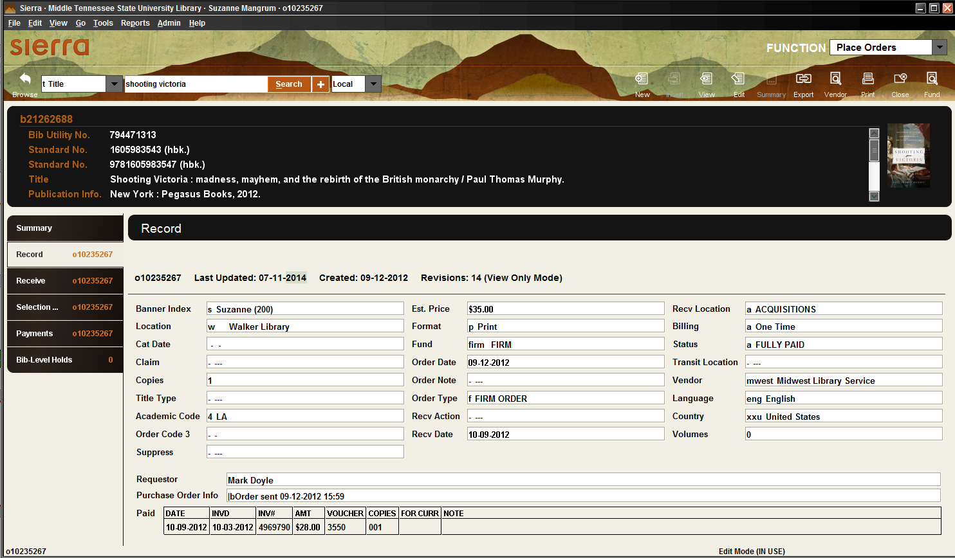
The Order Record – Our Home Plate
Notes:
This is our home plate. The order record. Of course, this is really a bib and an order record. That’s why I like to refer to it as our home plate. If you work in circ, it will be this view with an item record below the bib.

Slide 34
A local perspective
Order record
Bibliographic
record
Item Record
Catalog
Ledger
Patron [request] info

Slide 35
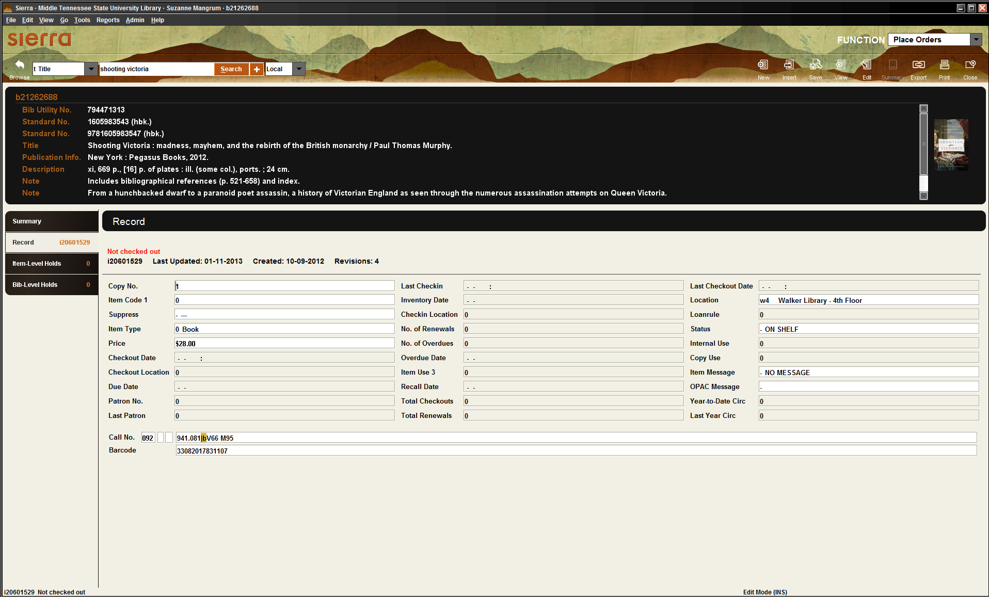
The Item Record

Slide 36
The home of data gems
Item Record
barcode
location
Shelf status
Circulation data
Call number

Slide 37
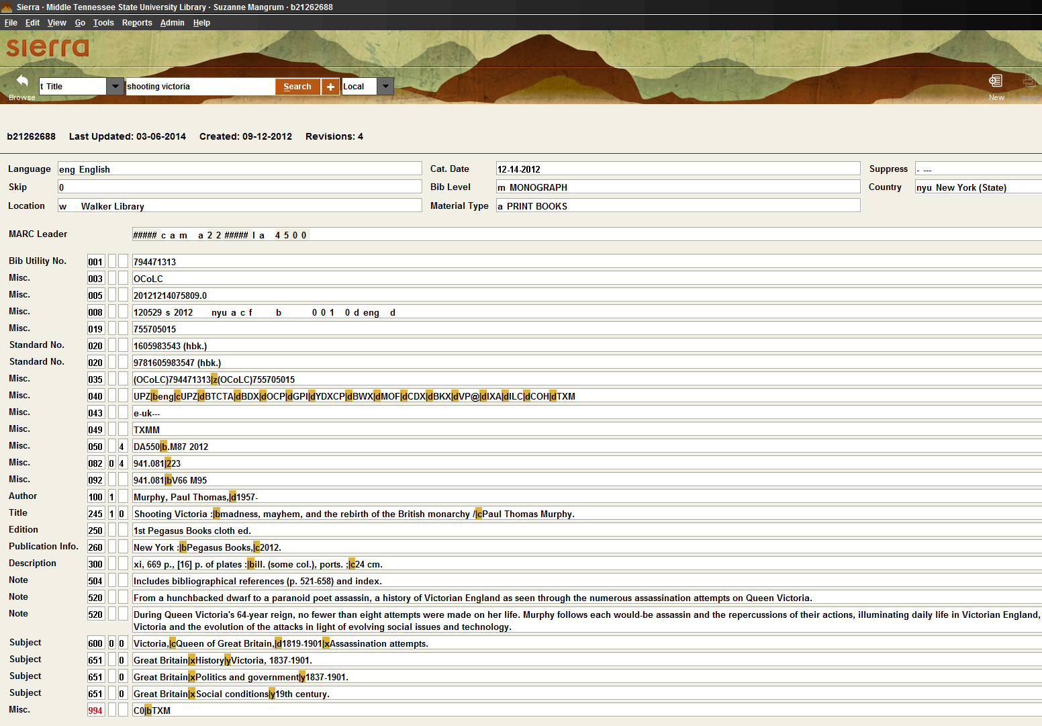
The Bibliographic Record

Slide 38
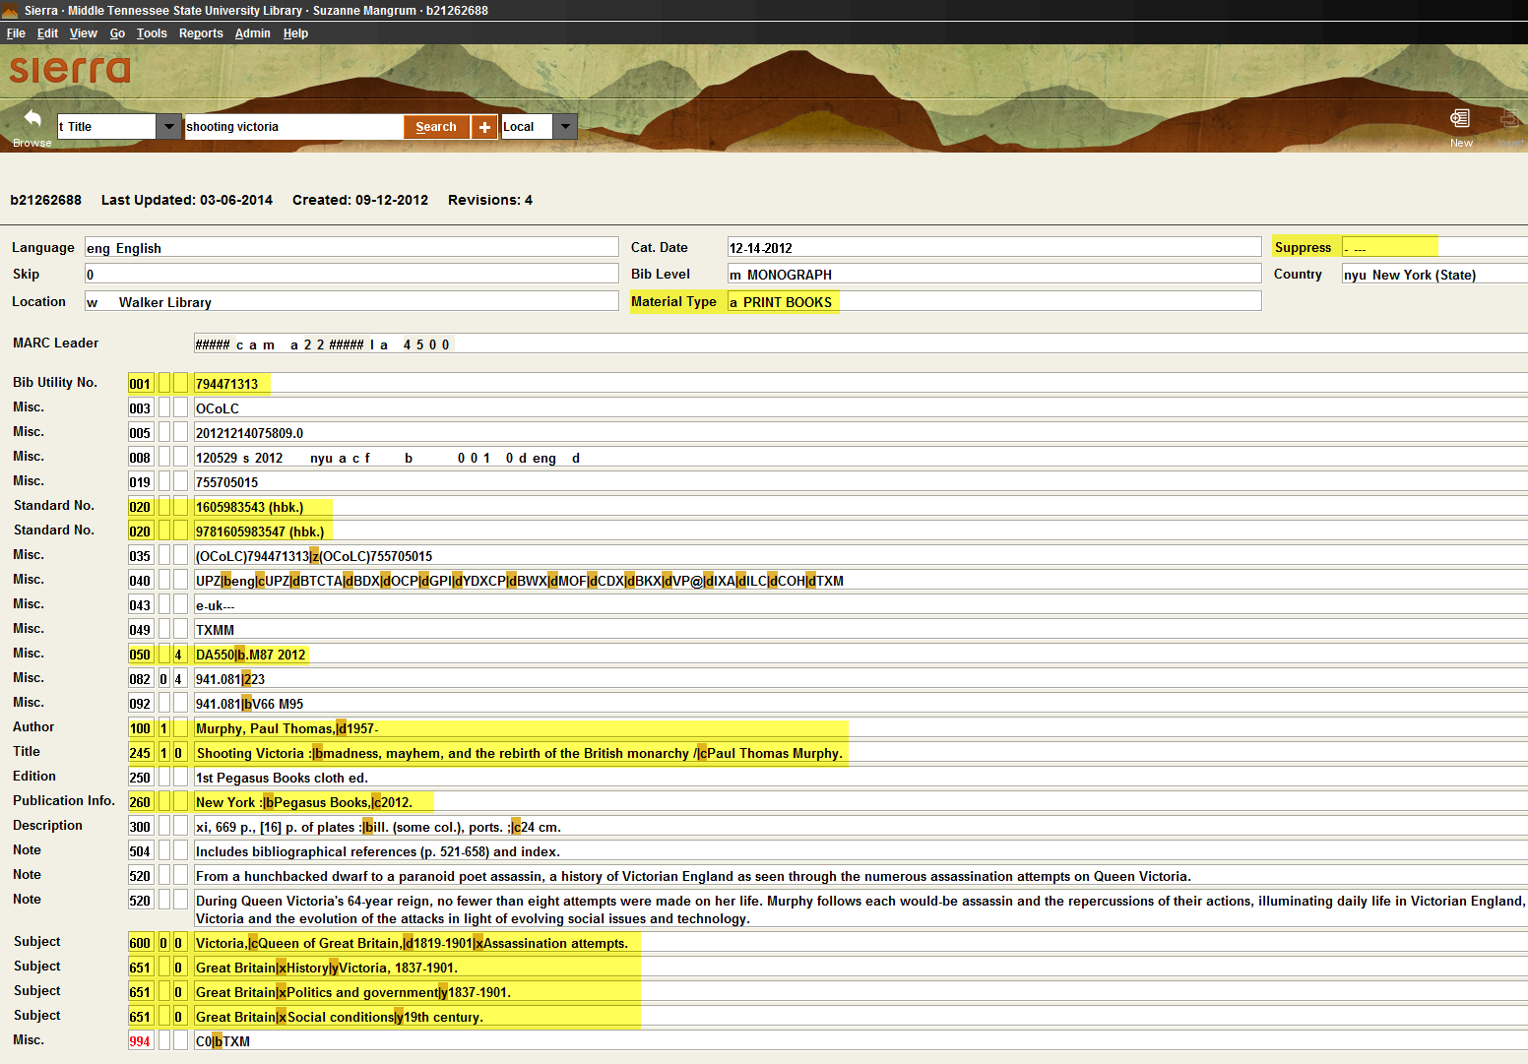
A treasure trove of information
Notes:
This is an electronic record of the actual item in the library’s collection. It describes the item. Tells us where it came from, who is responsible for creating it and much more.
Since this is not my home plate, I do not pretend to know the depths of a bib record. But the highlighted fields show some of the things that a liaisons, in particular, may be interested in knowing.

Slide 39
Back to home plate
Notes:
If I were doing this for a liaison, I may start with the bib record instead…they really need a light version of all three.
For acquisitions people, it is worth investing time here. For many reasons. But I think it helps to begin learning the nitty gritty of Create Lists HERE. Break out the data.

Slide 40
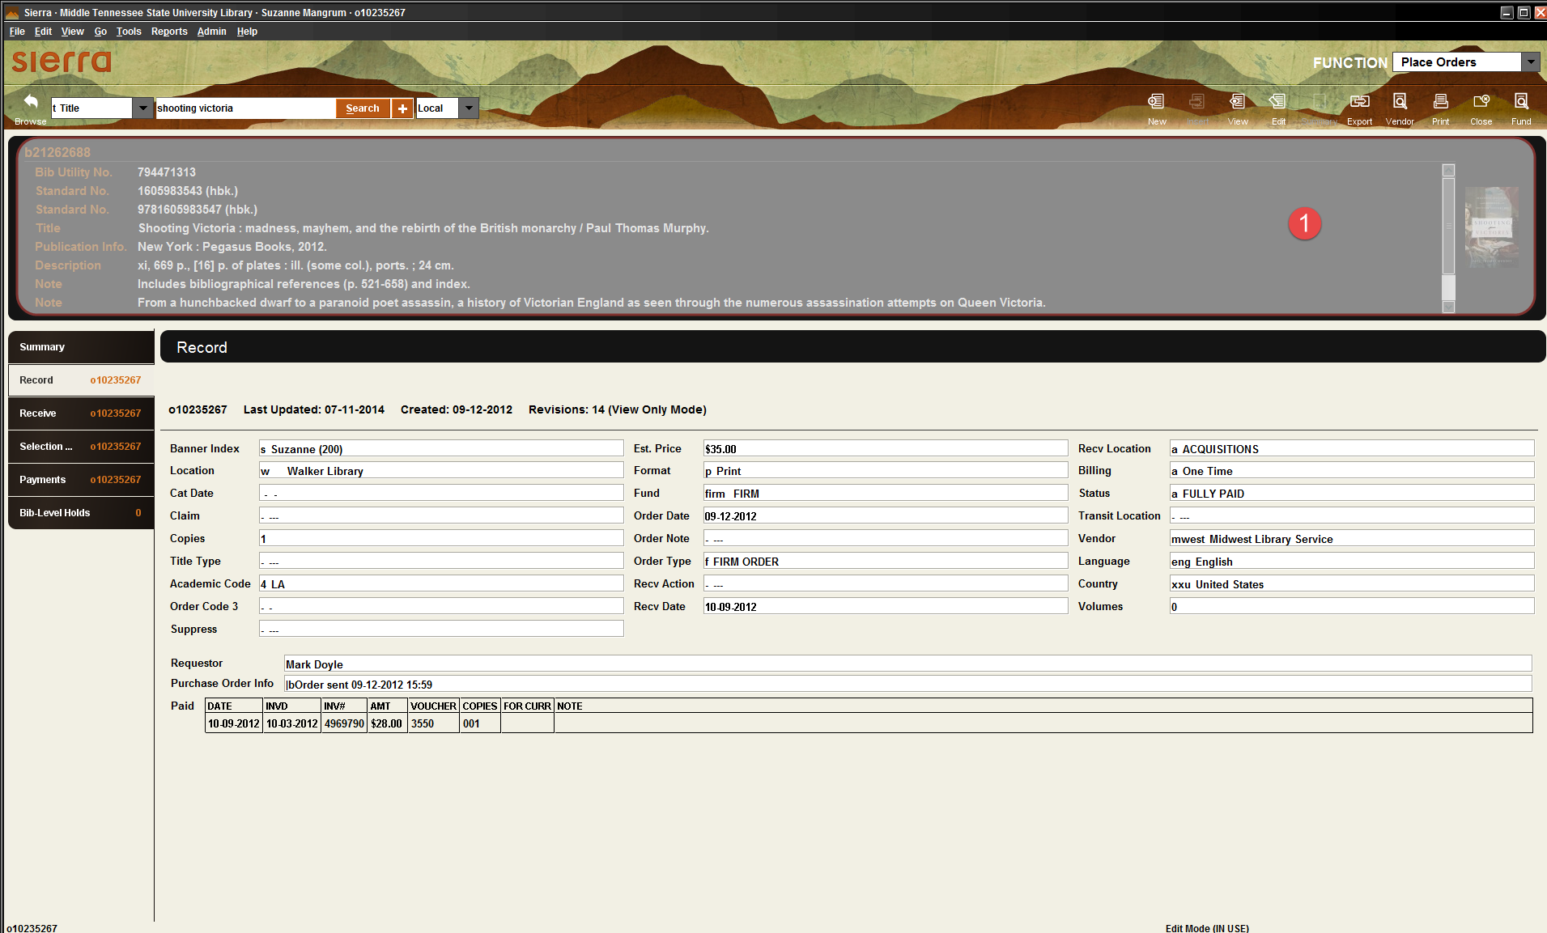
Notes:
Time to break our the data….and start talking about fields.

Slide 41
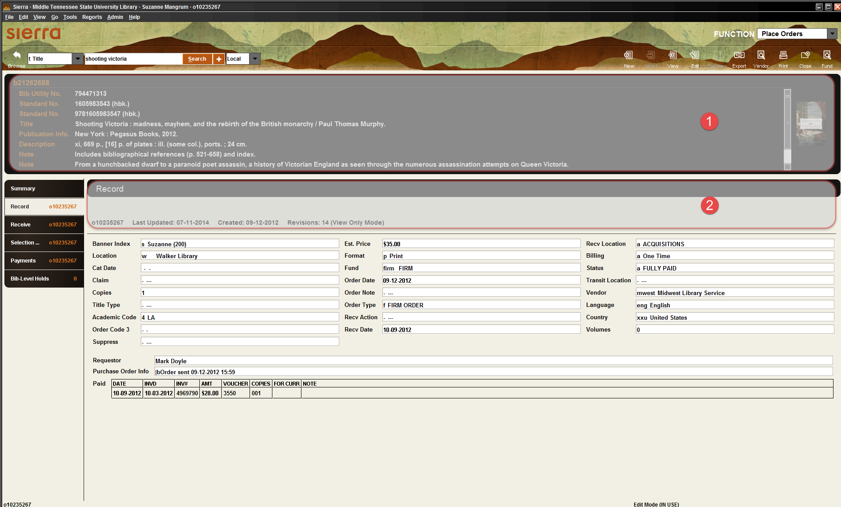

Slide 42
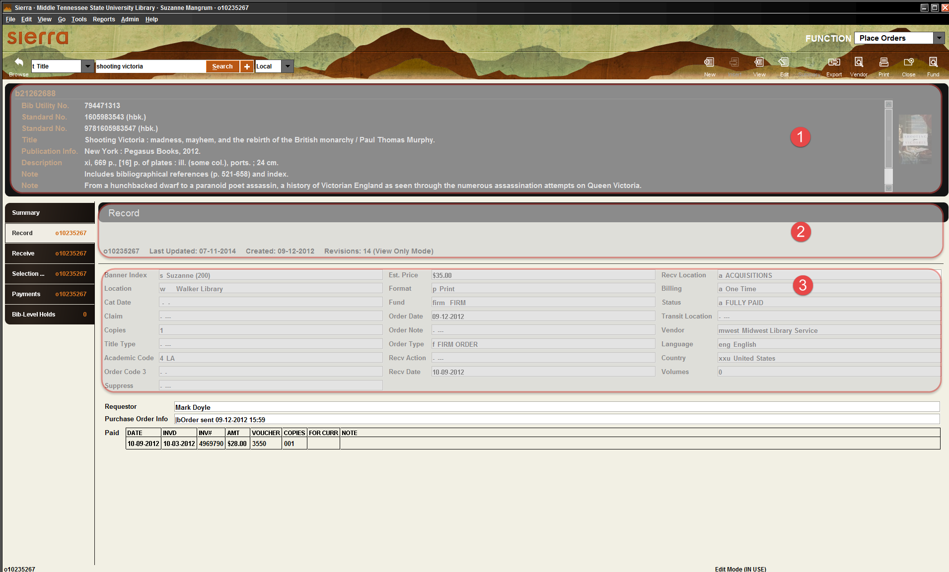

Slide 43
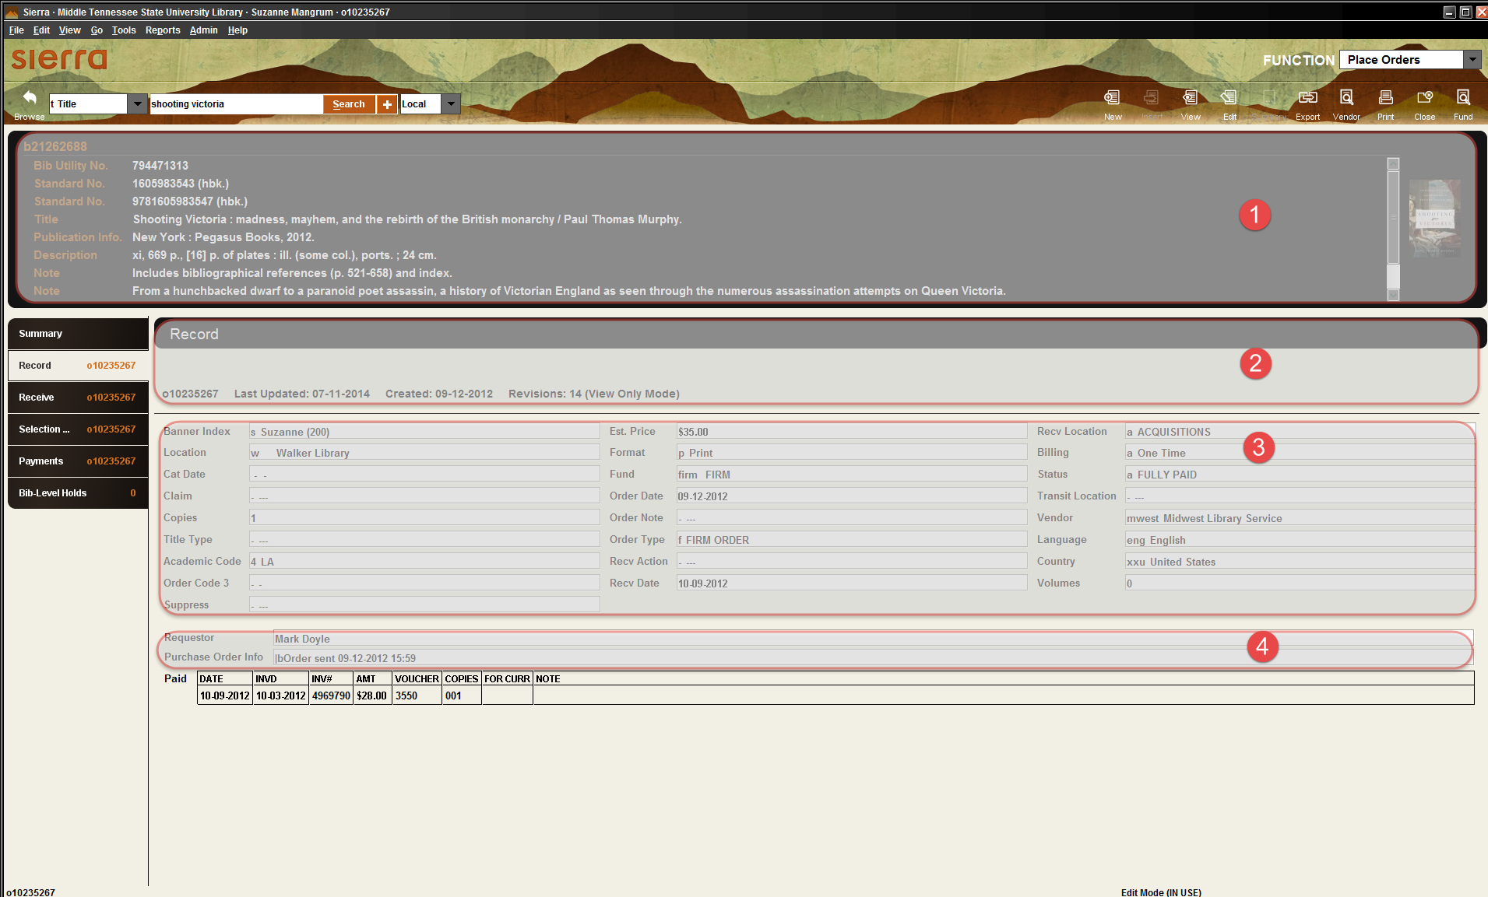

Slide 44
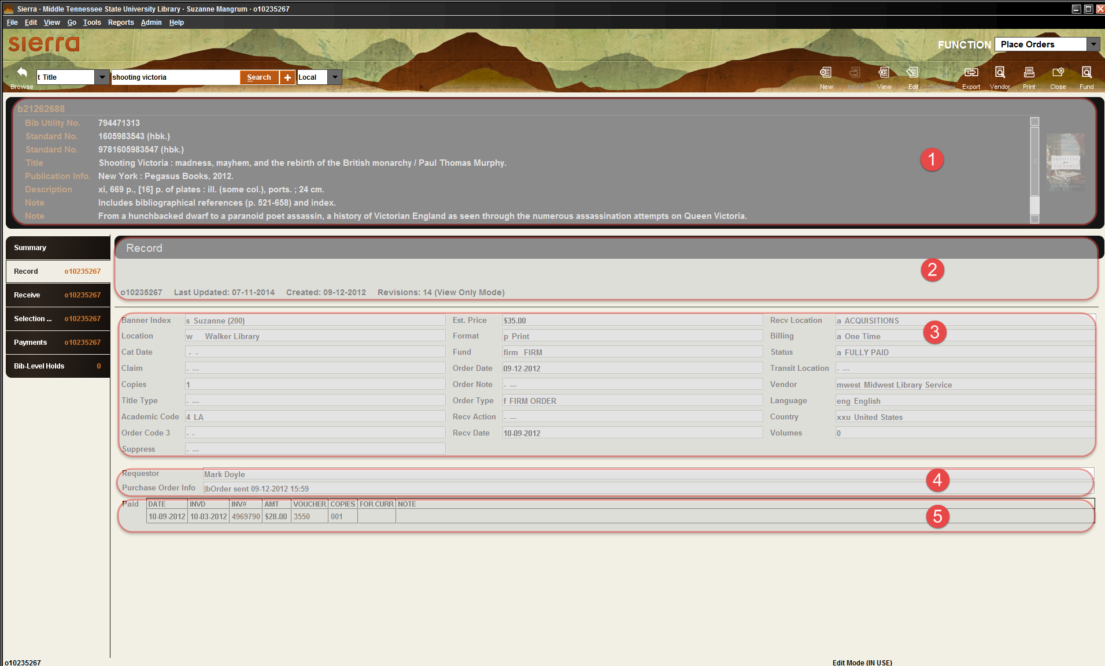
Notes:
What exactly is on this page. What data is collected? Why? What can add….what can’t we add. This is where we dig in….
If you work in another area of Sierra, my answer would be the same….Find the record type that you work with…your home plate…You have to dig in to all of the fields, understand what all the possibilities are for those fields.

Slide 45
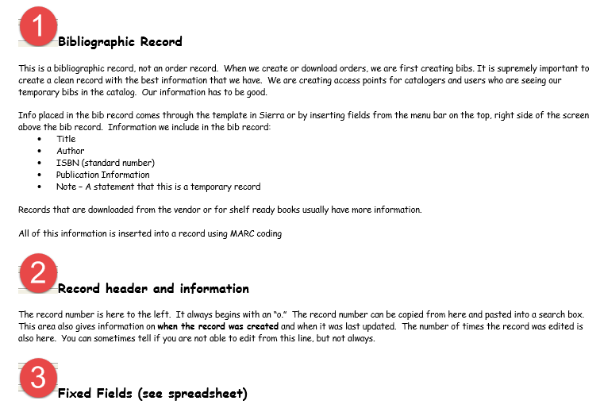
Notes:
What exactly is on this page. What data is collected? Why? What can add….what can’t we add. This is where we dig in….
If you work in another area of Sierra, my answer would be the same….Find the record type that you work with…your home plate…You have to dig in to all of the fields, understand what all the possibilities are for those fields.

Slide 46
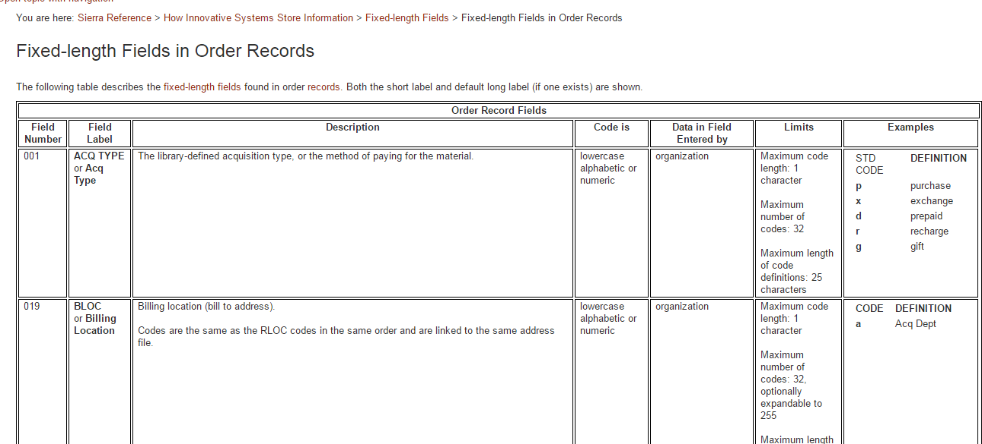
From CS Direct
Notes:
Again there is excellent information in CS direct. Why reinvent the wheel? This is a grid of all the fix fields….

Slide 47
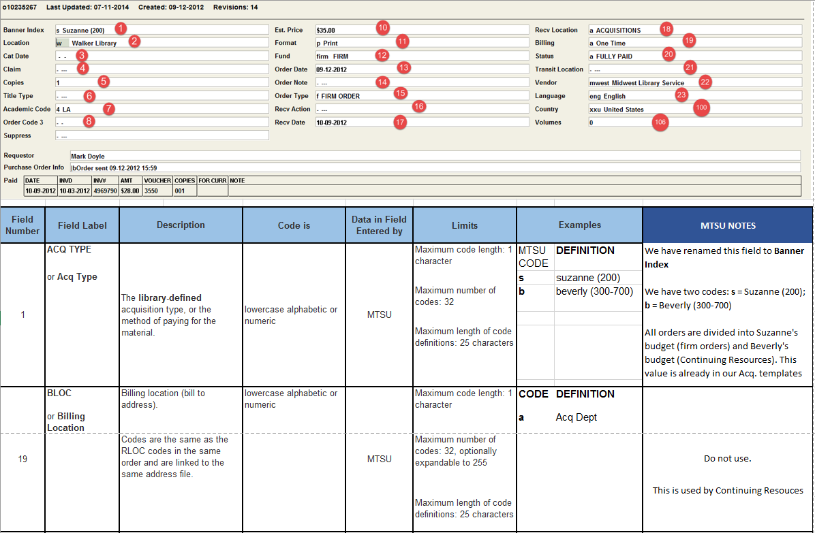
Our documentation
Notes:
But again, it’s hard to start with the documentation. This is my attempt to provide some context and introduce fields in a meaningful way.
Before do Create List training, we’re going to go through this. And of course this kind of documentation does more than prep for create lists…it clarifies the workflow.

Slide 48
Now you’re ready
If you can formulate questions
If you can organize a search
You already know the data, you just have to learn the ins and outs of Create Lists

Slide 49
Notes:
NOW your ready to face this.

Slide 50
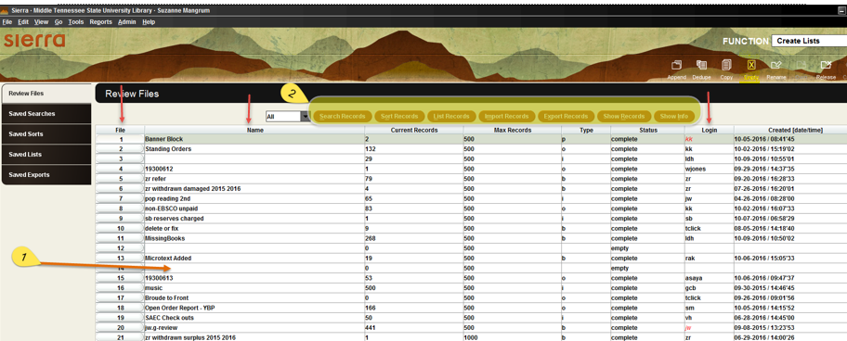
Notes:
>>>keep clicking

Slide 51
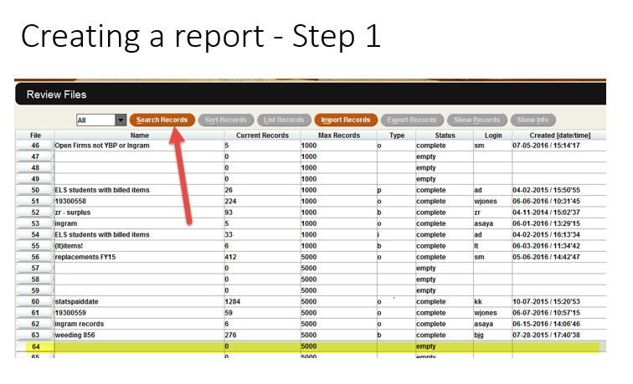

Slide 52
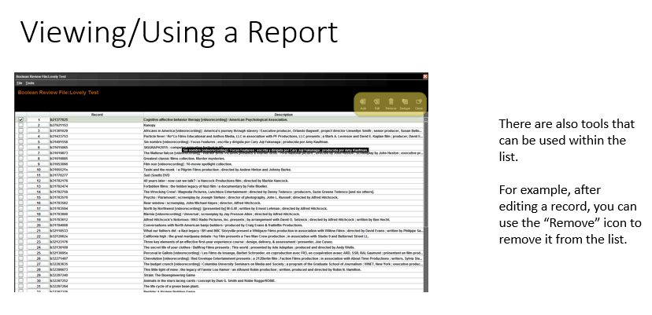

Slide 53
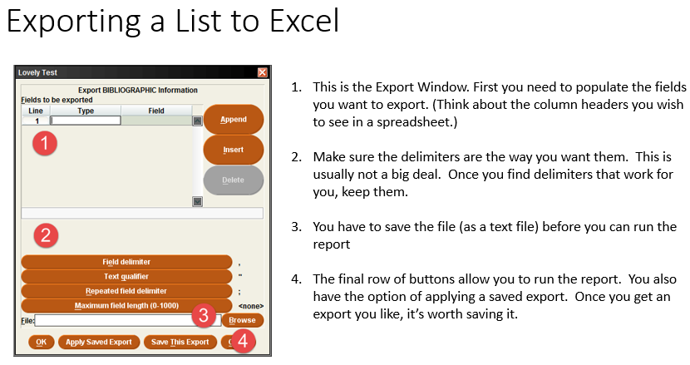
Notes:
Exporting a list to Excel….I think this is more complicated that running a report at firs….until you realize how powerful Create Lists is.

Slide 54
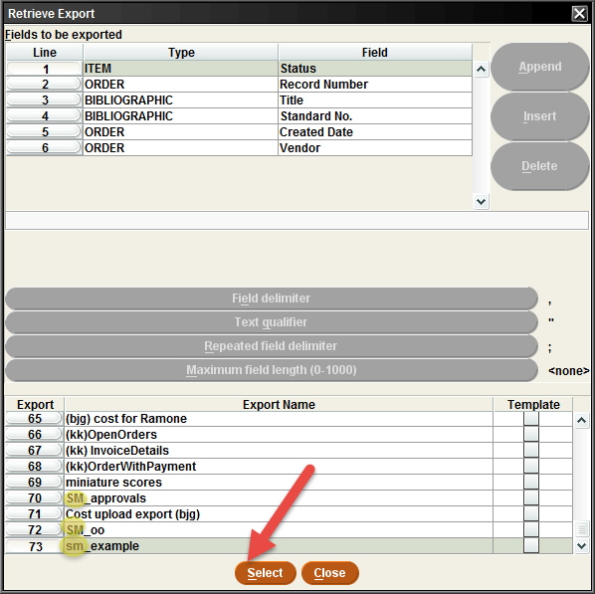
Notes:
Using saved search features

Slide 55
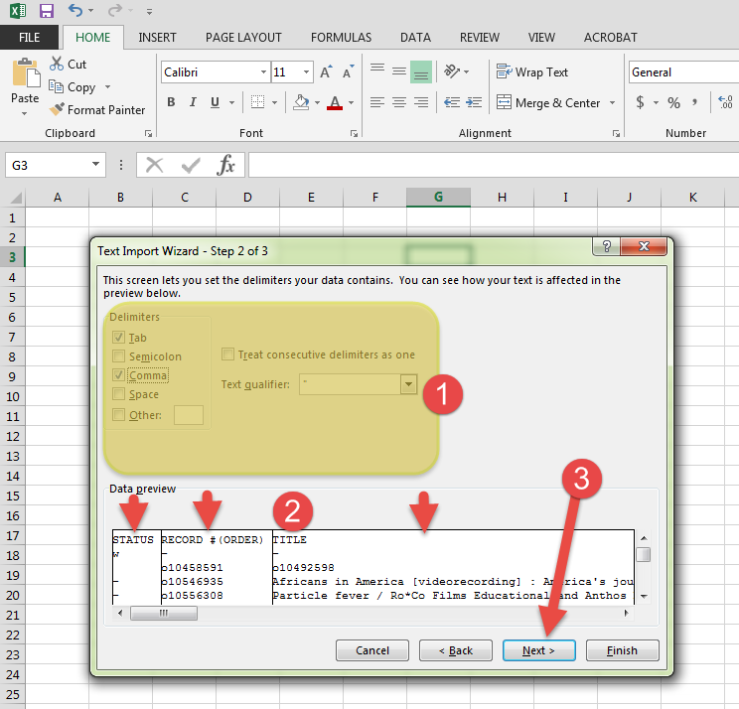
Notes:
Using saved search features

Slide 56
Some Final Thoughts
Check your data!
Great Create List Resources

Slide 57



Check your data!
Notes:
It is so important to verify your results. I tried to include a juicy example, but it was too messy. Bottom line: there’s a myriad of ways to mess up the data. If you’re familiar with the work….for example, your own orders…it can be easier to tell if the data “looks right”.. It’s really important to step back and take a second look at your results.

Slide 58
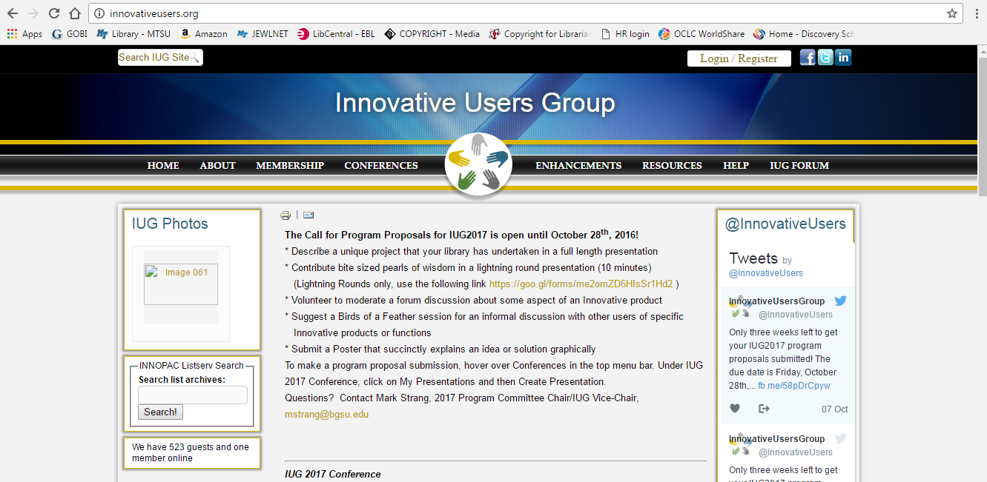
IUG Website
Notes:
Use the IUG website! Any iii user can register. You will need your Millennium number as part of the registration process, but your ILS administrator at your school can give you that.

Slide 59
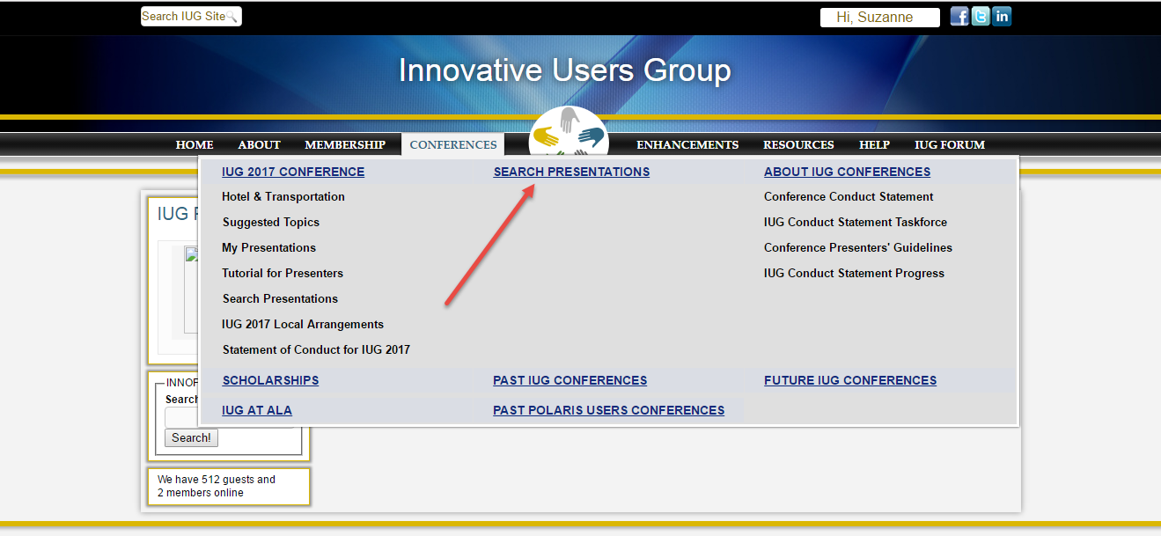
Search awesome PowerPoint Presentations
Notes:
One reason that I chose to emphasize our local data is that there are already a lot of good training presentations.

Slide 60
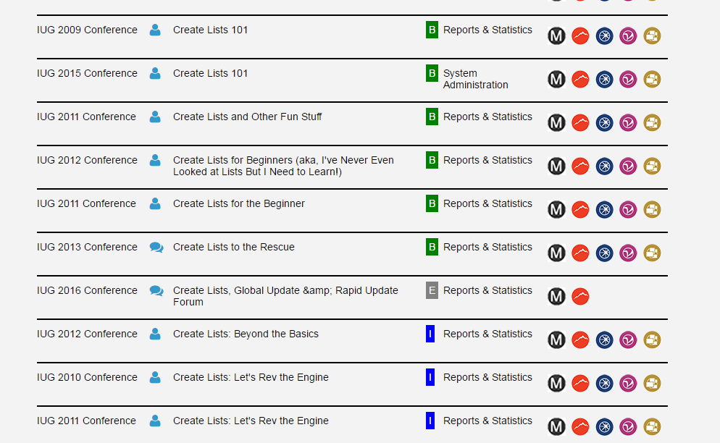

Slide 61
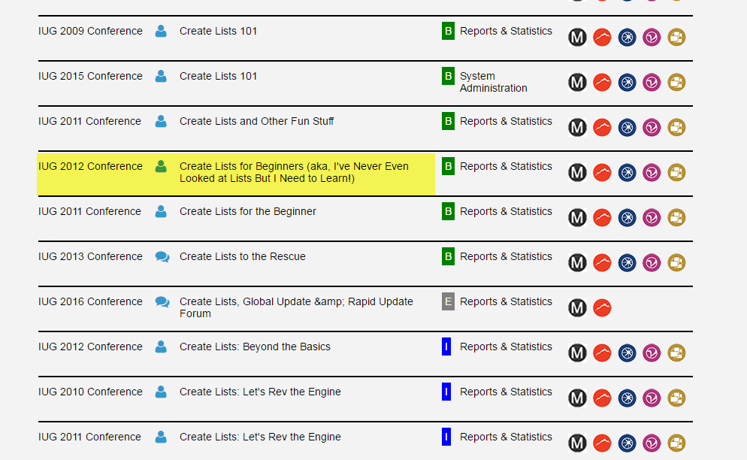

Slide 62
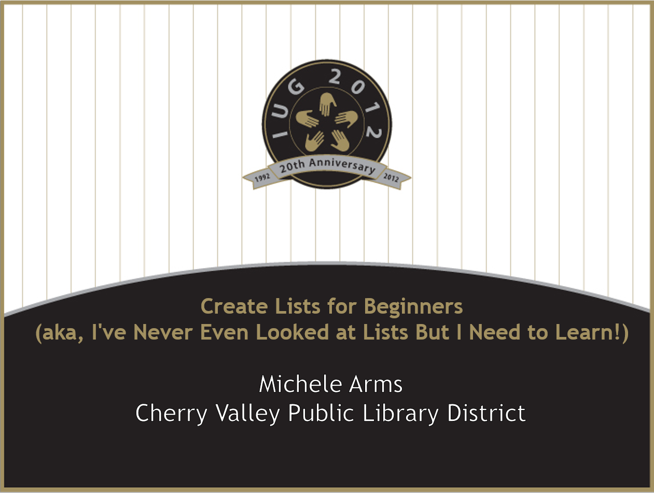
Notes:
This is one example of a particularly good one from Michele Arms

Slide 63
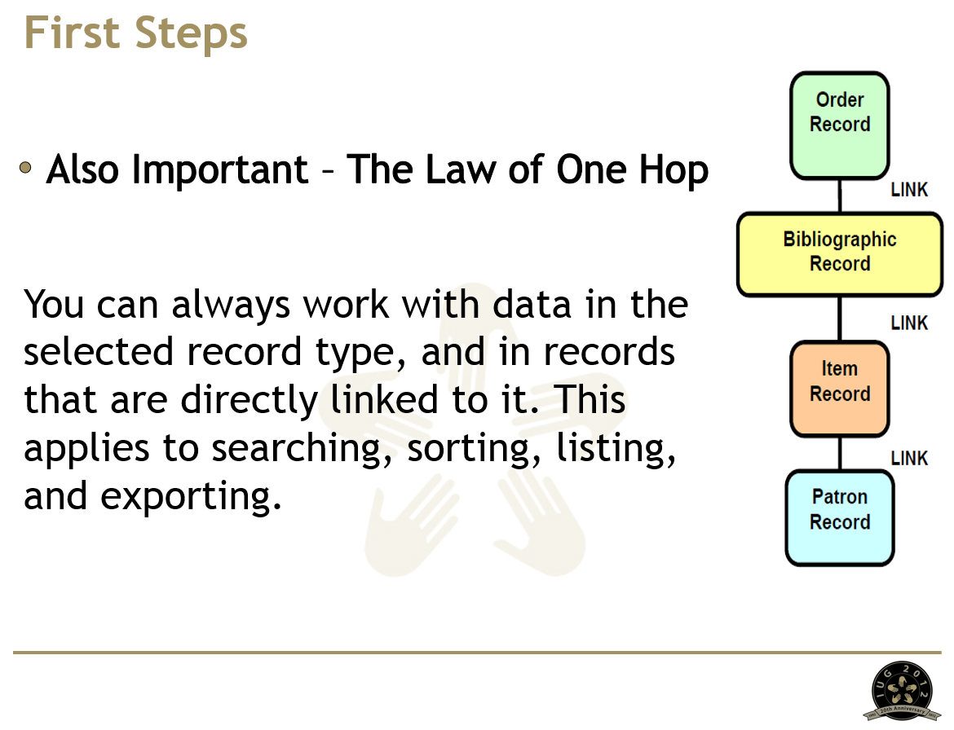
Notes:
This is the clearest explanation of the record links in create lists that I have found. There’s a lot of really good info throughout these presentations. And even if they aren’t working on the exact same system or release as you, it is still applicable.

Slide 64
References
Jacob Silberberg. 28 year old Eghosa Greg Ibizugbe stops at a fast food restaurant, Chicken Republic, to pick up some food for himself and his family on the way home from work. 2009. ARTstor : APANOSIG_10313576213. URL : http://library.artstor.org/library/secure/ViewImages?id=8CBRezQ6MDorQi85eT98RngtXHs%3D
The Iron Chef, Sakai Hiroyuki, sits on a panel of judges at a competition between fellow Iron Chefs and DC's Jordan's restaurant on Woodrow Wilson Plaza, Wednesday afternoon.. [Photography]. Retrieved from Encyclopædia Britannica ImageQuest. http://quest.eb.com/search/142_2338431/1/142_2338431/cite
Young lady cooking. [Photography]. Retrieved from Encyclopædia Britannica ImageQuest. http://quest.eb.com/search/156_2420874/1/156_2420874/cite
Warning sign. [Photography]. Retrieved from Encyclopædia Britannica ImageQuest. http://quest.eb.com/search/132_1307785/1/132_1307785/cite
CS Direct, Sierra Guide. Retrieved from https://library2.mtsu.edu:63100/sierra/admin/help/Default.htm#sgil/sgil_guide.html%3FTocPath%3DSierra%2520Guide%7C_____0
Arms, Michelle. Create Lists for Beginners (aka, I've Never Even Looked at Lists But I Need to Learn!), IUG 2012.Retrieved from: http://innovativeusers.org/conferences/search-presentations.html

