Slide 1
Load profiles
#for loading bib/order/item/invoice data via a full approval plan
|||0|0| | |0|n|G|0|@main="b"
|||0|0| | |0|n|G|0|@marc="boi"
|||0|0| | |0|n|G|0|@atab="a"
|||0|0| | |0|n|G|0|@msg="Approval plan records will be created"
/^999||m|0|12| | |0|n|G|0|#com="ins"@password=""
/^999||y|0|1| | |0|n|G|0|#com="po"@poprint="n"
/^999||z|0|10| | |0|n|G|0|@recs="pcat"
/^999||x|0|1| | |0|n|G|0|#com="clsi"@clsi="n"
/^999||w|0|1| | |0|n|N|0|#com="test"@test="n"
/^999||v|0|1| | |0|n|N|0|#com="init"@init="n"
/^999||u|0|1| | |0|n|N|0|#com="disp"@disp="n"

Slide 2
/^999||o|0|20| | |0|n|G|0|#com="dflt"@dflt="wcatbrief,YBPApp,witem"
Sets default templates

Slide 3
|||0|0| | |0|n|G|0|@ov_action="o"
0 Insert
1 Overlay
2 Insert

Slide 4
|||0|0| | |0|n|G|0|@ov_protect="b=V023456789hy(856,962)k(970,971)n(972)c(092,099)n(541,590)d(690)y(905,910)"
Protects MARC tags. Tags 856, 962, 970, etc will not be overwritten.

Slide 5
Creates MARC record
001||%|0|0|b|o|0|y|N|0|%001(start="1-9",char="!-~")
002-009||%|0|0|b|y|0|y|N|0|%008="y"
010||+|0|0|b|l|0|y|N|0|%strip_blanks="n"
013-019||+|0|0|b|y|0|y|N|0|
020-024||+|0|0|b|i|0|y|N|0|
050-055||+|0|0|b|y|0|y|N|0|
060-062||+|0|0|b|y|0|y|N|0|
066-072||+|0|0|b|y|0|y|N|0|
074||+|0|0|b|g|0|y|N|0|
080-084||+|0|0|b|y|0|y|N|0|
086||+|0|0|b|g|0|y|N|0|
088||+|0|0|b|y|0|y|N|0|
090-099||+|0|0|b|c|0|y|N|0|
100-111||-w|0|0|b|a|0|y|N|0|
241-243||+|0|0|b|u|0|y|N|0|
245||+|0|0|b|t|0|y|N|0|%bracket="h"

Slide 6
Creates order record
##order record fixed-length fields##
/^960||a|0|0|o| |1|n|N|1|acq type
/^960||b|0|0|o| |4|n|N|1|claim
/^960||c|0|0|o| |6|n|N|1|code1
/^960||d|0|0|o| |7|n|N|1|code2
/^960||e|0|0|o| |8|n|N|1|code3
/^960||f|0|0|o| |9|n|N|1|code4
/^960||g|0|0|o| |11|n|N|1|format
/^960||h|0|0|o| |14|n|N|1|ord note
/^960||i|0|0|o| |15|n|N|1|ord type
/^960||j|0|0|o| |16|n|N|1|raction
/^960||k|0|0|o| |18|n|N|1|rloc
/^960||l|0|0|o| |19|n|N|1|bloc
/^960||m|0|0|o| |20|n|N|1|status
/^960||n|0|0|o| |21|n|N|1|tloc
/^960||p|0|0|o| |3|n|N|1|cdate
/^960||q|0|0|o| |13|n|N|1|odate
/^960||r|0|0|o| |17|n|N|1|rdate
#/^960||z|0|20|o| |0|n|N|1|%foreign
/^960||s|0|0|o| |10|n|N|1|eprice
/^960||t|0|0|o| |2|n|N|1|location

Slide 7
Creates item record
/^945|092|ab|0|0|i|c|0|y|N|2|item call number
/^945||c|0|0|i|v|0|n|N|2|volume
/^945||g|0|3|i| |58|n|N|2|copy
/^945||i|0|0|i|b|0|n|N|2|barcode
/^945||a|0|5|i| |79|n|N|2|%map=("m2bmap.callloc")
/^945||m|0|0|i|m|0|n|N|2|message
/^945||n|0|0|i|x|0|n|N|2|note
/^945||o|0|1|i| |108|n|N|2|opac message
/^980||e|0|0|i| |62|n|N|2|price
/^945||q|0|5|i| |59|n|N|2|icode1
/^945||r|0|1|i| |60|n|N|2|icode2
/^945||s|0|1|i| |88|n|N|2|status
/^945||t|0|3|i| |61|n|N|2|itype
/^945||u|0|1|i| |97|n|N|2|imessage

Slide 8
Adds location depending on call number
@stop_on_map=true
^0|w2
^1|w2
^2|w2
^3|w2
^4|w3
^5|w3
^6|w3
^7|w3
^8|w4
^9|w4

Slide 9
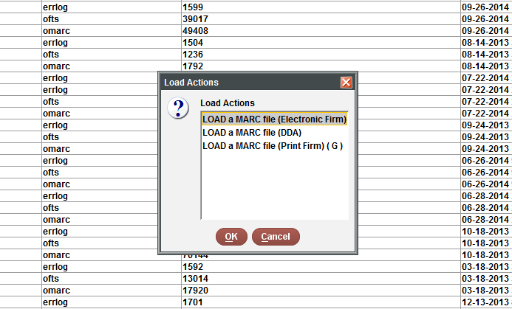
Load using data exchange

Slide 10
Different templates depending on type
/^999||o|0|20| | |0|n|N|0|#com="dflt"@dflt="biblio,_i,acqdef“
/^999||o|0|20| | |0|n|N|0|#com="dflt"@dflt="bibelec,_i,acqfirme“
/^999||o|0|20| | |0|n|N|0|#com="dflt"@dflt="bibelec,_i,dda"

Slide 11
Translation table for fund
BHS|1
BUS|2
ED|3
LA|4
GEN|5
MCOMM|6
SCI|7
UTL|8
LIS|9
SCOLL|s

