Slide 1


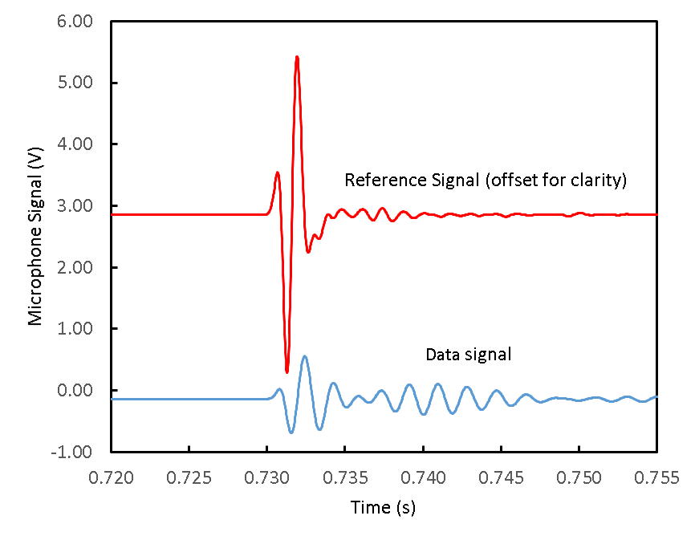
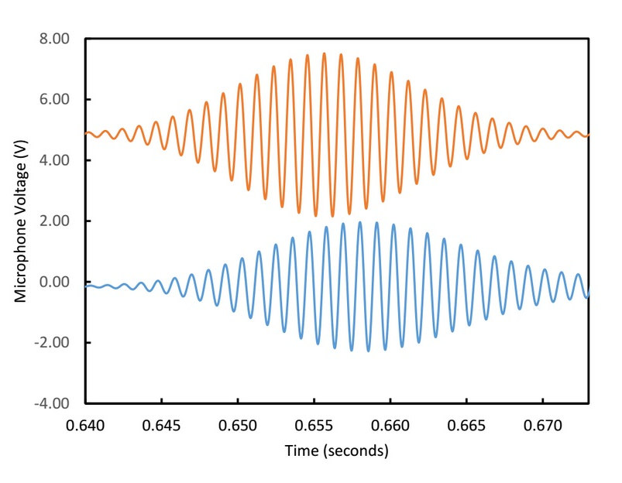
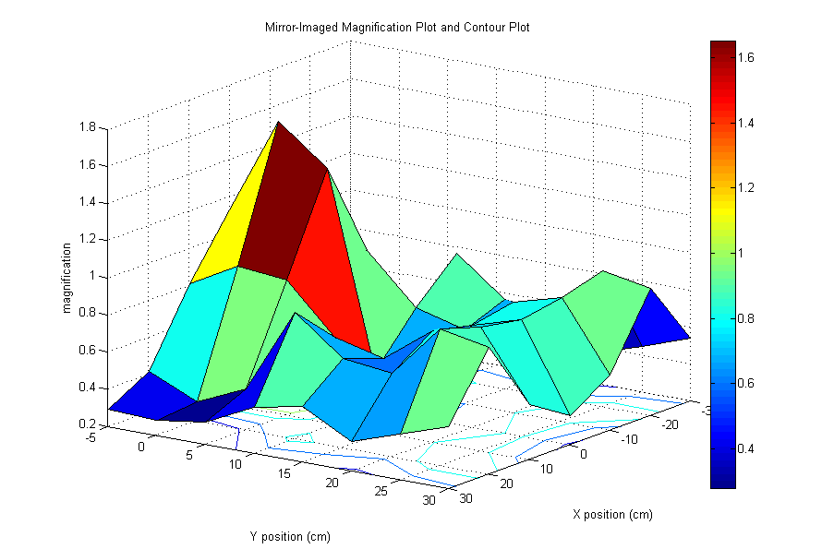
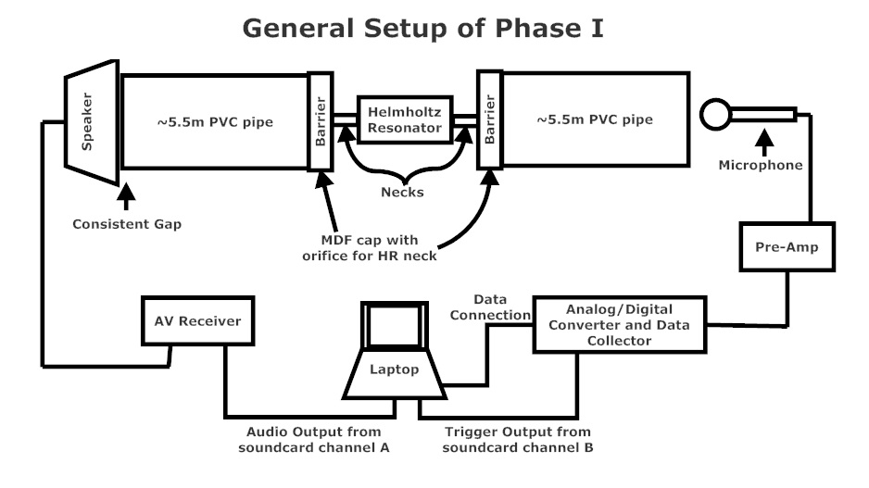
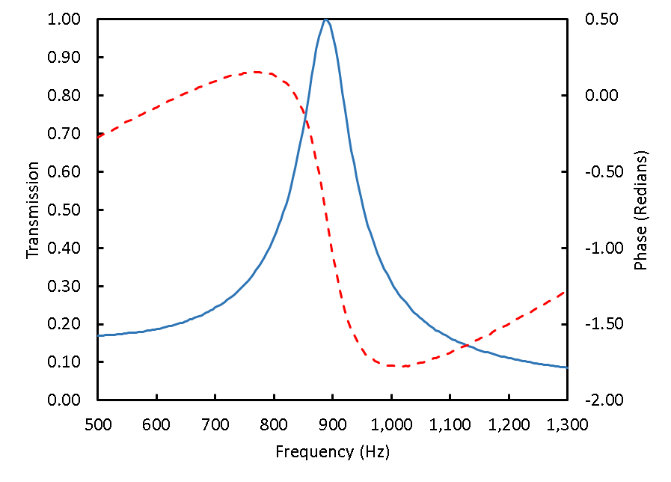
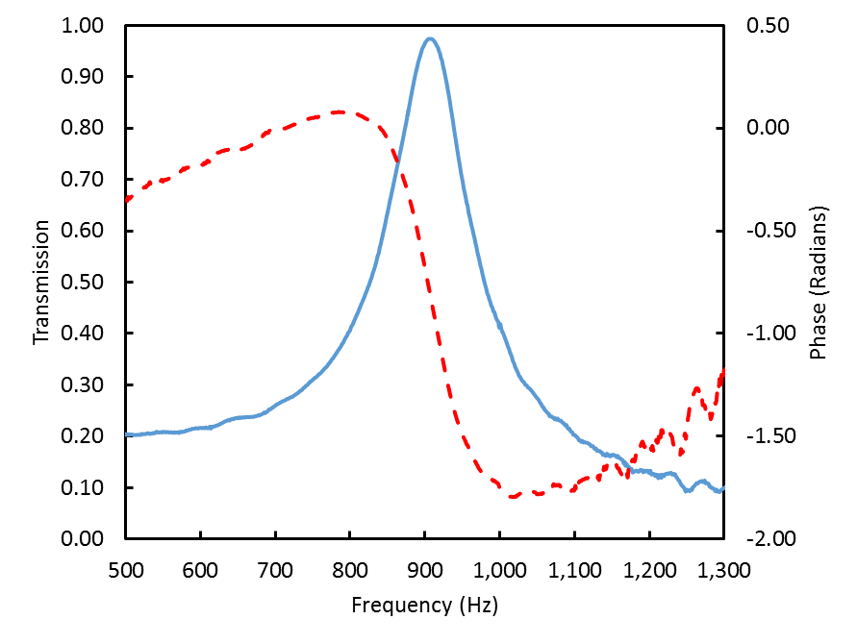
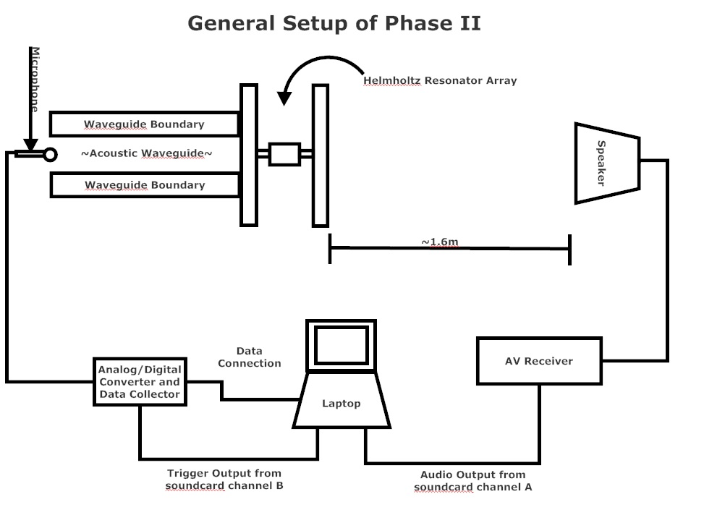
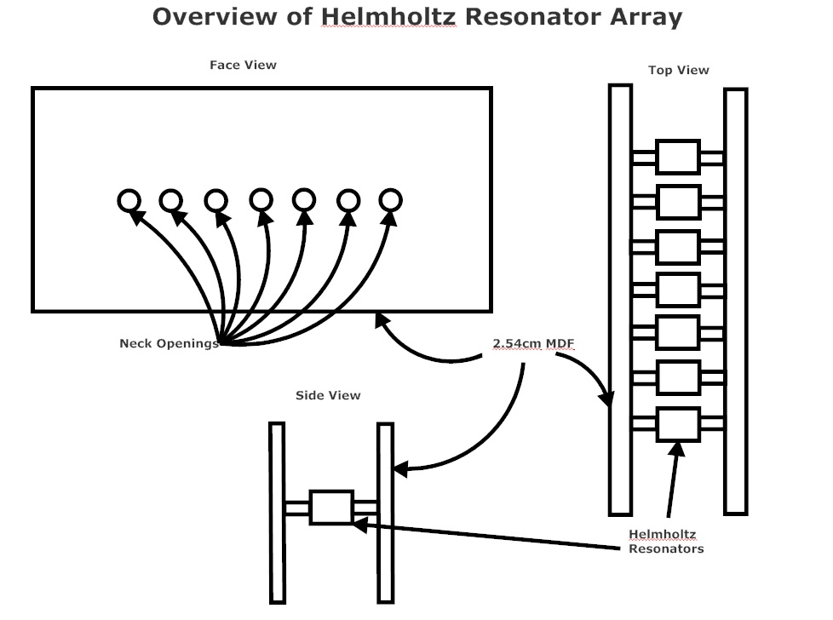
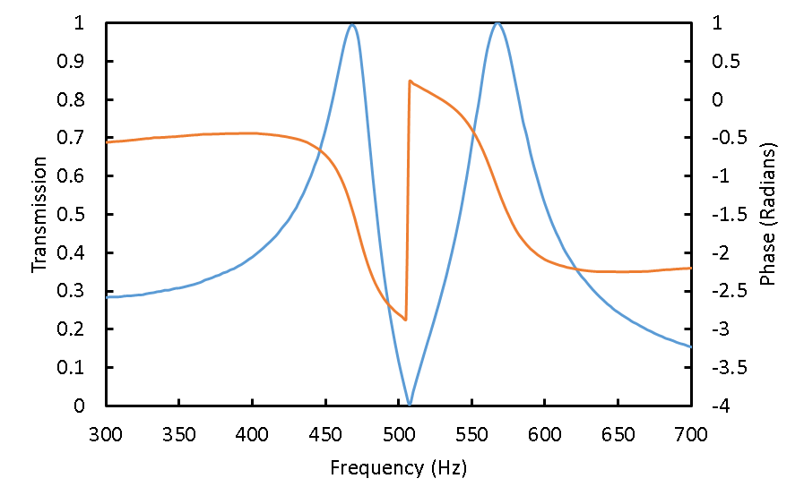
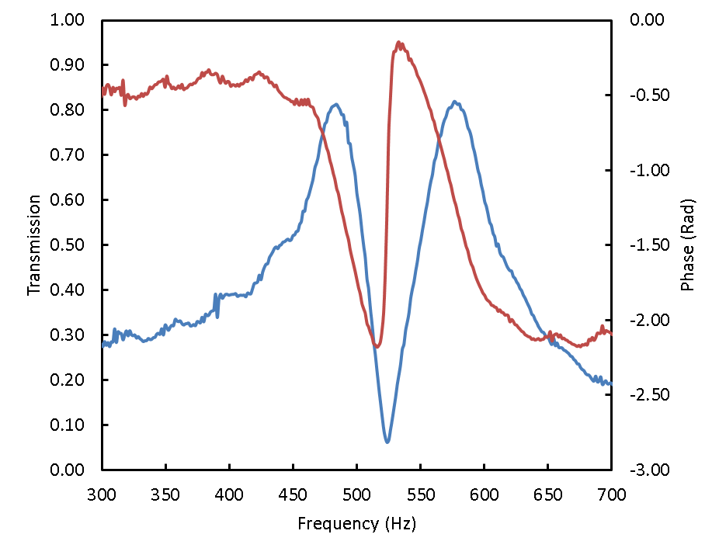
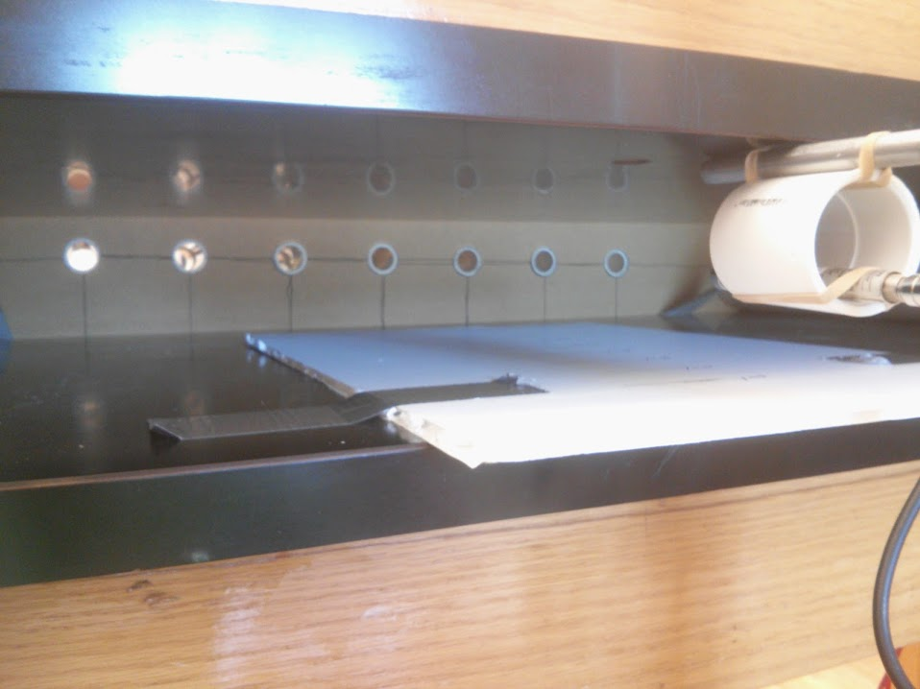

Experimental Realization of Extraordinary Acoustic Transmission using Helmholtz Resonators
Brian Crow, Jordan Cullen, William McKenzie, Vijay Koju, William M. Robertson Department of Physics & Astronomy
Methods
Data
Demonstration Of Acoustic Lens
Test signal reference versus signal in HR chamber
Coherent averaging of 100 tests per trial
Helmholtz resonator frequency: $f_{HR}=\left(\frac{v}{2π}\right)\sqrt{\frac{A}{L^{′}V}}$
Short duration “click” for finding HR frequency experimentally
Long duration wave packet “chirp” for testing phase shift of signal
Experimental Set-up of the HR in Wave Guide
Red depicts signal through an open pipe.
Blue depicts signal passed through HR in pipe.
Signals offset in graph for clarity.
Red depicts “chirp” centered at 910Hz passing through empty wave guide.
Blue depicts “chirp” passing through HR tuned to the same frequency.
Note time delay for the HR sound pulse.
A visualization of the acoustic power measured experimentally relative to reference signal through the acoustic lens (see General Setup of Phase II).
The focal point is approximately 30cm behind the lens depicted by the red peak.
Due to time constraints, data was gathered for the positive x direction only. The magnification of the lens mapped in figure above has been mirrored about the x=0 line under the assumption that a focusing apparatus works symmetrically.
Linear array of 7 HR’s offset by 20 HZ and 10 cm
900 Hz for central HR
840 Hz at ends
Analysis
Acoustic Transmission in One HR
Experimental Set-up of the Acoustic Lens
Summary and Conclusions
Experimentally demonstrated the phenomenon of extraordinary acoustic transmission (EAT) predicted previously in COMSOL simulations.
Used a Helmholtz Resonator (HR) to effect extraordinary transmission in a narrow frequency band.
Realized 97.5% transmission of acoustic amplitude through an orifice comprising only 6.25% of the total barrier area - over 15 times what is expected on area alone.
Realized a predictable, frequency-dependent phase shift demonstrating effective “trapping” of sound at the resonant frequency corresponding to group delay.
Showed interference behavior through two parallel HRs tuned to two slightly different frequencies in agreement with COMSOL simulation.
Observed phase shift in an array of HRs was utilized to design and test an acoustic lens.
COMSOL simulation of transmission (left)
Amplitude of transmitted sound through HR relative to reference signal in blue.
Phase change of signal in red. Negative slope indicates group velocity delay.
Spectral analysis of actual measured transmission.
97.5% transmission of 910Hz signal.
By comparison, there was 100% transmission in the simulation.
Two Parallel HRs - Small Freq Gap
References
V. Koju, E. Rowe, and W. M. Robertson, AIP Advances 4, 077132 (2014).
L. Kinsler, A. Frey, A. Coppens, and J. Sanders, Fundamentals of Acoustics, Third edition (John Wiley and Sons, New York, NY, 1982).
Z. G. Wang, S. H. Lee, C. K. Kim, C. M. Park, K. Nahm, and S. A. Nikitov, J. Appl. Phys. 103, 064907 (2008).
N. Fang, D. Xi, J. Xu, M. Ambati, W. Srituravanich, C. Sun, and X. Zhang, Nature Mater. 5, 452 (2006).
J. Fey and W. M. Robertson, J. Appl. Phys. 109, 114903 (2011).
J. Li, L. Fok, X. Yin, G. Bartal, and X. Zhang, Nature Materials 8, 931 (2009).
COMSOL simulation of transmission through two HRs with resonant frequencies within 100Hz in parallel.
As above, amplitude transmitted through parallel resonators relative to reference signal is in blue.
Phase of signal as a function of frequency is in red.
Spectral analysis of transmission through experimental configuration.
Transmission of signal in experimental setup is approximately 80%.
Positive phase shift between the resonance frequencies of the parallel resonators.
Photo of the Acoustic Lens

