Slide 1
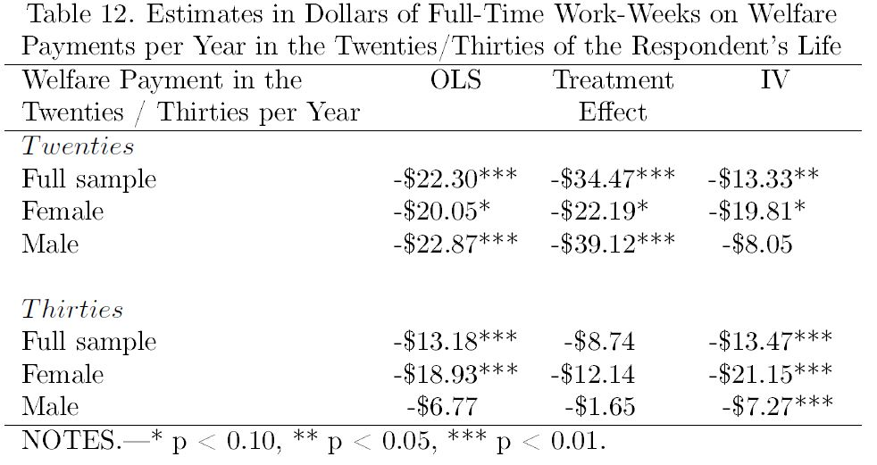
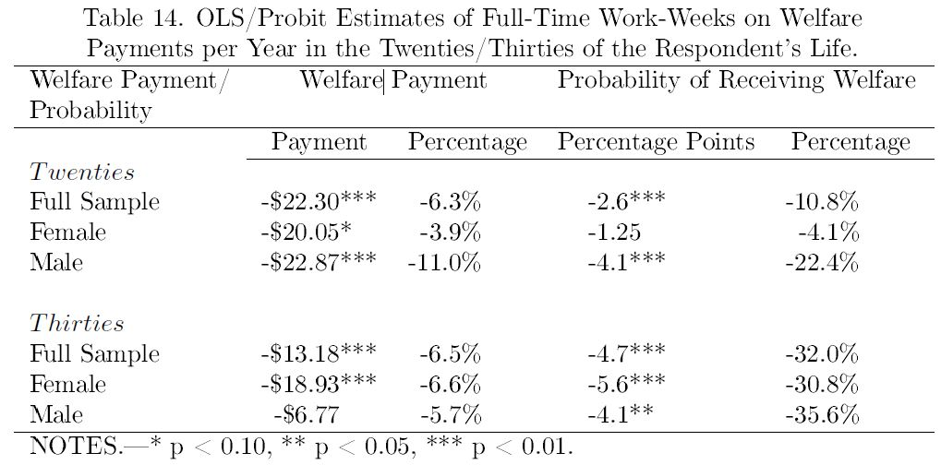
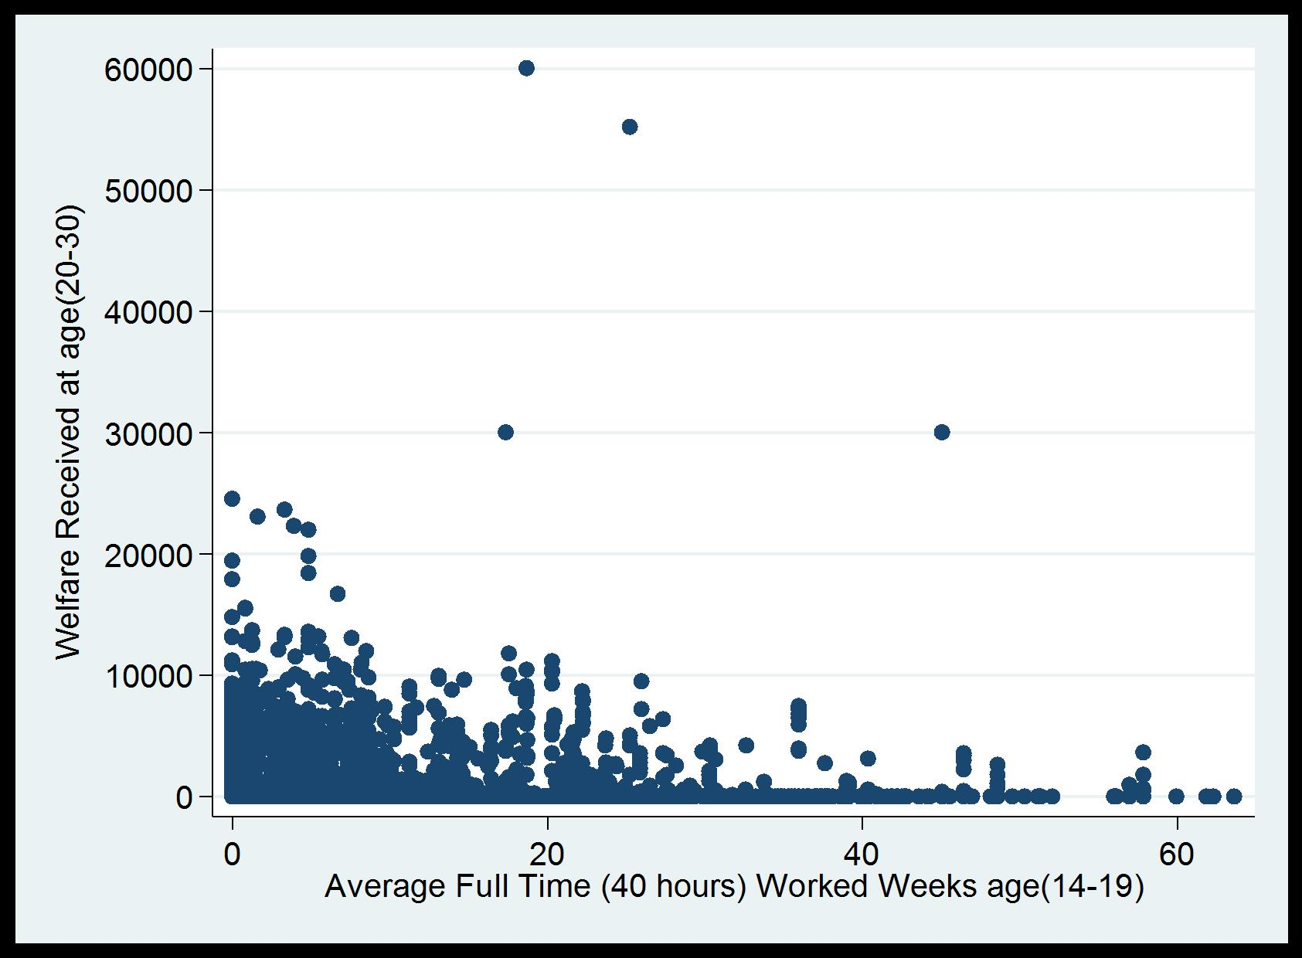

The Impact of Adolescence Employment on
Welfare Participation Later in Life
Fady Mansour
Department of Economics, Middle Tennessee State University.
Abstract
Materials & Methods
Results
Conclusion
This study is the first to employ welfare participation to investigate the impact of working during adolescence on outcomes later in life. I use National Longitudinal Survey of Youth (NLSY) 1997 data to investigate the impact of the average hours worked from age 14 through 19 on both the welfare payment and the probability of welfare participation in the twenties and thirties of the respondents’ life. I use a variety of different model specifications, including instrumental variables and Heckman selection models, to check the robustness of the results. The study shows that working one extra full-time week per year for an average individual between the ages of 14 to 19 will reduce the probability of receiving welfare in the twenties by 2.6 (10.8%) percentage points and the welfare payment received in the twenties by 6.3% per year. This impact is generated mainly from the hours worked during the ages of 17, 18 and 19.
Methods
Using data from the National Longitudinal Survey of Youth (NLSY) 1979, and a variety of different model specifications, including instrumental variables and Heckman selection models, this study shows that working one extra full-time week per year for an average individual between the ages of 14 to 19 reduces both the probability of receiving welfare by 2.6 percentage points (10.8%) in the individual's twenties and the welfare payments received in their twenties by 6.3% per year. Working one extra full-time week per year between the ages of 14 to 19 reduces the probability of receiving welfare by 4.7 percentage points (32%) when the individuals are in their thirties and the amount of welfare payments by 6.5% per year when they are in their thirties. Males are slightly more affected in their twenties than their females counterparts. Working an extra full-time week in their early life will reduce their welfare payments by 11% in their twenties compared with 3.9% for females. For males, working an extra full-time week early in life will reduce the likelihood of receiving welfare by 4.1 (22.4%) percentage points and 4.1 (35.6%) percentage points, in their twenties and thirties, respectively. For females, there is no significant impact on the likelihood of receiving welfare in their twenties, yet the impact in their thirties is significant, a reduction of 5.6 (30.8%) percentage points. The impact is generated mainly from working at the ages of 17, 18, and 19, with the greatest impact coming from working at the age of 17. This study provides evidence that work in adolescence increases the stock of human and social capital, and develops psychological barriers that reduce the likelihood of participating in a welfare program and the amount of welfare receipts. Using the Heckman selection model, the study accounts for subjects who were qualified yet did not participate in a welfare program. The model successfully predicts welfare participation through early life psychological characteristics and provides evidence that sensitivity to stigma and other psychological traits influence the take-up rate of welfare programs. By looking at the full-time work-weeks reported based on the age of the respondent instead of high school completion, this study is able to include subjects who did not graduate from high school in addition to high school graduates. This increases the representativeness of the sample and addresses a problem not taken into consideration in previous research.
I use a variety of different model specifications, including ordinary least square (OLS), probit, instrumental variables (IV), and Heckman selection models. The basic model controls for a wide set of covariates that represent demographics, personal characteristics, proxies for cognitive ability, and family background.
$$y_{it}= {αh}_{i}+{βh}_{i}^{2}+{γx}_{it}+ε_{it}$$
where $y_{it}$is the outcome variable, welfare receipts for individual $i$ at time $t$ . Each $t$ represents a calendar year from 1979 to 2012. The welfare payments received by respondents while being in their twenties, who were 14 years old in 1979, is estimated by tracking the payments received from 1986 (when he/she was 21 years old) to 1995. Welfare receipts in their thirties is monitored from 1996 to 2005. The key independent variable $h$ is the average number of full-time work-weeks which an individual worked between the ages of 14 and 19. Respondents who were identified as 14 years old by 1979 were interviewed in 1980; the number of hours they reported in 1980 represents the number of hours they worked at the age of 14. Likewise, the number of hours that they reported in 1981 to have worked since the last interview represents their worked hours when they were 15 years old, and so on. A variable hours squared is added to the regression to allow for a nonlinear impact of the early life work on welfare participation. A set of controls for demographics, personal characteristics, cognitive ability, and family background for individual $i$ at time $t$ is represented by $x_{it}$. The error term is $ε_{it}$. The coefficients of interest are $α$and $β$ ; the standard error for each parameter is reported separately. The probability value (P-value) for the hypothesis that both parameters $α$ and $β$ are jointly equal to zero is reported using an F-test or a likelihood ratio test.
Introduction
Previous research on the impact of working during adolescence on adult employment has focused on the employment channel: after high school, adolescents start to work in the same companies where they held entry-level positions during their high school years (Mortimer, 2003). Therefore, adolescent work experience matters for adult employment. However, with the decline in industry jobs, the character of adolescent employment has changed. Retail and service jobs are now most common for high school students and there is little expectation that these jobs will convert into an adult career. Increasingly, there is a lack of overlap between high school employment and adult work. As a consequence, the employment channel of youth employment declines in importance. In fact, the future wage premia associated with working during the senior year of high school have declined dramatically over the past 20 years (Baum and Ruhm, 2014). Studying two cohorts from the WWII and Babyboom generation, Aronson et al. (1996) find that the differences in the types of jobs held by adolescents between these two cohorts matter less than the psychological growth obtained through adolescent work. This points toward a very different channel of adolescent work and adult labor market outcomes. What appears to matter for adolescents is not the experience gained in job-specific human capital, but exposure to an environment that is rather different from high school. Working allows them to gain self-confidence, self-sufficiency, discipline, motivation, accountability, interpersonal skills, and most of all, responsibility (Aronson et al., 1996). I argue that the development of these psychological traits, rather than any job-specific skills, is the key outcome of working during adolescence. I further suggest that participation in welfare programs later in life is driven by the same psychological dimensions that connect working during early life with employment outcomes later in life. Therefore, I suggest that welfare participation later in life should be negatively related to working during adolescence. The various dimensions of psychological growth that Aronson et al. (1996) find are lower on average for people who are receiving welfare (Bruce and Waldman, 1991). This study is the first to use welfare participation to test the hypothesis that work in adolescence is beneficial in developing decision making skills and discipline, which in turn lay the groundwork for accumulating human and social capital. The key hypothesis is that this capital will eventually work as a barrier to participation in welfare programs later in life. Previous research has estimated the impact of work during adolescence on samples that included only people who remained in high school through graduation. This study includes also subjects who did not graduate from high school. This should increase the representativeness of the sample as welfare recipients later in life include a disproportionate number of people who failed to graduate from high school . Using data from the National Longitudinal Survey of Youth (NLSY) 1979, and a variety of different model specifications, including instrumental variables and Heckman selection models, the study finds a negative impact of early life work experience on the likelihood of participating in a welfare program later in life. In particular, working one extra full-time week per year for an average individual between the ages of 14 to 19 reduces both the probability of receiving welfare in the twenties by 2.6 percentage points (10.8%) and the welfare payment received in the twenties by 6.3% per year. Also, the probability of receiving welfare and welfare payment in their thirties is reduced by 4.7 percentage points (32%) and 6.5% per year, respectively.
This study has direct policy implications. it suggests that moderate adolescence employment may be instrumental in accumulating social and human capital that can help to reduce welfare participation later in life.
TRIFOLD AREA – THIS GUIDE WILL BE REMOVED BEFORE PRINTING – TRIFOLD AREA – THIS GUIDE WILL BE REMOVED BEFORE PRINTING – TRIFOLD AREA – THIS GUIDE WILL BE REMOVED BEFORE PRINTING – TRIFOLD AREA – THIS GUIDE WILL BE REMOVED BEFORE PRINTING – TRIFOLD
TRIFOLD AREA – THIS GUIDE WILL BE REMOVED BEFORE PRINTING – TRIFOLD AREA – THIS GUIDE WILL BE REMOVED BEFORE PRINTING – TRIFOLD AREA – THIS GUIDE WILL BE REMOVED BEFORE PRINTING – TRIFOLD AREA – THIS GUIDE WILL BE REMOVED BEFORE PRINTING – TRIFOLD
Participants
Data come from the National Longitudinal Survey of Youth (NLSY) 1979, a nationally representative sample of 12,686 young men and women between the ages of 14-22 years old when they were first surveyed in 1979. These individuals were surveyed on an annual basis until 1994 and biannually thereafter. The survey includes detailed questions on educational attainment, high school test scores, Armed Forces Qualification Test (AFQT) and Armed Services Vocational Aptitude Battery (ASVAB) test scores, income and assets, number of children, alcohol and substance abuse, parental information, sexual activity, and marital and fertility histories. Additional labor force data includes hours worked, earnings, occupation, industry, benefits, and other specific job characteristics. In order to monitor the respondents from the age of 14 through 19, I limit the sample to include only the individuals that were 14 years old in 1979 (950 respondents) when they were first interviewed.
Limitation
Family and individual characteristics that we are unable to observe in the data could affect both early life employment and future welfare participation.
A family fostering responsibility and self-dependence would positively affect their children’s early life employment and welfare participation in the future, causing upward biasedness toward a greater effect for early life employment.
A distaste for school or preference to work could also bias the results.
An individual with a high tendency to work would be more likely to work when young and less likely to receive welfare in the future. An individual with distaste for both school and work is expected to work less when young and is more likely to receive welfare in the future, causing an upward bias.
A behavior such as taking drugs in early life would cause a downward bias. An individual with such a behavior is expected to work less when he is young and is more likely to receive welfare when he is old due to health problems or disabilities. An individual with a family background of poverty is expected to work more hours in his/her early life and also is more likely to receive welfare in the future; that would cause a downward biased result. I use a wide set of variables as controls in order to overcome the problem of endogeneity. These variables represent demographic characteristics, cognitive ability, various aspects of individual characteristics, and family background. I also use instrumental variables and Heckman selection models to minimize the bias and to check the robustness of the results.
Acknowledgements
I would like to thank DR. Zietz for his support and his invaluable detailed advices on grammar, organization, and the theme of the paper.
I am immensely grateful to DR. Baum, DR. Debacker, and DR. Owens for their comments on an earlier version of the manuscript.
Contact Information
Fady Mansour
Email: fmm2f@mtmail.mtsu.edu
Phone: (804) 714-9278

