Slide 1
Longitudinal Journal Usage Analysis and the Development of Institutional Specific Core Journals
Retrospective Analysis
Rachel Kirk
Larry Hansard

Slide 2
What we wanted to know
1. How many of our journals are used consistently?
2. Does the pattern of use follow Pareto’s Law
3. Which journals were highly used in 2012, 2013, 2014?
4. Which journals showed low usage in at least two of those years?
5. Which journals were never used in all three years?

Slide 3
Why we wanted to know the answers to those questions?
Current usage reports such as JR1 (R4) and Usage Consolidation products provide a wealth of data, but analyzing the data beyond cost-per-use ratios lacks a widely used methodology.
Establishing patterns in data and submitting them to tests such as Pareto’s Law provides librarians with a framework for contextualizing the usage numbers.

Slide 4
Why we wanted to know the answers to those questions? (2)
If we knew which journals were both consistently and highly used during a three year period, we could create a core journal list for the library as well as the academic disciplines of our university.
If we could identify journals that were rarely or never used during the three year period, we could de-clutter our electronic holdings.

Slide 5
Pilot Project (2013)
In August 2014, an analysis of journal usage by subject was created for calendar year 2013.
The findings of this analysis were informative and sometimes unexpected.
Medical journals were highly used. This usage was surprising because MTSU does not have a medical school.
The analyses was shared with our Dean, who conferred with the Dean of the College of Basic and Applied Science (BAS). The Dean of (BAS) confirmed that most of the research conducted in that college related to Medicine.
Journal analyses were distributed to liaisons based on their assigned academic programs.
Many journals that could not be associated with any specific academic subjects. New categories were created for interdisciplinary/multidisciplinary, trade, consumer, and industry.

Slide 6
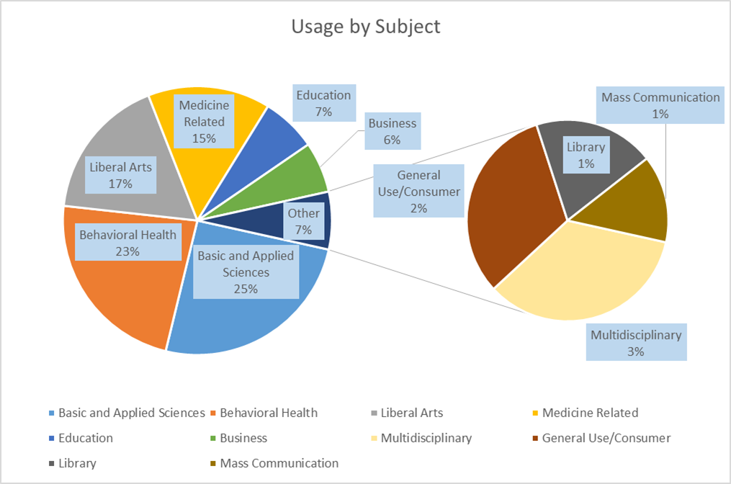
Results of 2013 Journal Analysis

Slide 7
Extending the 2013 Journal Analysis to find longitudinal patterns
While the 2013 analysis was helpful, an analysis that follows journal usage patterns over time, would be more informative.
The journal usage patterns that are consistent over a three year period provide the parameters for an institution-specific core collection.
The next step is to normalize the data from three calendar years and create a dataset that includes all of the information.

Slide 8
Approach to normalizing and analyzing journal usage data
Created a dataset for each year (2012, 2013, 2014) by downloading the SWETS products usage consolidation product.
Integrated vendor supplied JR1 reports from vendors who were not part of the SWETS platform into these datasets.
Assigned subject headings to every journal title based on my knowledge of Middle Tennessee State University’s (MTSU) programs and by referring to ULRICHS.com.
Because Ulrich’s.com often provided more than one subject heading for a journal, a judgement was made about which subject should be assigned based on MTSU’s curriculum.
In these subject heading assignments, the first priority was to assign subjects to journals in as close alignment as possible to MTSU’s curriculum.
The assignment of subject values remained a subjective process.

Slide 9
Observations gleaned by preparing the dataset
Each year’s data set was composed by a higher number than expected “new” journals or journals that had not been in the previous year’s data set.
In each year’s data set, many journals had not been used at all. A very few had been used of 1,000 times.
Data normalization was extremely time consuming. Beyond applying a subject to each journal, these categories had to be reviewed for consistency and the format of the data had to be standardized.
I noticed that many of the journal titles used were actually “ceased” according to Ulrichs.

Slide 10
How three years of data were combined into one data set
Sorted dataset by Title, ISSN, Platform, Vendor using UNIX sort command
“sort +1 -2 +2 -3 +6 -7 +5 -6 –t”|” allyears >allyears2”

Slide 11
Combining three years of data into one data set
Combined all 3 years into one data set using UNIX cat command
Example:
“cat file1 > allyears”
“cat file2 >> allyears”
“cat file3 >> allyears”

Slide 12
Combining three years of data into one data set
Example of output data set:
2014|ABA Journal|0747-0088|2162-7983|Law|American Bar Association|EBSCOhost|
2012|ABA Journal|0747-0088|2162-7983|Law|West Information Publishing Group|EBSCOhost|
2013|ABA Journal|0747-0088|2162-7983|Law|West Information Publishing Group|EBSCOhost|
2014|ABA Journal|0747-0088|no data|Law|American Bar Association|Gale|
2013|ABA Journal|0747-0088|no data|Law|American Law Association|GOLD|
2014|ABA Journal|0747-0088|2162-7983|Law|American Bar Association|JSTOR|
2013|ABA Journal|0747-0088|2162-7983|Law|American Law Association|JSTOR|
2012|ABA Journal|0747-0088||Law|American Bar Association|ProQuest|
2014|ABA Journal of Labor & Employment Law|2156-4809|no data|Law|American Bar Association|JSTOR|
2013|ABA Journal of Labor & Employment Law|2156-4809|no data|Business Law|American Law Association|JSTOR|

Slide 13
Combining three years of data into one data set
Created UNIX script to determine the totals for what years we had:
Years 2012, 2013, 2014
Years 2012, 2013
Years 2012, 2014
Years 2013, 2014
One year either 2012 or 2013 or 2014

Slide 14
Combining three years of data into one data set
The result, Created a dataset with an instance for each unique occurrence of a journal title, ISSN, publisher, and platform, regardless of year.

Slide 15
Research Questions 1-3
R1. What is the percentage of journals used (as defined as at least 1 full-text download) to journals offered? Do these percentages conform to Pareto’s Law?
R2. How many journal titles exist within this dataset with same titles, ISSNs, publishers, and platforms during the three year period (with any usage during each year)?
R3. How many journal titles exist within this dataset with same titles, ISSNs, publishers, and platforms during the second and third year period (with any usage during each year)?

Slide 16
Research Questions 4 thru 6
R4. How many journal titles exist within this dataset with same titles, ISSNs, publishers, and platforms during the second and first period (with any usage during each year)?
R5. How many journal titles exist within this dataset with same titles, ISSNs, publishers, and platforms during the third and first period (with any usage during each year)?
R6. Journal titles with same titles, ISSNs, and platforms during the three year period (with no usage during any year)?

Slide 17
R1 Finding: Percentage of online journals with one or more full-text downloads vs. available online journals
 | 2012 | 2013 | 2014
Online journals with one or more full-text downloads | 13,446 | 10,726 | 19,055
Available online journals | 62,727 | 66,000 | 78,970
Percentage | 21.44% | 16.25% | 24.13%
MTSU’s percentage of journals used vs. journal available for use generally conforms to Pareto’s 80/20 rule.

Slide 18
R2 Finding: The number of journal titles within this dataset with same titles, ISSNs, and platforms during the three year period (with any usage during each year)?
 | 2012 | 2013 | 2014
Online journals with one or more full-text downloads during 3 years | 5,928 | 5,928 | 5,928
Online journals titles used | 13,704 | 10,727 | 19,055
Percentage | 43% | 55% | 20%
The 5,928 journals came from 1,711 publishers

Slide 19
R3. How many journal titles exist within this dataset with same titles, ISSNs, and platforms during the second and third years (with any usage during each year)?
3,308 Journals
The 3,308 journals came from 34 publishers

Slide 20
R4. How many journal titles exist within this dataset with same titles, ISSNs, publishers, and platforms during the second and first years (with any usage during each year)?
446 journal titles are used in both 2012 and 2013
Full text usage for these journals in 2012 39,325
Full text usage for these journals in 2013 9,411
The 446 journals came from 230 publishers

Slide 21
R5. How many journal titles exist within this dataset with same titles, ISSNs, publishers, and platforms during the first and third years (with any usage during each year)?
2,694 journals had full text usage in both 2012 and 2014
2012 full text usage of these journals 11,759
2014 full text usage of these journals 11,103
The 2,694 journals came from 935 publishers

Slide 22
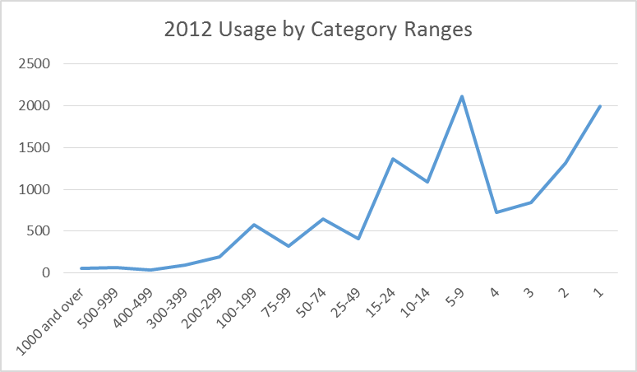

Slide 23
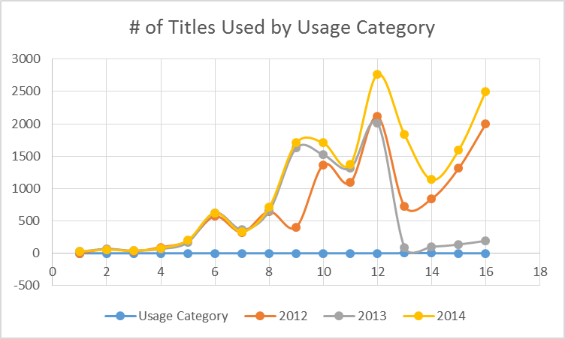
1= 1000+ and 16 =1

Slide 24
Next Steps …..
Analyze the full-text journals in subject categories to determine if Pareto’s Law is constant among different subjects. If not, which subjects are the outliers?
Propose MTSU core journal collection based on journals with consistently high usage within a subjects.
Create a collection development strategy that focuses on preserving core journal collections while annually assessing usage in specific academic disciplines.

Slide 25
Next Steps (2) …..
Provide Library Liaisons with the core list findings for their subject assignments.
Continue to add to the dataset by integrating 2015 journal usage.
Analyze four years of data to analyze.
Determine if previous usage trends continue over time.

Slide 26
Questions?
Contact Information
Rachel Kirk, Professor, James E. Walker Library at Middle Tennessee State University, Email: Rachel.Kirk@mtsu.edu
Larry Hansard, Assistant Professor, James E. Walker Library at Middle Tennessee State University, Email: Larry.Hansard@mtsu.edu

