Slide 1

MTSU Show and Tell
TNIUG Meeting 2014
Loading Records and Shelf Ready
Larry Hansard, Suzanne Mangrum and Linda Turney

Slide 2
Overview
In the fall of 2011 Walker library made the decision to move to a full approval plan.
We also decided to implement shelf-ready materials
Worked with our primary vendor, YBP, and OCLC WorldCat Cataloging Partners
Use Sierra’s EAPI loader for approval orders
Use Data Exchange and Sierra’s EAPI loader for firm shelf ready orders
Use Data Exchange for Electronic Firm orders and DDA

Slide 3
Shelf Ready – YBP (approvals & firms)
We have been using YBP since 2009 for a small approval plan
In late 2011 we expanded our profile to include all subjects
Familiar workflow and a profile that was already in place led us to stay with YBP. We have implemented shelf-ready for firms and approvals
We are also planning to expand to another vendor this year.

Slide 4
Setting Up the Profiles
YBP was very supportive in this process
Worked through YBP to set up information that YBP would include in each order record
YBP then worked with us to set up our OCLC profile

Slide 5
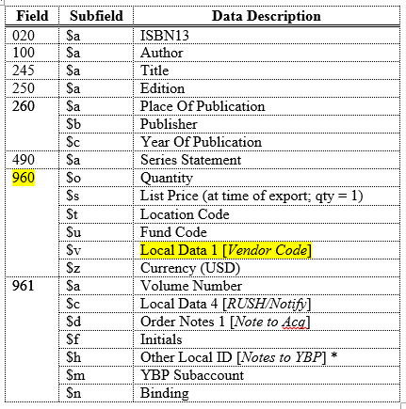
Setting Up Order Record Information
YBP record info

Slide 6
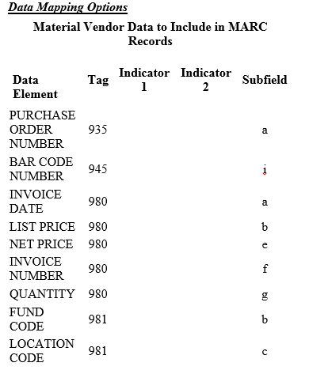
YBP and WCP Profiling

Slide 7
All About Loaders

Slide 8
Approval Orders

Slide 9
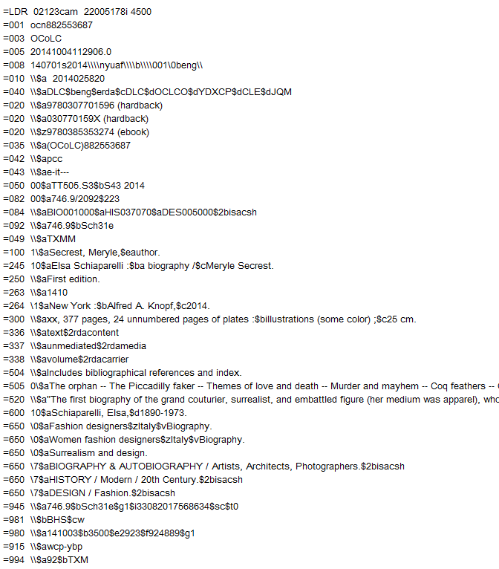
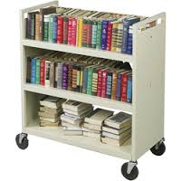

Slide 10
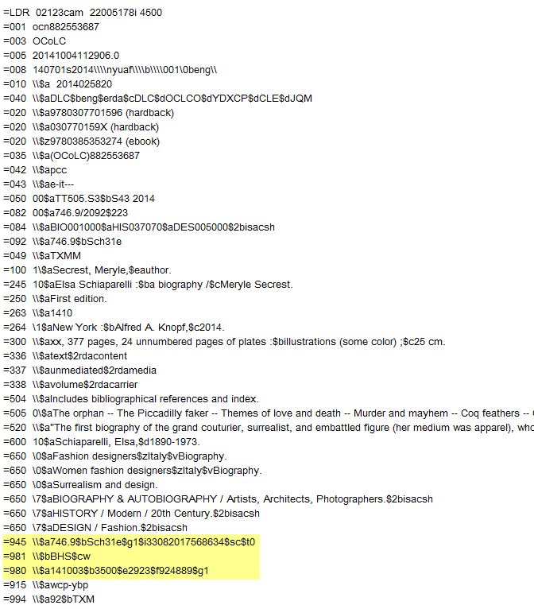

Slide 11
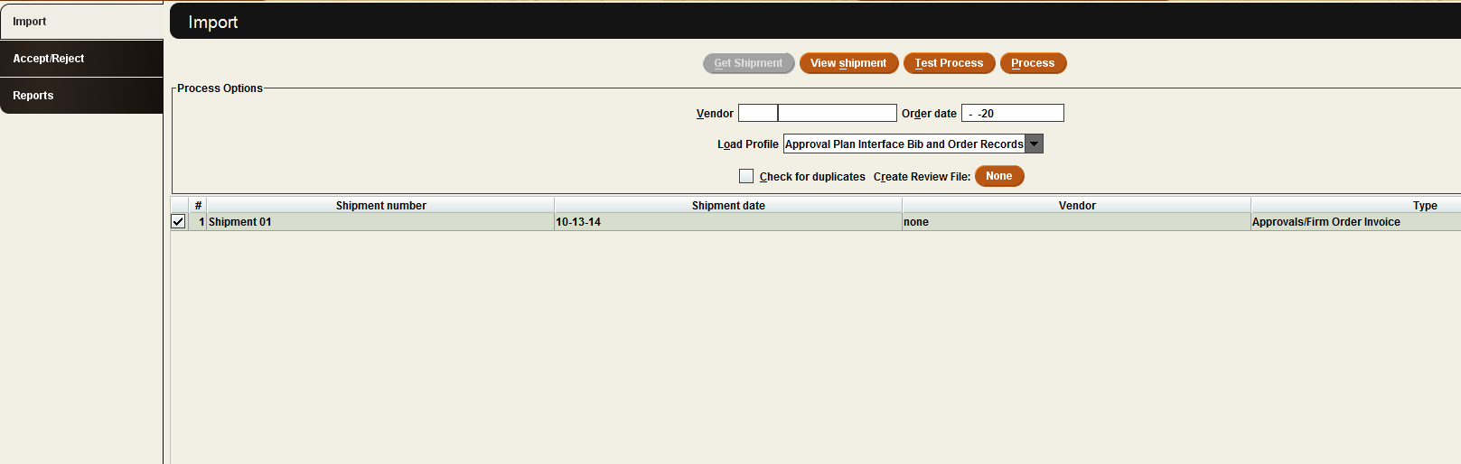
Importing records into Sierra - EAPI

Slide 12
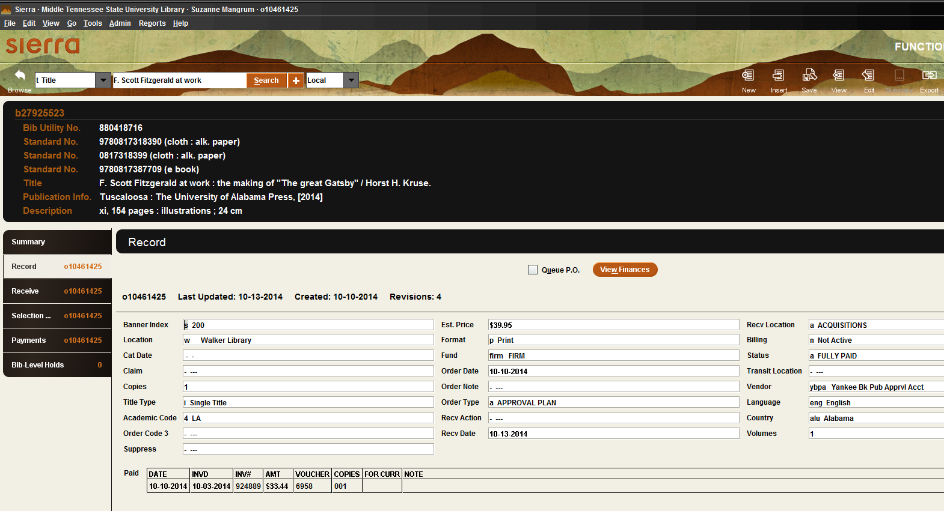

Slide 13
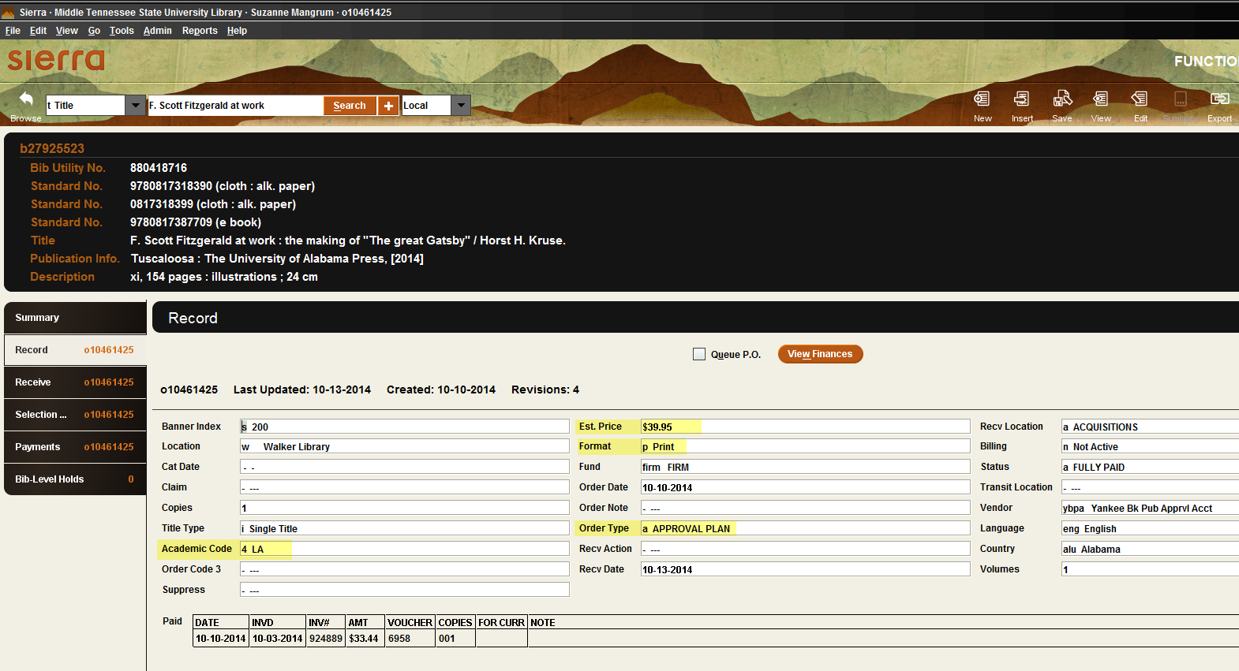

Slide 14
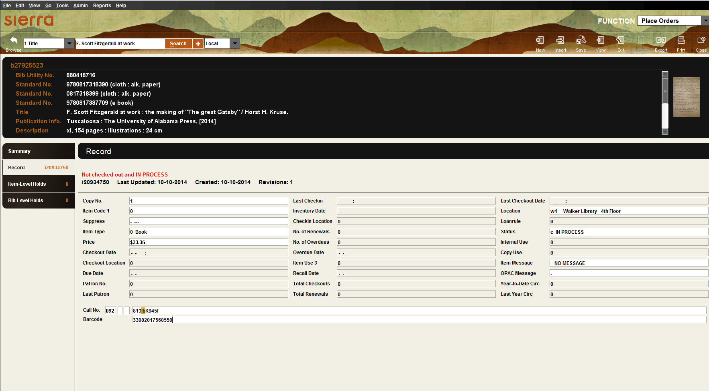

Slide 15
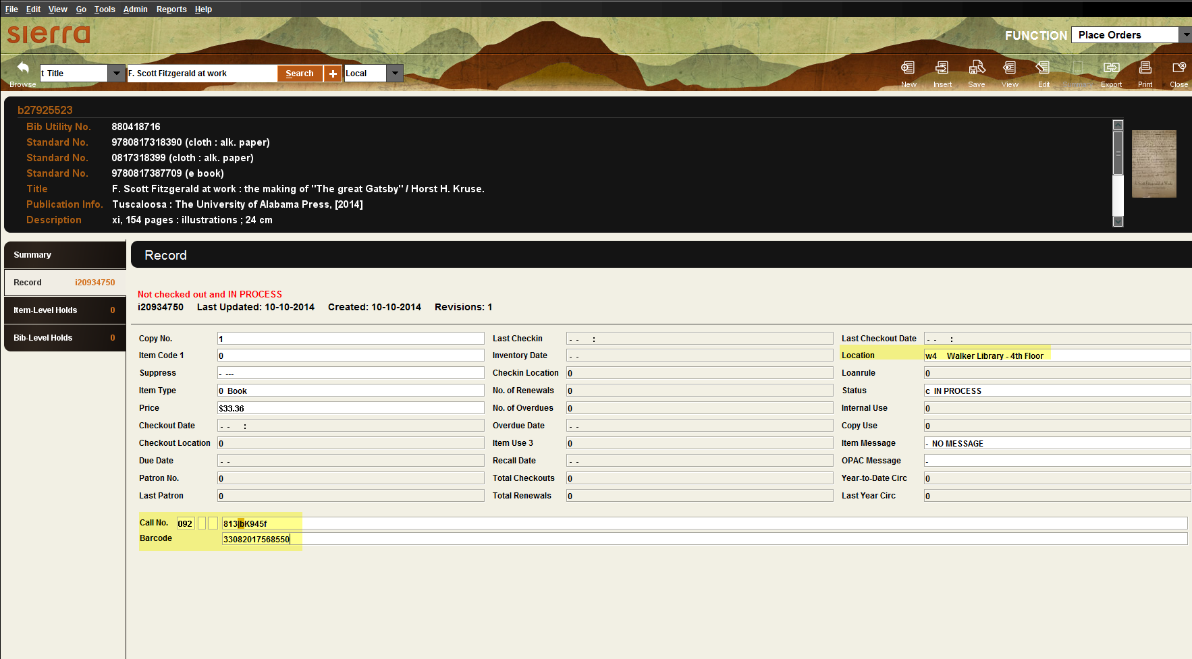

Slide 16
Firm Orders

Slide 17
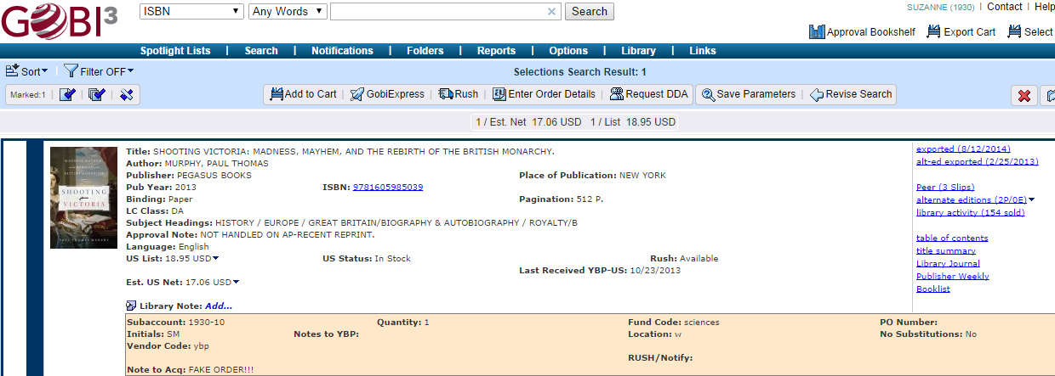
Process begins in GOBI

Slide 18
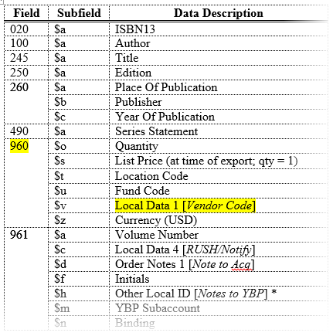
Process begins in GOBI

Slide 19
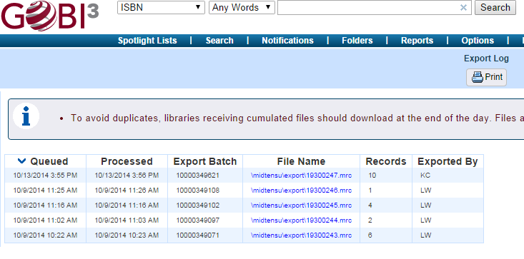

Slide 20
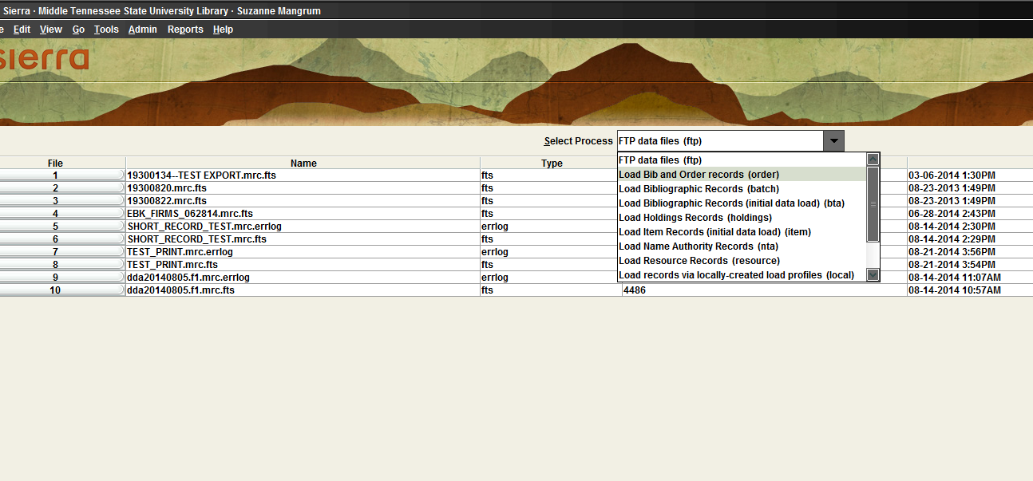
Data Exchange

Slide 21
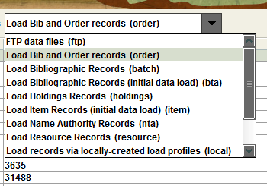
Data Exchange

Slide 22
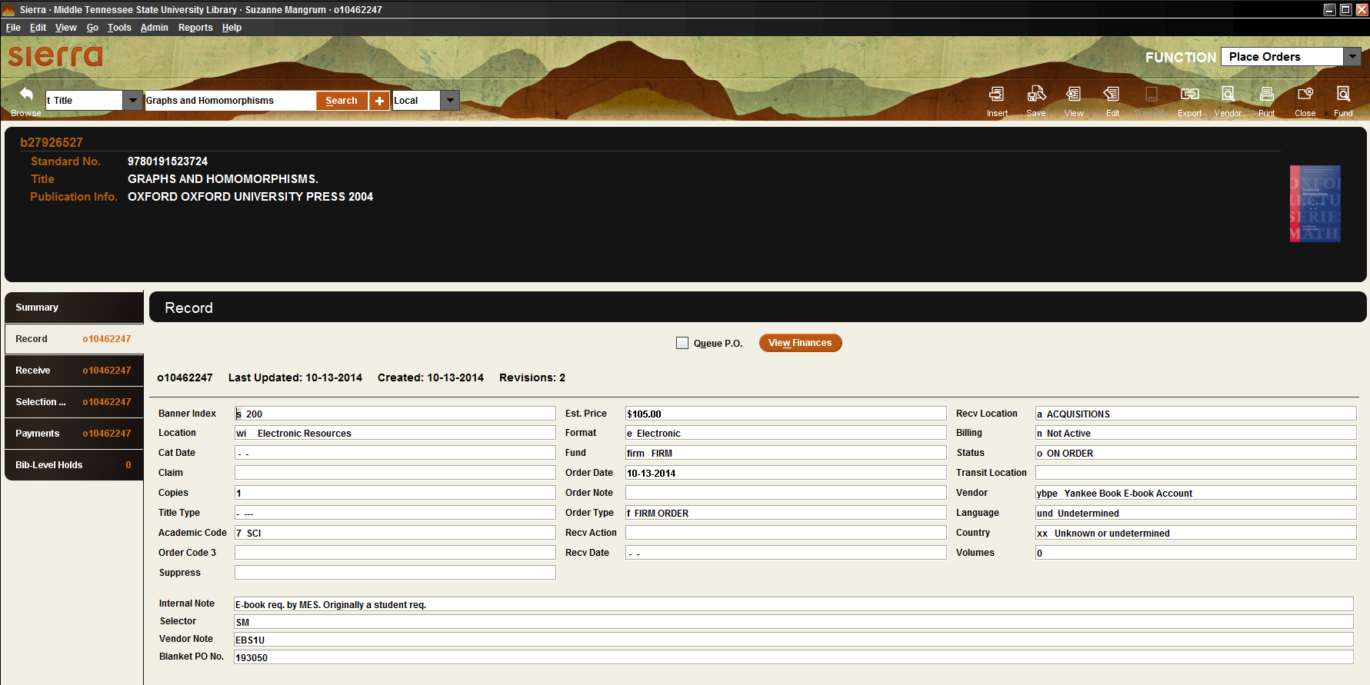

Slide 23
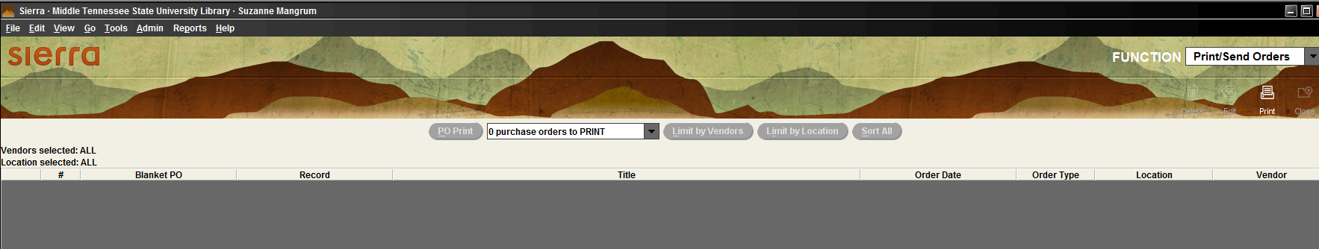
EDI Order to YBP

Slide 24


Slide 25
Importing records into Sierra - EAPI
Separate vendor codes are used because our YBP profiles are different. Some things are included on approval records that are not included on firm records.

Slide 26
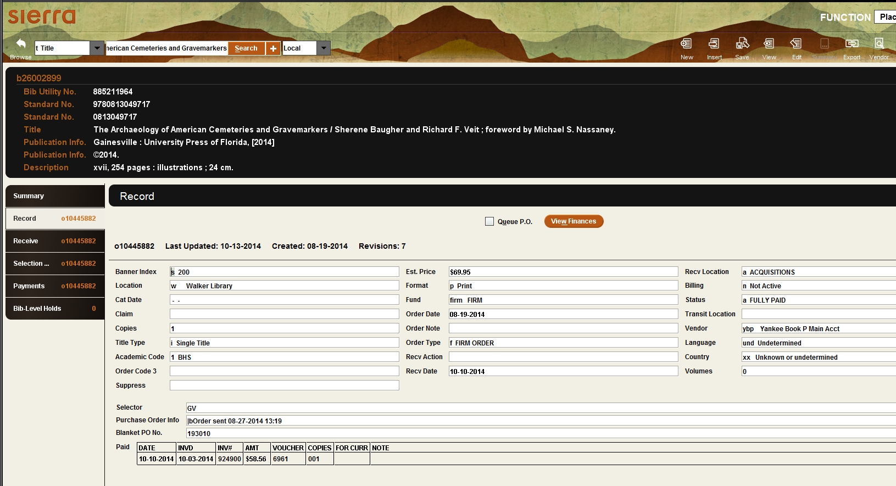

Slide 27
Other Workflow Changes
Receiving process changed to include review of shelf ready materials and separate shelf ready from what needed to go to the catalogers
We also now run a report to determine the certain factors of the records to pull books with sub-par marc records.
Frees up time…to learn new workflows for e-books and DDA!

