Slide 1

Circulation
not just about books
Notes:
NOTE: Want a different image on this slide? Select the picture and delete it. Now click the Pictures icon in the placeholder to insert your own image.

Slide 2
Extending our check out period
Main collection items check out for a full semester
How to handle other collections
Patron types other than MTSU Student/Staff

Slide 3
Collections
Media: videos, DVD, and Audiobooks
Music: CD, Scores, etc.
Curriculum
Popular Reading
Reserves

Slide 4
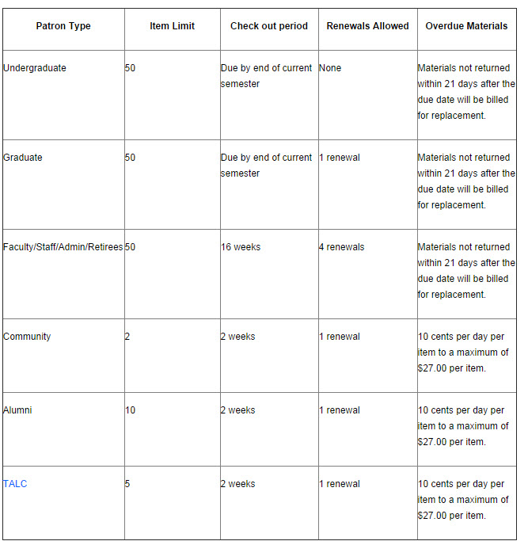
Patron Types
First consideration always students, faculty, staff/admin
Community, Alumni, TALC policies
Visitors/Partnerships

Slide 5
Collections and Considerations
Curriculum
Textbooks
Children's books
Media
Audiobooks
Video Cassette
Music
CD
Scores
Reserves
DVD
Library items
Professor's personal copies
MTSU Information
Curriculum items

Slide 6

We still have books!
Change in check out = easier for students with long-term research needs.
Every item type check out period was created with main users in mind.
Intended to encourage usage and increase access.

Slide 7
Circulation: Not just about books
Part two

Slide 8
Sierra Item Types and Check Out

Slide 9
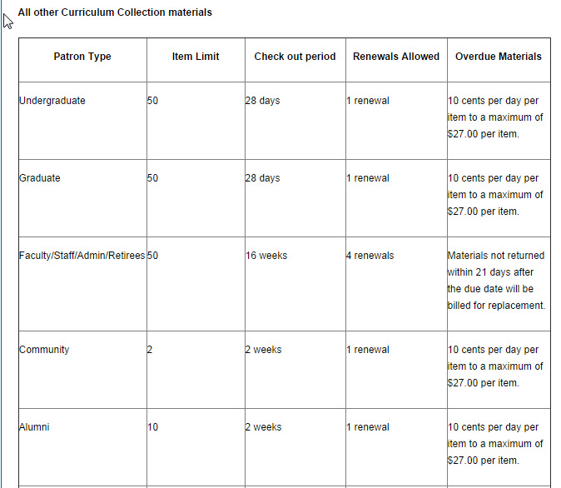
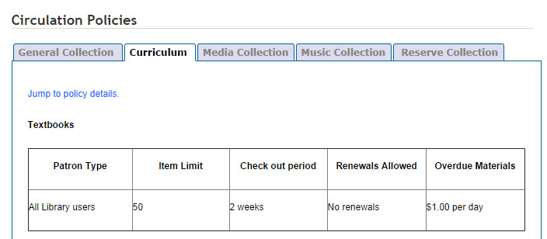
Curriculum Collection
Children's Books
State Adopted Textbooks

Slide 10
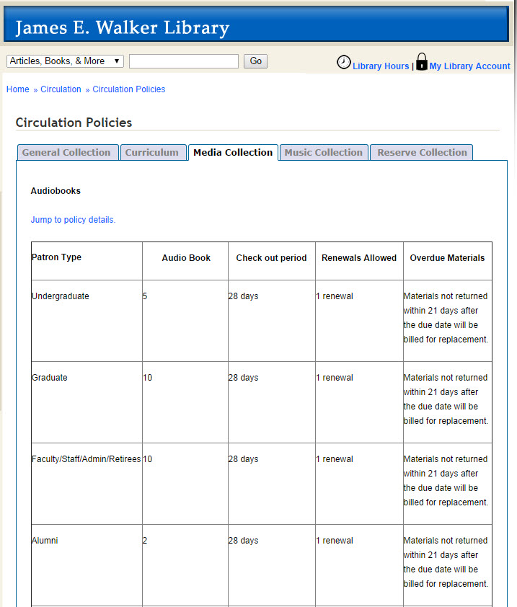
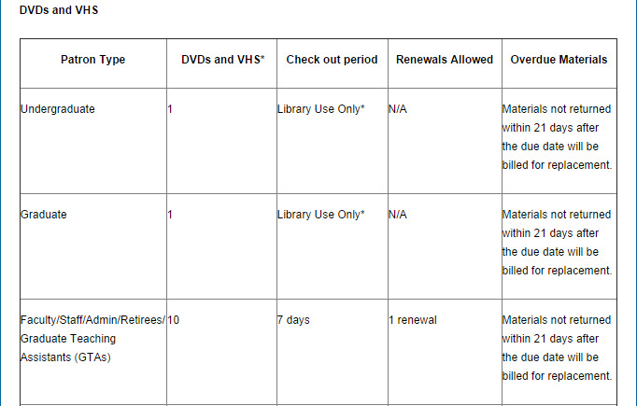
Media Collection
Audio Books
DVD/Video Cassettes

Slide 11
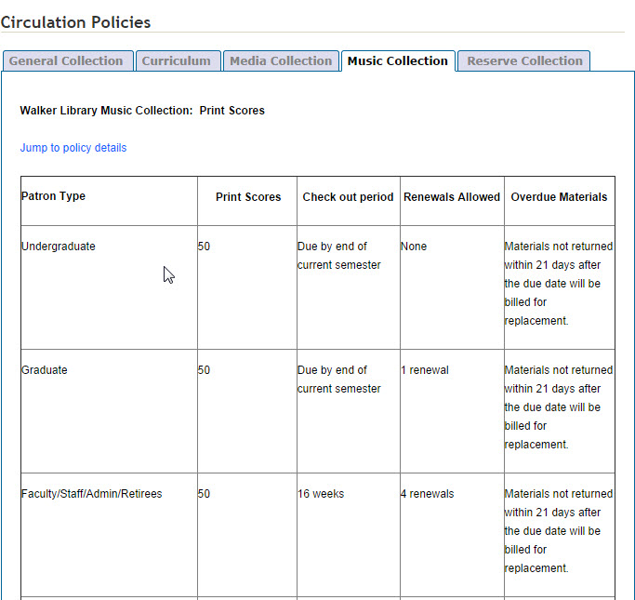
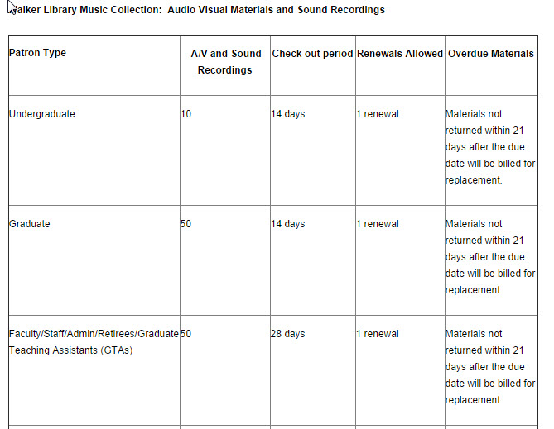
Music Collection
Audio Visual Materials & Sound Recordings
Print Scores

Slide 12
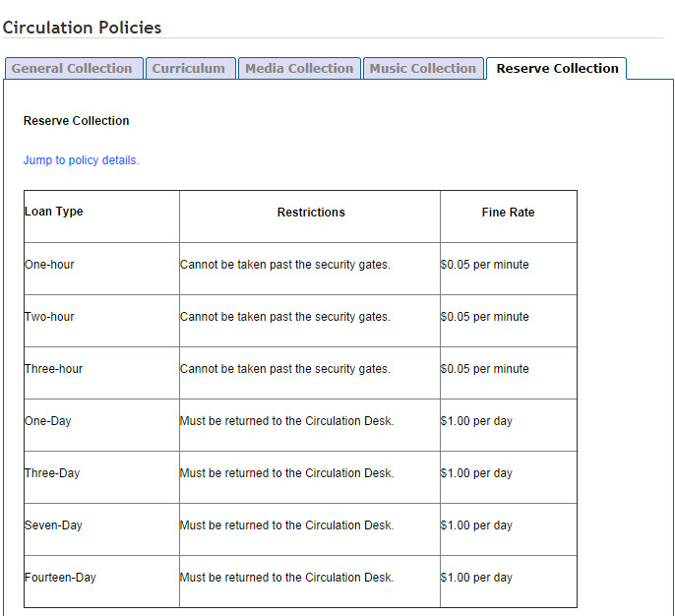
Reserves

Slide 13
10th Annual Circulation Conference
Memphis Public Library
June 19, 2014
Internal Customer Service
Technology you can check out
Balancing Career and Personal Life
Safety
Keeping Up Morale

Slide 14
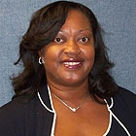
Focusing on the Internal Customer
Attitude is closely connected to how you serve others.
Listen more, be observant, be direct
Saying things appropriately to people
Talk to coworkers (interview); don't just go on perception, assumptions
SMART objectives: know what they are, come up with goals for unit and individuals
Customer Service Vision- shows others what is expected to be accomplished
Care about the others in your organization
Gauge "normal" and then extend an olive branch if coworkers are off
Believe in others; love your business; respect your coworkers and customer
People don't leave jobs; people leave people.
Find ways to relax. Go for a walk. Find something humorous. Read, meditate, whatever at least 15 minutes a day
Choose different words- learn to say what you learned from a mistake. Train your mind to do something. Write down negative phrases so you can stop saying them.
Book: the Simple Truths of Service
Berlinda Williams-Strong

Slide 15
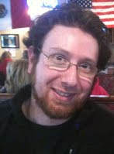
Putting Technology in the Hands of Patrons
Webcam w/ built in mic - use for test monitoring
Portable scanners- 2 cords, both USB. Recognized by the computer as external device. Auto detects paper size. Very quick, software is loaded with device.
Extra monitor- more like tech for patron's benefit than checkout. See what you're viewing.
MP3 player - iTunesU, podcasts, build collections on music player. Music appreciation class- can load all required materials.
3D printer - 5th gen makerbot 3D lab. Self-service. 1 hour training required. Free to students. Free CAD training. 2 3D printers, 1 maker bot digitizer, 1 dell optic lex in lab.
K'nex education kits - STEM - circulate to educators. Roller coaster physics, etc. come with lesson plans
Engineering technology- soldering irons, multimeter
Zeb Mathews

Slide 16
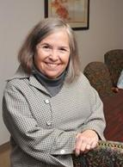
Balancing Career and Personal Life
Imbalance happens. Don't make it the norm.
Mental health crisis: crisis can't go on beyond 6 weeks. Once it goes beyond that time, it is the norm.
One of the main benefits if working is the social aspect.
Set priorities- important/urgent, important/not urgent,
Interruptions and distractions: avoid, reschedule, assert and say no.
Say no to yourself when you spend time on trivial activities.
Sleep- do it. Bodies need routine maintenance.
Keep a short list of 5 minute tasks to do while you wait
Plan time with your partner/friends
Judy Bookman

Slide 17
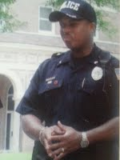
Is the Library a Safe Place?
Contact your Campus Police or local authorities
Use clear, concise language. No codes
Document all situations
Install metal detectors if possible
Develop a plan for emergencies and train other staff
Seargeant Marco Anderson

Slide 18
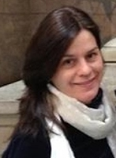
Keeping Up Morale in Tough Times
Low morale symptoms- do staff members look professional? Are they getting complaints? Don't care, miss work
Poor communication!! Lack of training, limited professional growth, no common goals, no accountability.
Silos - lack of communication with other depts
Both sides at fault- leadership doesn't communicate, no atmosphere of trust, no team vision
Staff - no motivation, gossip, bicker, chronic absenteeism.
Influence morale- make an effort to vain respect. Dress professionally and arrive on time. Allow room for creativity, share knowledge. Trust
Provide recognition and appreciation
Practice transparency
Mentorship -especially with student workers
Thank-you-gram. Positive note for great service/performance.
Yvonne Mills

Slide 19
Questions
Your Topics
Tour of Circulation

