Slide 1
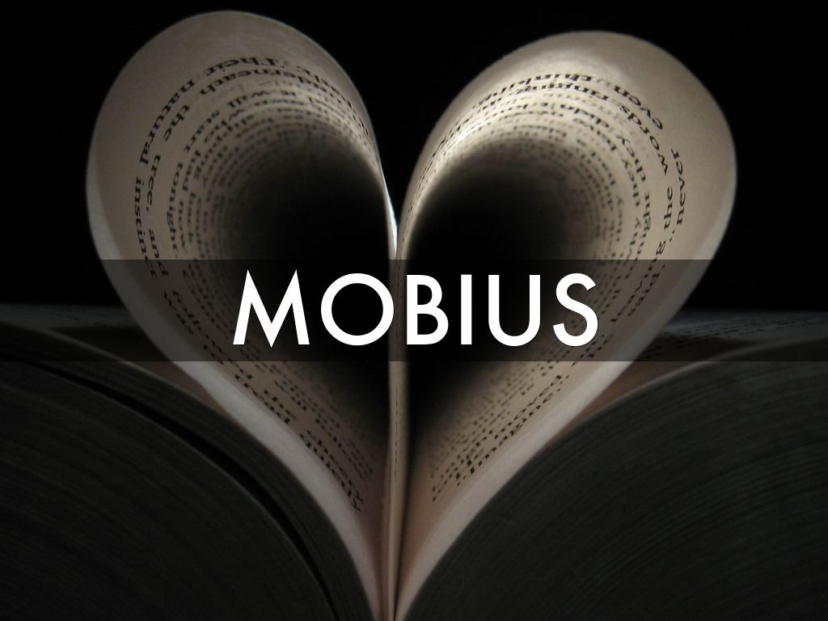
Photo by Chocolate Geek - Creative Commons Attribution-NonCommercial-ShareAlike License https://www.flickr.com/photos/75632859@N00
Created with Haiku Deck

Slide 2
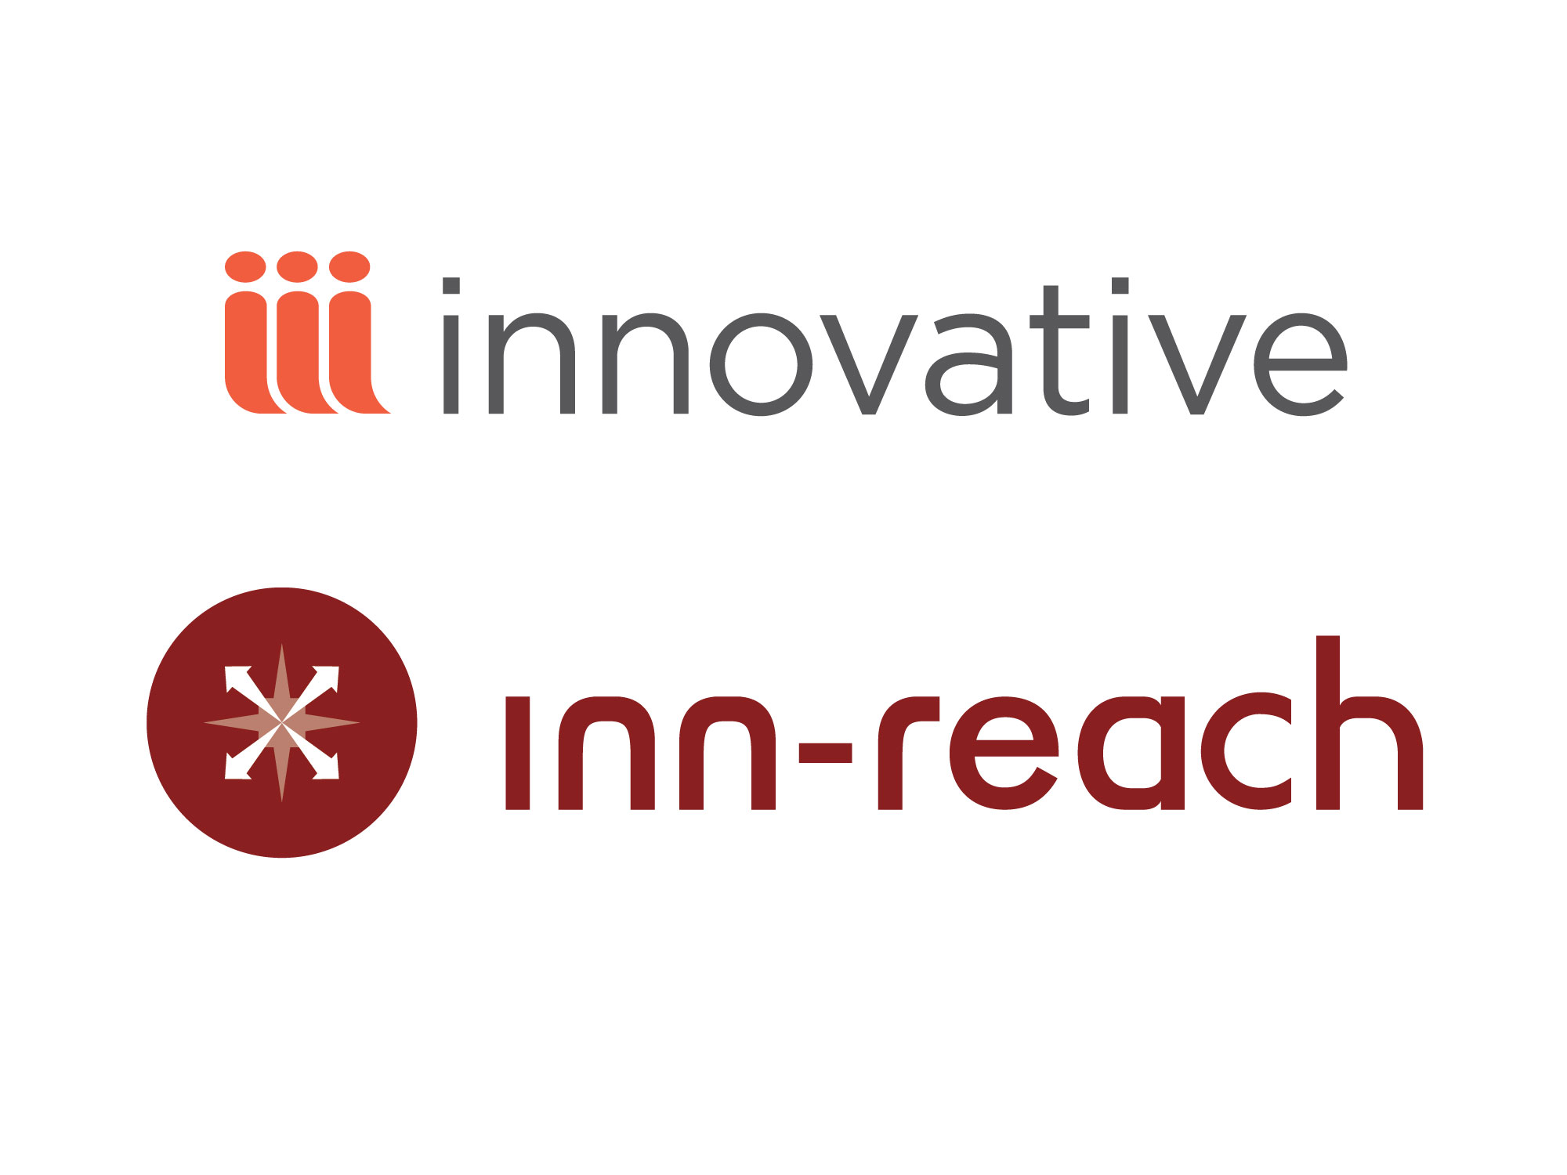

Slide 3


Slide 4
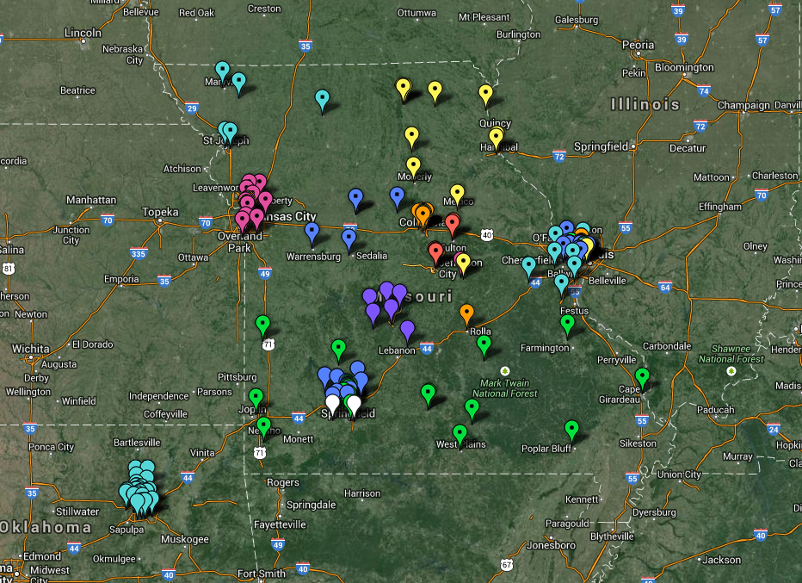

Slide 5


Slide 6


Slide 7

14 Four Year Public
27 Four Year Private
6 Two Year Public
6 Community Colleges
5 Seminaries
4 Medical Libraries
4 Law Libraries
5 Public Libraries
4 Special Libraries

Slide 8

Over 27 million items
Over 10 million unique holdings

Slide 9

MOBIUS libraries borrow twice as often and lend nearly three times as often through the MOBIUS Union Catalog as they do their local catalog. Books arrive in 2 to 3 days.

Slide 10
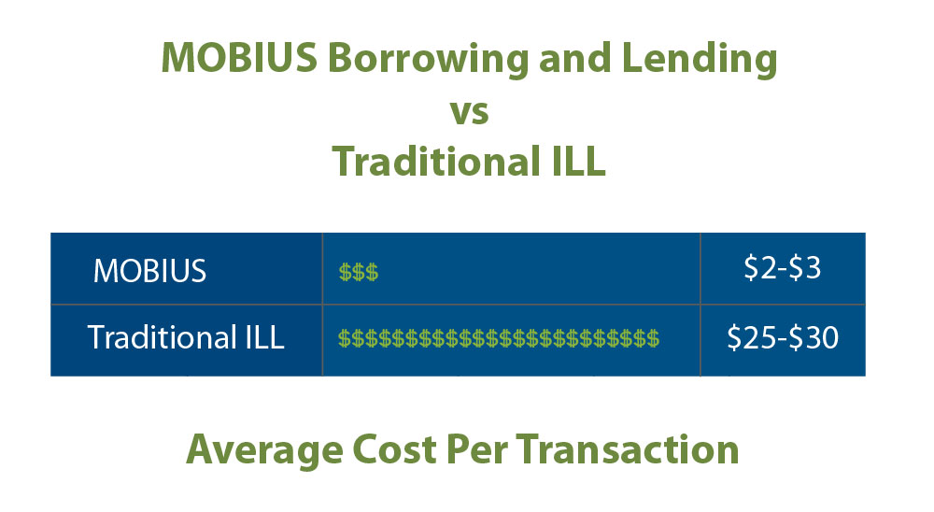

Slide 11

Photo by roger g1 - Creative Commons Attribution-NonCommercial-ShareAlike License https://www.flickr.com/photos/52721565@N00
Created with Haiku Deck

Slide 12


Slide 13

What is Peer-to-Peer?
A product from Innovative Interfaces that allows InnReach systems to interface with each other.
The Inn-Reach systems remain separate and discrete without merging bibliographic databases
First 6 weeks over 1,800 items were lent and borrowed

Slide 14
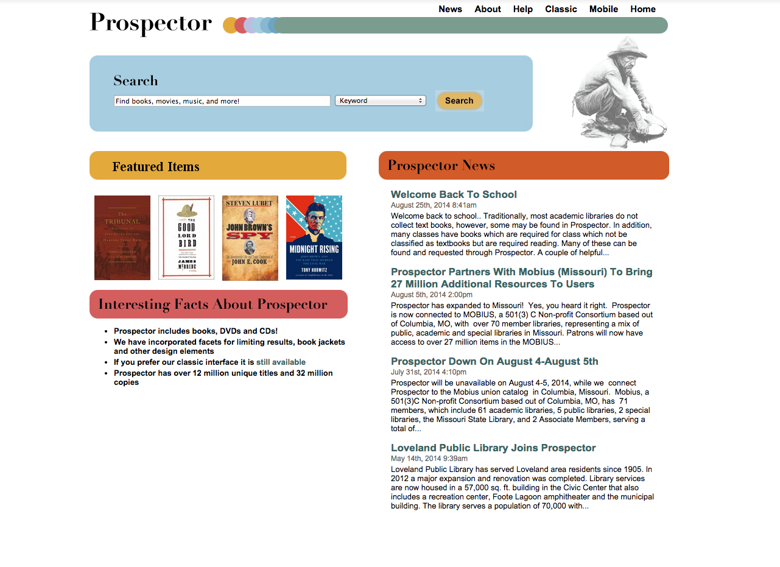

Slide 15






Slide 16


Slide 17
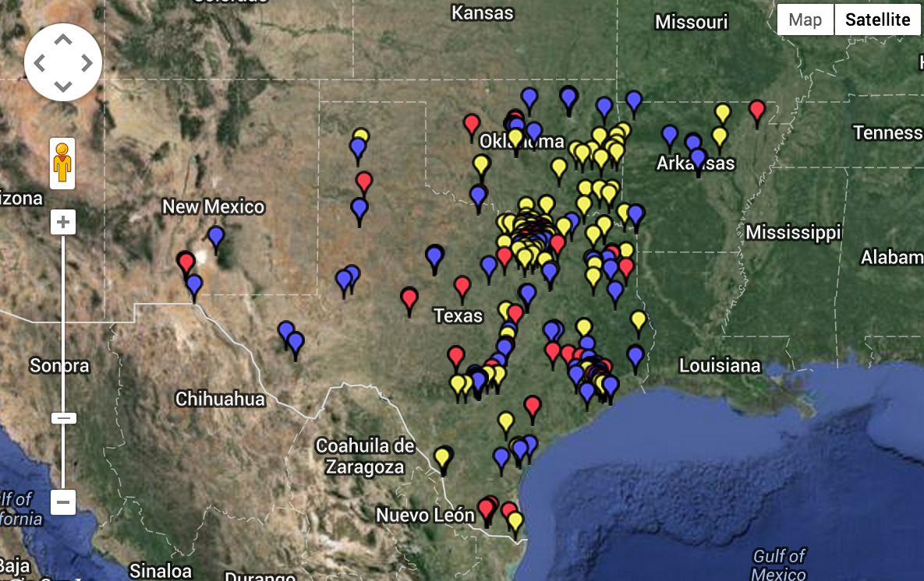

Slide 18
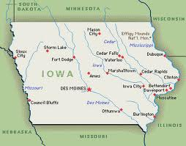
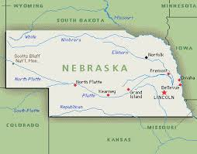
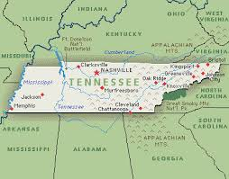
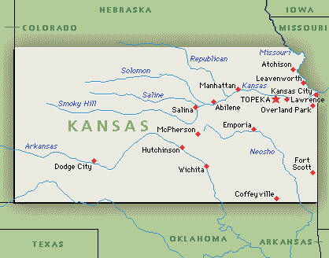
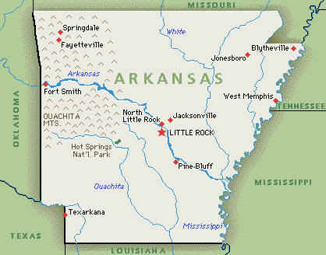

Slide 19


The Missing Piece in Your Information Puzzle

Slide 20
Why we should partner?
Patron Initiated Borrowing
Streamlined re-directed search to the MOBIUS Union Catalog from your local catalog
Easy access to 27 million items at MOBIUS and 33 million items from Prospector.
InnReach is tightly integrated with the Innovative circulation system making it fast and efficient for library staff
Significant cost savings over traditional ILL
Complementary collections
Courier service—cost savings and increased response time
Potential future project coordination
Potential access to other consortia collections
Participation in a regional resource sharing system

Slide 21
How can we partner ?
Standalone Member Library, Local library managed
Standalone Member Library, MOBIUS managed
Cluster Library Member, MOBIUS managed
Non-Innovative Library, Local library managed

