Slide 1



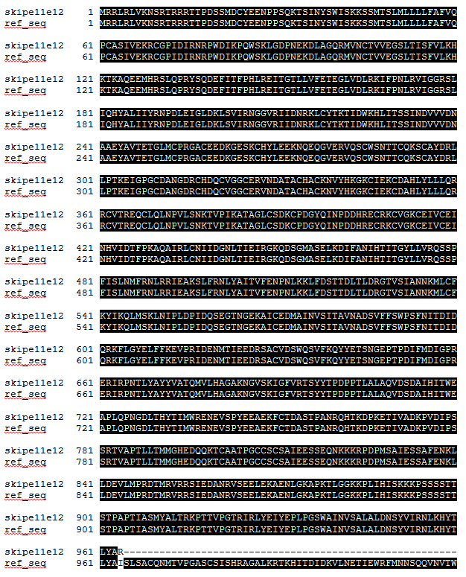
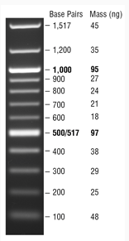
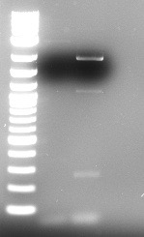
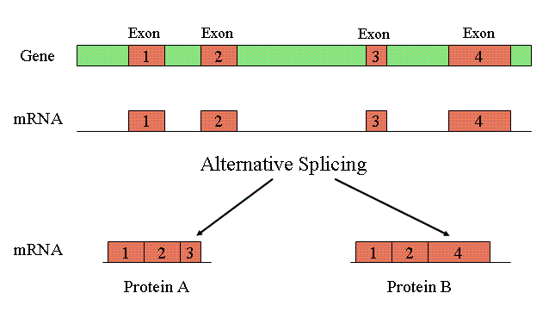
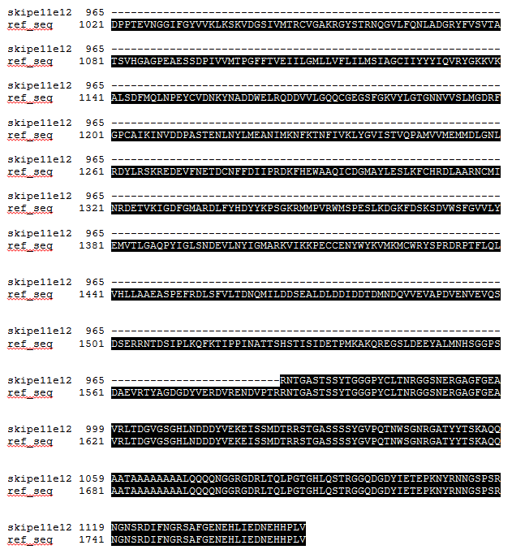
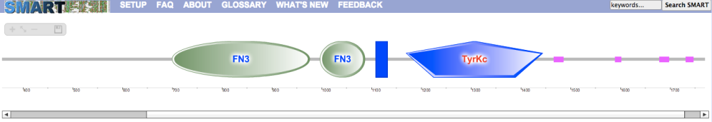
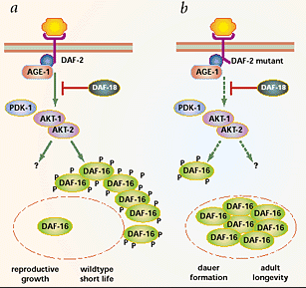
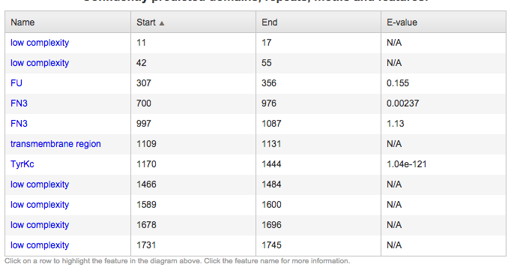
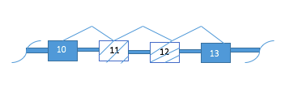

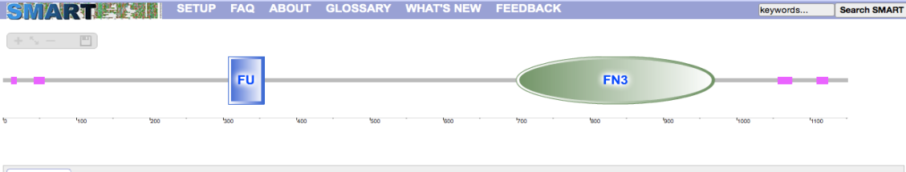
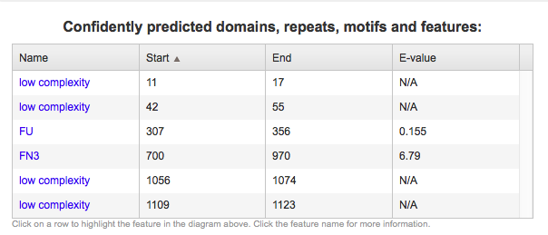
Alternative mRNA Splicing Analysis of DAF-2 During Hydrogen Peroxide Stress
Mahmuda Akter, Paige Fairrow-Davis, and Rebecca Seipelt-Thiemann
Honors Genetics, Middle Tennessee State University
Introduction
Hypothesis
Alignment of DAF2 Isoforms
RT-PCR Gel-Electrophoresis on RNA from
Control and Peroxide-Exposed Nematodes
Marker
H₂O₂
Control
Not all genes in the genome are expressed in every cell.
Regulation of gene expression can occur at many levels including transcription, splicing, nuclear export, RNA decay, and translation.
Alternative mRNA splicing, which is a common gene regulation mechanism in eukaryotes, occurs when one gene encodes multiple proteins (isoforms).
The RNAs produced via AS may differ in mRNA stability and the proteins produced via AS may differ in function, enzyme activity, or binding properties.
RNAs can be spliced differently in response to environmental exposures, including stress.
In response to stress , via hydrogen peroxide exposure,
DAF-2 mRNA will be alternatively spliced to produce
mRNA encoding a non-functional protein, by removal of the
tyrosine kinase domain.
Methods
1
The actual and reference sequence for nematode DAF-2 were mapped based on resources at the National Center for Biotechnology Information (REF), Aceview (REF), and Wormbase (REF).
Regions of alternative splicing were identified from the maps. Protein domains of all isoforms were determined using SMART domain analysis (REF)
Nematodes were cultured and exposed to H₂O₂ or medium for 24 hours (REF)
5
6
Reverse transcriptase-polymerase chain reaction (RT-PCR) was performed to generate DNA fragments corresponding to a specific region of DAF-2 mRNA.
7
Agarose gel electrophoresis for is performed on the cDNA.
8
DNA fragment sizes were determined based on comparison to a known DNA standard.
4
RNA was isolated from nematodes for both conditions
Primers for polymerase chain reaction were designed using Primer3Plus (REF)
2
3
The observed fragment sizes were compared to the expected sizes for alternatively spliced mRNA for both conditions.
9
Fig. 5 RT-PCR Analysis of RNA from control and peroxide-treated set, using 1.5% agarose gel electrophoresis.
(NCBI)
Conclusions
The cDNA from the control showed 4 fragments on the gel electrophoresis approximately at- 1915bp, 1150bp, 380bp and 49 bp.
The cDNA from the worms under the treatment of 20mM of H₂O₂ showed only one fragment at approximately 49 bp.
The splicing of the domain TyrKc was significantly different under different environmental conditions.
We can conclude that, under different environmental conditions, the domain TyrKc of DAF-2 mRNA is spliced alternatively.
This would result in production of only the non-functional protein isoform during this stress.
We, therefore, do not reject our hypothesis that peroxide stress will result in DAF-2 mRNA alternatively spliced to produce a non-functional protein, by removal of the tyrosine kinase domain.
In addition, two other mRNA isoforms that were not predicted by the existing data were detected in control RNAs.
Figure 2. Multiple alignment of the Isoform with the Reference Sequence of DAF-2.
DAF-2 Gene
DAF-2 is a multi-exon gene found on chromosome III in the nematode Caenorhabditis elegans (C. elegans).
This gene encodes the insulin growth factor receptor tyrosine kinase DAF-2 and has homologs in many species including humans.
This gene functions in embryonic and larval development, reproduction, adult longevity, and even fat storage.
DAF-2 also plays a role in the formation of dauer (the long-lived state) when put under stress.
Isoform Protein Domains
Fragment Sizes for
Expected Isoforms
REFSEQ
- E10-E11-E12-E13-
Expected cDNA size: 1915 bp
Isoform_1
--E10-[skipE11]-[skipE12]-E13--
Expected cDNA size: 49 bp
Future Directions
Fig 3. Confidently Predicted Domains for DAF-2 Reference Sequence (SMART).
Future research should focus on the identification of the two uncharacterized isoforms detected in this study and also confirmation of the exact identification of the two other detected isoform species.
(Larsen, 2001)
Fig 1. Alternative mRNA Splicing DAF-2
References
Map of DAF-2 Gene
Larsen, P. 1993. Aging and resistance to oxidative damage in Caenorhabditis elegans. VOL.90. University of Missouri,Columbia. 8905-8909 P.
Larsen PL. 2001. Asking the age-old questions. Nature Genetics 28: 102 – 104.
http://www.ncbi.nlm.nih.gov/gene/175410
https://genome.ucsc.edu/cgi-bin/hgPcr
http://www.expasy.org
http://pir.georgetown.edu
http://smart.embl-heidelberg.de
http://www.wormbase.org/#01-23-6
(Wormbase)
Fig 4. Confidently Predicted Domains for DAF-2 Isoform 1 (SMART). Note that the domain TyrKc is missing in the Isoform 1 structure.
.
Notes:
http://pir.georgetown.edu

