Slide 1
MINING ORDER RECORDS

Slide 2
2 Funds
Firm
Continuing

Slide 3
4 Banner indexes
Firm 200
Continuing 300
Utilities 500
TAF 700
Recorded as one index in Sierra (a.k.a Not Firms)

Slide 4
2 Acq Units
Acquisitions
Continuing Resources

Slide 5
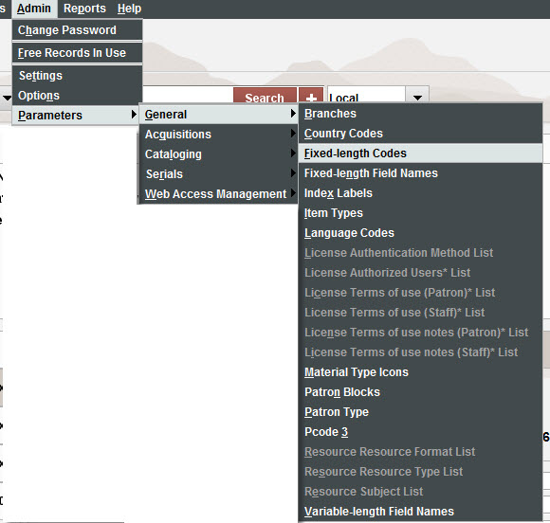
Modifying Order Record Fixed Fields
Admin/Parameters/General/Fixed-length codes

Slide 6
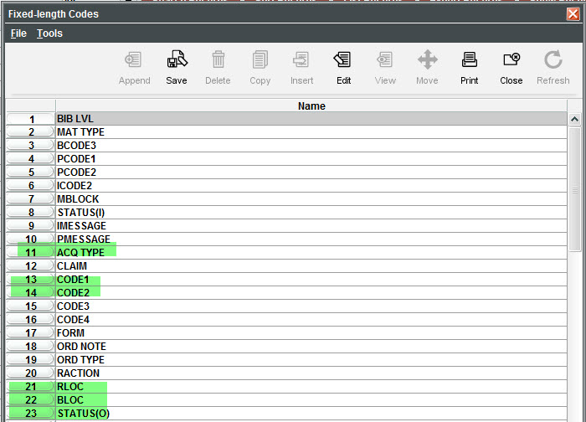
Order Record Fixed Fields
Sierra code names
Captions in Order Record can be changed

Slide 7
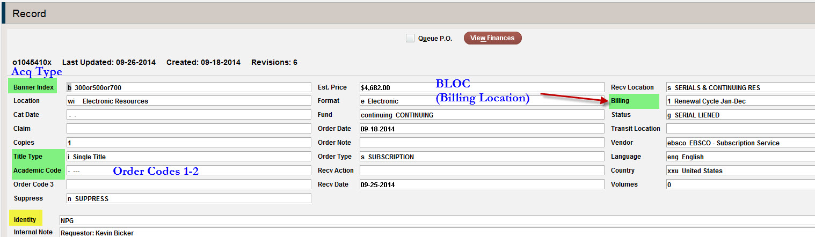
New Captions

Slide 8
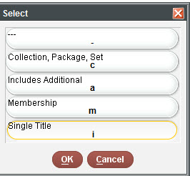
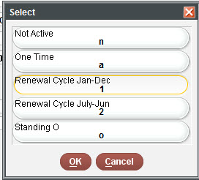
Title Type (Code 1)
Billing
(BLOC)

Slide 9
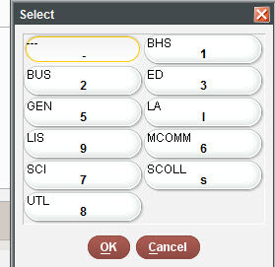
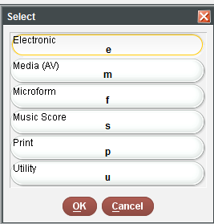
Academic Code (Code 2)
Form

Slide 10
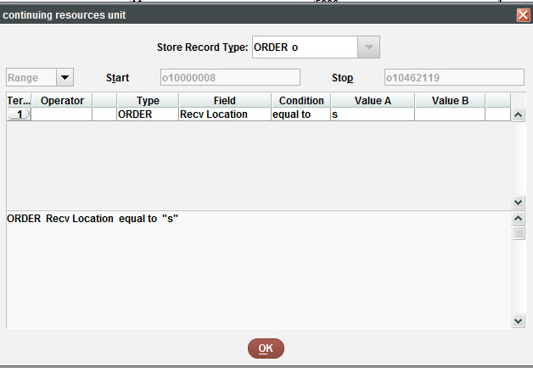
Create a List (CR unit)

Slide 11
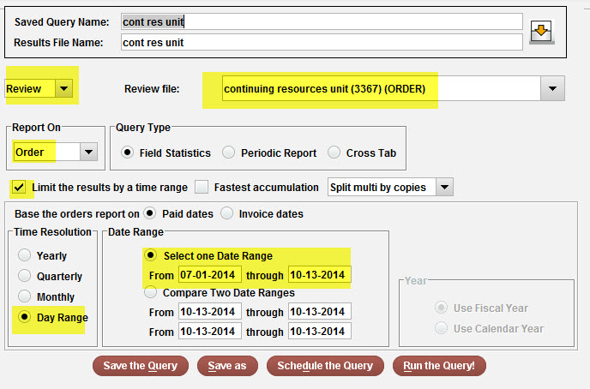
Statistics Query
Expenditures for FY to date

Slide 12
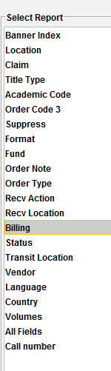
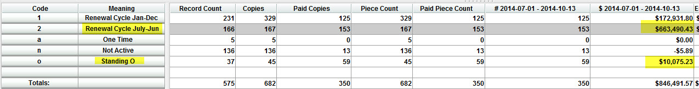
Statistics
Select a “filter”
Paid resources with July to Jun cycles
166 Orders
$663,490

Slide 13
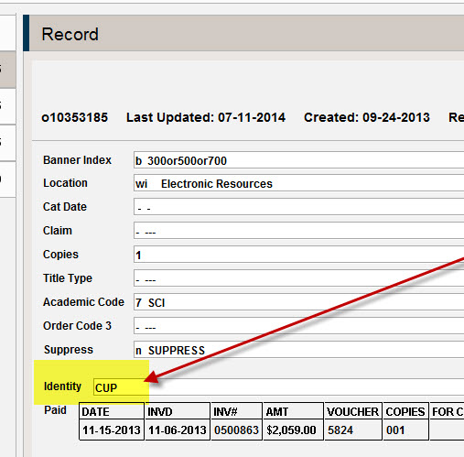
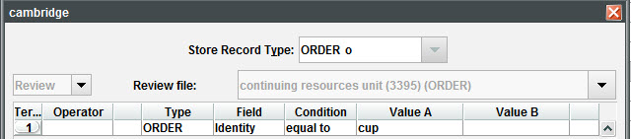

Identity (variable field)
Order Record
Create List
49 Cambridge titles
Vendor = Ebsco
Identity = CUP
(Cambridge Univ Press)

Slide 14
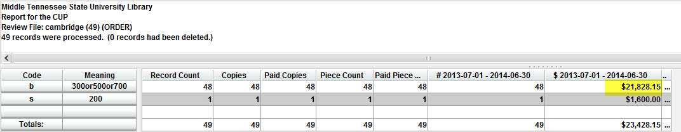
Statistics
FY 13/14
Cambridge titles (continuing) = $21,828

Slide 15
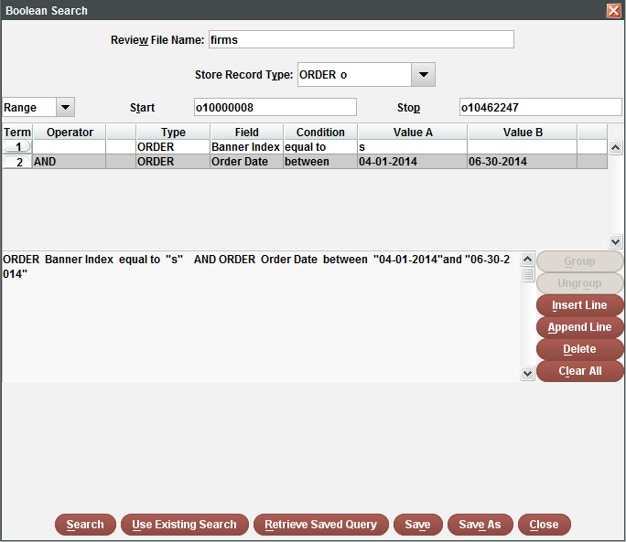
Create a List (Firm orders / End of year)
Index = Firms
Apr-June

Slide 16
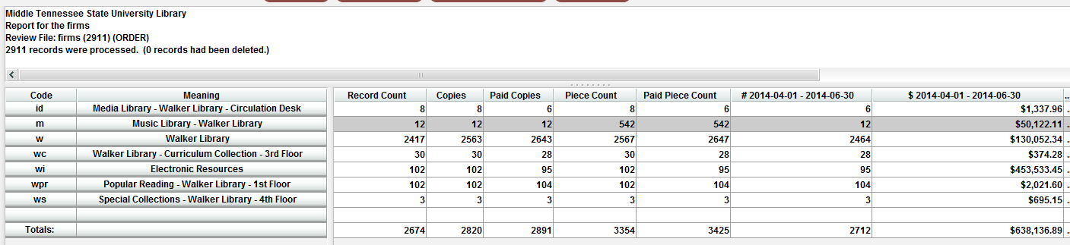
Statistics (EOY by location*)
*Location in Order Record
Music Library = $50,122
Electronic Resources = $453,533

Slide 17
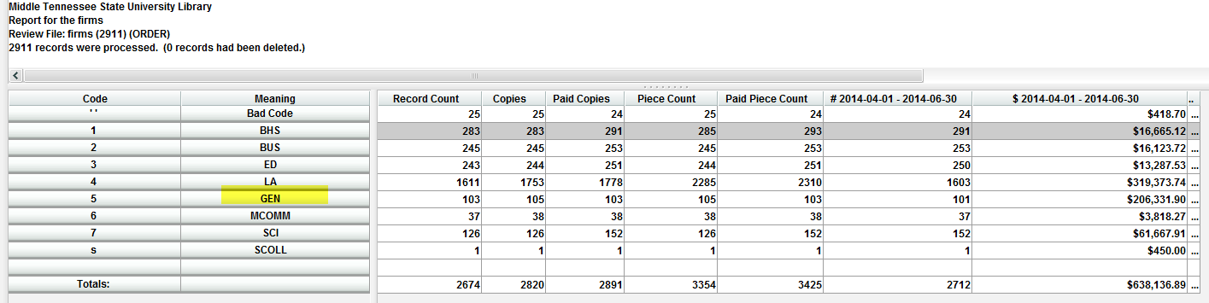
Statistics (EOY by Academic Code)
GEN = $206,311

Slide 18
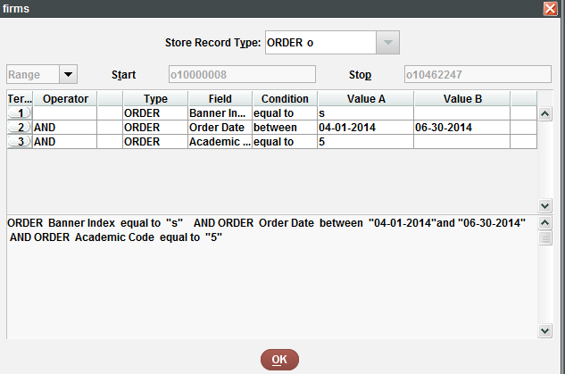
Create List (EOY General)
Academic Code = 5

Slide 19
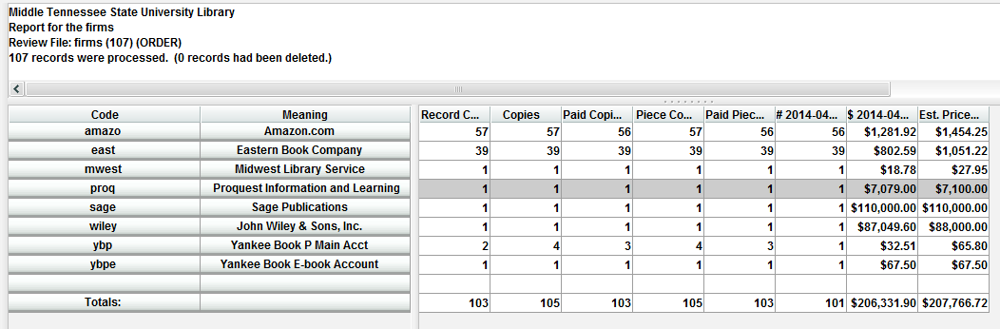
Statistics (EOY General by Vendor)
Proquest = $7079
Sage = $110,000
Wiley = $87,049

Slide 20
CONCLUSION
Learn to your Order Records.
Think about the questions you might ask and code accordingly.
Funds are not flexible, but Order Fields are.
Evaluating/Analyzing Acquisitions in Sierra possible.

