Slide 1
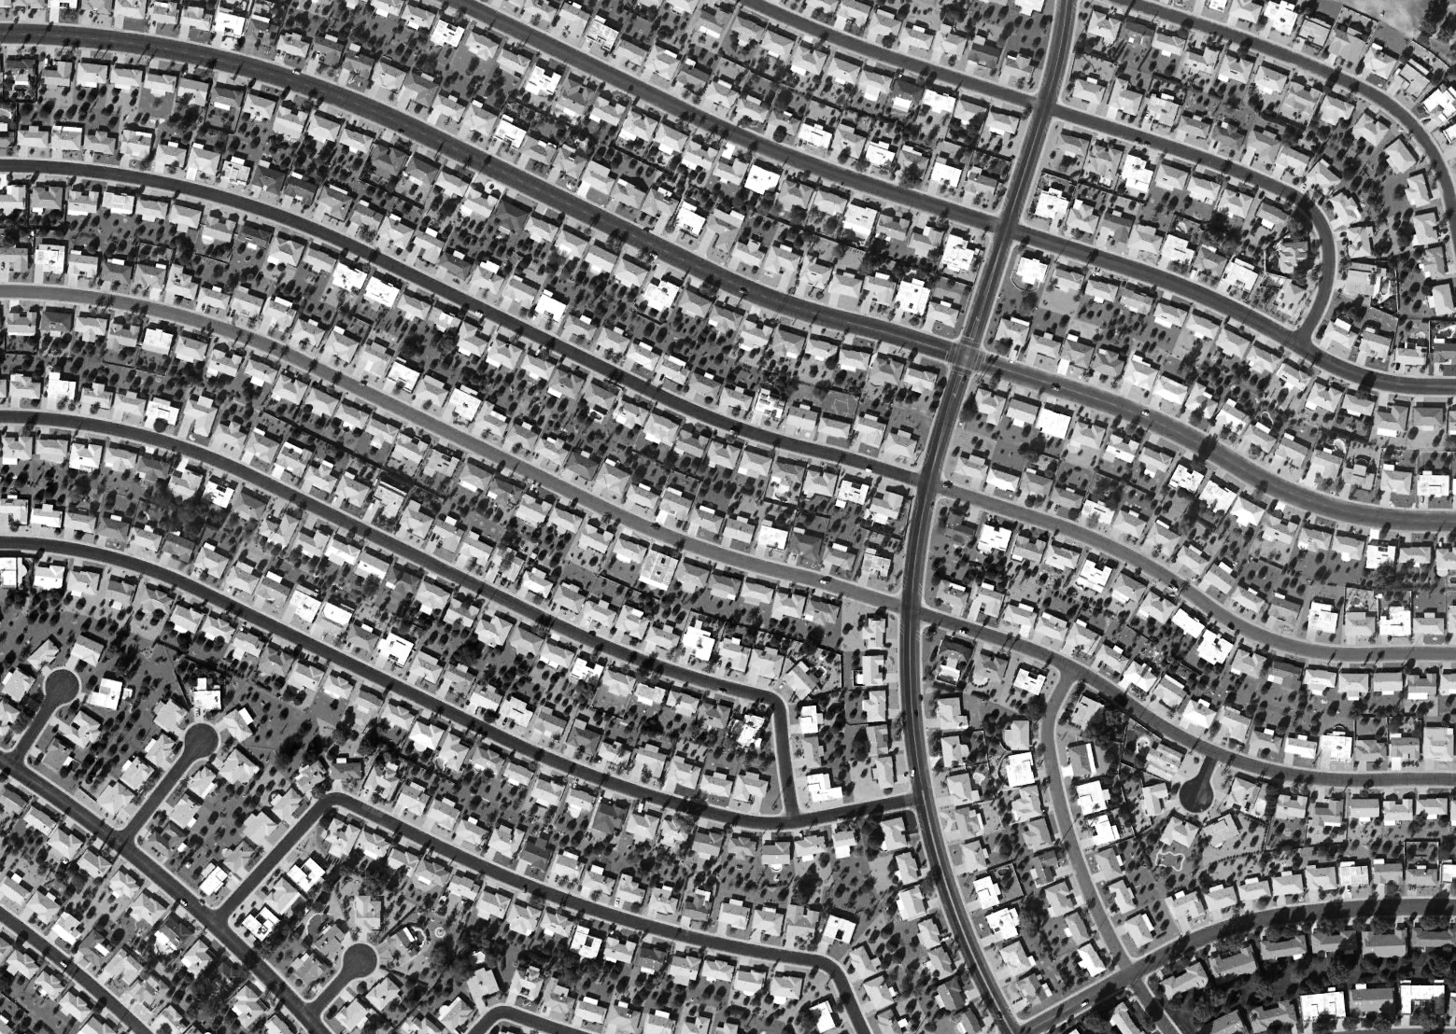
URBAN SPRAWL
Brittnie Hall, Eli Phipps, Christopher Sharp
ABSTRACT
FINDINGS
CONCLUSION
URBAN SPRAWL AND ENVIRONMENTALLY SAFE ALTERNATIVES
A critical issue that faces many places all over the world is urban sprawl. This issue affects overpopulated and underpopulated regions alike, and is detrimental to both the people and the communities that it touches. Using various online reports, articles and graphs, we are attempting to better educate our community on urban sprawl as well as propose ways to decrease it, and its impact on our communities, cities, and planet. Our research was done in November, 2015, and we hope that the results of said research and proposal of possible solutions will influence the community in the future to strive to create laws, new procedures, or limitations for the mitigation, or perhaps eventually the total elimination of urban sprawl. Our goal is to bring urban sprawl into the spotlight, and help start conversations that could lead to more ideas to do something about the problem.
During our research, we found that there are multiple issues associated with Urban Sprawl, including, but not limited to:
Urban sprawl is an issue that is literally growing daily, as new neighborhoods pop up nationwide. Unfortunately, it has an effect on people as individuals, as a community, and on an international level. Fortunately, there are proven solutions that can be implemented to help stop the spread of the problem, and alleviate the impact that urban sprawl has already made.
Loss of land for agriculture
Deforestation and loss of animal habitats
Deterioration of inner city communities and economies
Increased use of vehicles, resulting in more air pollution
Decrease in trees and biodiversity, also decreasing oxygen production.
REFERENCES
Berlin, Cynthia. "Urban Sprawl Destroys Habitat and Farmland and Harms Biodiversity." Urban Sprawl. Ed. Debra A. Miller. Detroit: Greenhaven Press, 2008. Current Controversies. Rpt. from "Sprawl Comes to the American Heartland." Focus 46.4 (Spring 2002): 2-10. Opposing Viewpoints in Context. Web. 12 Nov. 2015.
Bonfiglio, Olga. "Urban Sprawl Has Impoverished U.S. Cities." Urban Sprawl. Ed. Debra A. Miller. Detroit: Greenhaven Press, 2008. Current Controversies. Rpt. from "Addressing Urban Sprawl: The Archdiocese of Detroit Hopes the Battle Against Sprawl and for Mass Transit Will Help Promote Justice." America (4 Nov. 2002): 12. Opposing Viewpoints in Context. Web. 12 Nov. 2015.
Burge, Gregory S., et al. "Can Development Impact Fees Help Mitigate Urban Sprawl?." Journal Of The American Planning Association 79.3 (2013): 235-248. Business Source Complete. Web. 22 Nov. 2015.
Frumpkin, Howard. "Urban Sprawl and Public Health." Public Health Reports 117 (2002): 202. CDC.gov. Center for Disease Control and Prevention. Web. 12 Nov. 2015.
Mitchell, John. "Northern Virginia Housing Development." National Geographic. Web. 9 Nov. 2015. <http://environment.nationalgeographic.com/environment/habitats/urban-sprawl/#page=2>.
"Urban Sprawl." Merriam-Webster.com. Merriam-Webster, n.d. Web. 22 Nov. 2015.
"Causes and Effects of Urban Sprawl - Conserve Energy Future." Conserve-Energy-Future.com. 29 Dec. 2013. Web. 26 Nov. 2015.
Bradford, Alina. "Deforestation: Facts, Causes & Effects." Livescience.com. TechMedia Network, 4 Mar. 2015. Web. 27 Nov. 2015.
Diehl, Rachel. "Alternatives to Urban Sprawl | Museum of the City." Museum of the City. 2014. Web. 27 Nov. 2015.
PROPOSED SOLUTIONS
OBJECTIVES
Although our research shows that urban sprawl has more than a few negative effects, we have some solutions in mind to help with these problems.
Define urban sprawl
Explain problems with urban sprawl
Propose solutions
Spread awareness and start conversation about urban sprawl
“…zone-based impact fees can be effectively used to encourage cost-efficient, sustainable urban development patterns and to mitigate the intensity of urban sprawl.” - Journal of the American Planning Association, Summer 2013, Vol. 79, No. 3
Urban Sprawl is defined by the Merriam-Webster Dictionary as “a situation in which large stores, groups of houses, etc., are built in an area around a city that formerly had few people living in it”
CONTACT
Building “up” instead of “out” – Rather than building on the fringe of the city, build buildings higher, within the city limits.
Implementing zoning fees – Increasing the price of developing on the fringe of the city to discourage sprawl.
Alternate modes of transportation – Busses, bicycles, walking, trains, and streetcars
Brittnie Hall – bdh5i@mtmail.mtsu.edu
Eli Phipps – ep2r@mtmail.mtsu.edu
Christopher Sharp – cas2aq@mtmail.mtsu.edu

