Slide 1
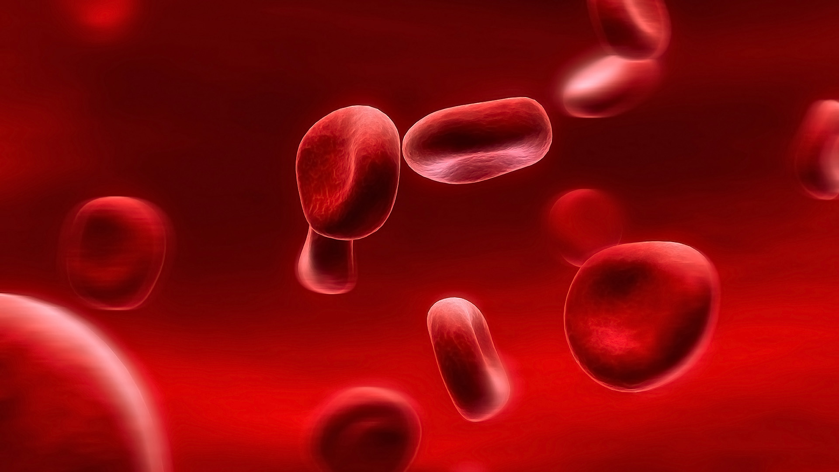




Does Chromium Help Control Blood Glucose Levels in Patients with Type 2 Diabetes?
By: Kanwal Qureshi
Introduction
Method
Conclusion
In the 1950’s it was suggested that brewer’s yeast had a substance which prevented diabetes in experimental animals. This substance was initially known as the Glucose Tolerance Factor; after additional research it was found to be the trivalent chromium ion.
Cr³⁺
Since then more research has been done to determine the role that chromium plays in reducing blood glucose levels, its effect on insulin receptors, and how much of it is necessary for an observable effect. The following data have been established over the years:
Searched for studies on PUBMED, ScienceDirect, and EBISCO using the key terms “chromium and diabetes,” “chromium's role in glucose metabolism,” and “chromium's effect on insulin sensitivity of cells,”.
To summarize our understanding of the systematic review, it can be deduced that chromium only works in the presence of two specific conditions:
High blood glucose concentrations resembling the diabetic state
The body’s deficiency of the mineral
In the absence of either of these conditions, chromium will not exert its effects on the insulin receptors, which results in unaffected glucose metabolism and absorption.
Therefore, we accept the hypothesis that chromium assists in lowering blood glucose levels in type 2 diabetes patients by increasing insulin sensitivity. However, it would only act as a treatment supplement if the patient is chromium deficient, as it does not exert effects after crossing a maximum threshold.
Therefore chromium can be used to help type 2 diabetic patients obtain a form of treatment that will support and possibly reduce their medications, because chromium can also be obtained from natural food sources such as broccoli, egg yolks, whole wheat grains, etc. Further research still needs to be conducted however, to validate our understanding of chromium’s capabilities.
Selected peer reviewed studies published between the year 2000 to the present that contained details regarding either chromium, diabetes, or their correlation.
Reviewed and analyzed selected studies, and categorized them into three broad sections: lowers glucose levels (positive), does not lower glucose levels (negative), or more research needs to be done.
RDA | 50-200 mcg for men and women
Current Intake
Men | 33 mcg/day
Women | 25 mcg/day
Positive studies further analyzed to determine how the process took place and on whom the effects were observed.
Objective
Results
The objective of this systemic review was to compile previous research and accept or reject the hypothesis that trivalent chromium increases insulin sensitivity and reduces blood glucose levels. If it does have an effect, is it only in diabetics or also in non-diabetics.
Author | Subjects | Findings
Shinde et al. | Type 1 / 2 diabetic Wistar rats | Significantly improved glucose transport and metabolism when combined with a dose of insulin. Decreased glucose levels only observed in diabetic and STZ-induced type 2 diabetic rats; no effect in type 1.
Sharma et al. | 40 newly developed type 2 diabetics | Increased absorption and better controlled fasting blood glucose and lipid levels.
Bailey. | Non-pregnant adults 36-67 y | Increased absorption with Chromium supplements only in populations that are deficient in it.
Patter et al. | Adipocytes | Positive effect only under high glucose conditions that resembles the diabetic state.
Cefalu et al. | Type 2 diabetic patients; 30-70 y | Increased sensitivity only in Cr deficient subjects with elevated fasting blood glucose levels.
Rhodes et al. | 63 male rats | Increased Cr loss through urine due to increased absorption.
Krol et al. | 32 male rats | No effect of Chromium supplements in insulin resistant rats.
Kleefstra et al. | Type 2 diabetic patients, -<75 y | No effect on blood glucose, but positive effect in lowering lipid levels
References
William T, Frank B. Role of Chromium in Human Health and in Diabetes. Diabetes Care. 2004; 27: 2741-2751.
Vincent JB. Quest for the Molecular Mechanism of Chromium Action and its relationship to Diabetes. Nutr Rev. 2000; 58: 67-73.
Pattar GR, Tackett L, Liu P, Elmendorf JS. Chromium Picolinate positively influences the glucose transporter system via affecting cholesterol homeostasis in adipocytes cultured under hyperglycemic conditions. Mutat Res. 2006; 610: 93-100.
Cefalu WT, Rood J, Pinsonat P, et al. Characterization of the metabolic and physiologic response to chromium supplementation in subjects with type 2 diabetes mellitus. Metabolism. 2010; 59: 755-762. Doi: 10.1016/j.metabol.2009.09.023.
Bailey CH. Improved Meta-Analytic methods show no effect of Chromium Supplements on Fasting Glucose. Biol Trace Elem Res. 2014; 157: 1-8. Doi: 10.1007/s12011-013-9863-9.
Rhodes N, McAdory D, Vincent J, et al. Urinary chromium loss associated with diabetes is offset by increases in absorption. J Inorg Biochem. 2010; 104(7): 790-797. Doi: 10.1016/jinorgbio.2010.03.015.
Shinde UA, Sharma G, Xu YJ, Dhalla NS, Goyal RK. Insulin sensitizing action of chromium Picolinate in various experimental models of diabetes mellitus. J Trace Elem Med Biol. 2004; 18: 23-32. Doi: 10.1016/jtemb.2004.03.002.
Krol E, Krejpcio Z, Iwanik K. Supplementary Chromium(III) Propionate Complex Does Not Protect Against Insulin Resistance in High-Fat-Fed Rats. Biol Trace Elem Res. 2014; 157: 147-155. Doi: 10.1007/s12011-013-9877-3.
Kleefstra N, Houweling ST, Jansman F, et al. Chromium Treatment Has No Effect in Patients with Poorly Controlled, Insulin-Treated Type 2 Diabetes in an Obese Western Population. Diabetes Care. 2006; 29 (3): 521-525.
Balk EM, Tatsioni AT, Lichtenstein AH, Lau J, Pittas AG. Effect of Chromium Supplementation on Glucose Metabolism and Lipids. Diabetes Care. 2007; 30 (8): 2154-2163.
Chen G, Liu P, Pattar Gr, et al. Chromium Activates Glucose Transporter 4 Trafficking and Enhances Insulin-Stimulated Glucose Transport in 3T3-L1 Adipocytes via a Cholesterol-Dependent Mechanism. J Mol Endocrinol. 2006; 20(4): 857-870.

